Slide 1
The Ultimate Promise Keeper!
Numbers 23:16-20 / Psalm 145:13

Slide 2
“There can be a disruption in hormones that result in specific symptoms, such as disturbed sleep, loss of appetite, fatigue and anxiety,”
Dr. Jannel Philips
Henry Ford Health System

Slide 3
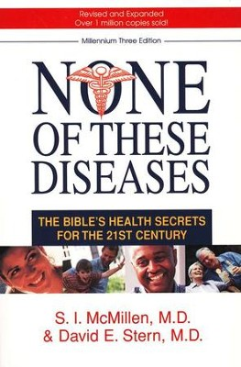
None of These Diseases shows how to obtain extraordinary medical benefits simply by heeding the Word of God.
Drs. McMillen and Stern take us back to the Bible and show us how to apply our Creator's guidelines to our modern lifestyles.

Slide 4
How often God’s people have
brought Him grief.

Slide 5
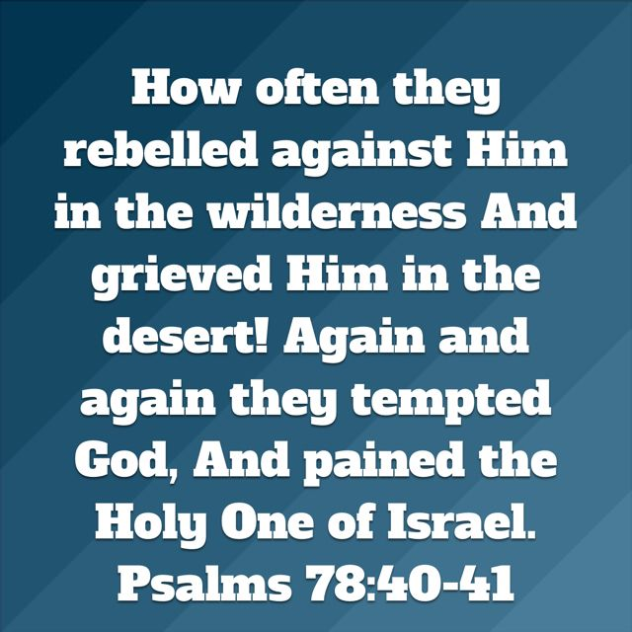

Slide 6
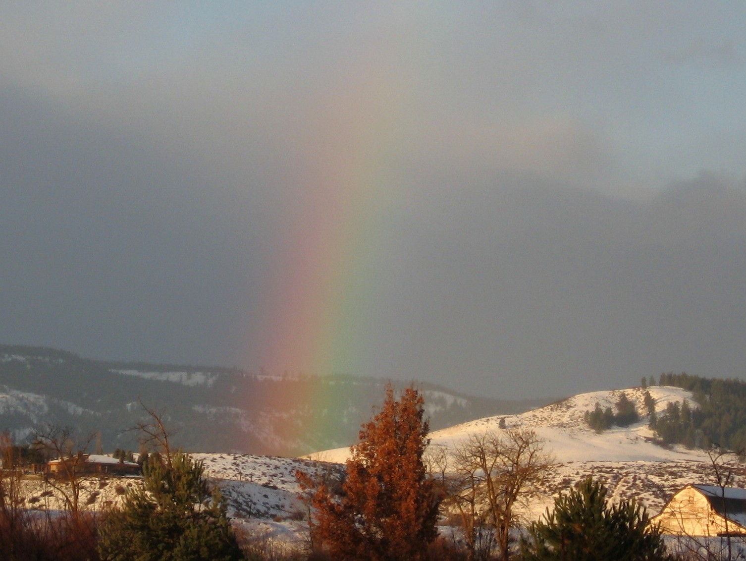
“The Lord was sorry that He had made man on earth, and He was grieved
in His heart.”
Genesis 6:6

Slide 7
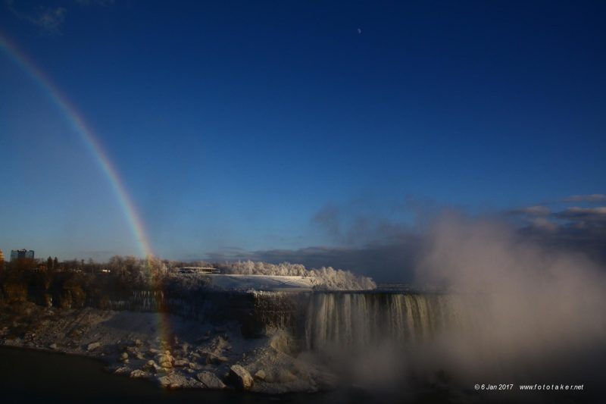
“For He said, “Surely they are My people, Children who will not lie.” So He became their Savior. In all their affliction He was afflicted, And the Angel of His presence saved them; In His love and in His pity He redeemed them; And He bore them and carried them all the days of old. But they rebelled and grieved His Holy Spirit; So He turned Himself against them as an enemy”.
Isa. 63:8-10

Slide 8
“Look down from Heaven, and see from your habitation, holy and glorious. Where are Your zeal and Your strength, The yearning of Your heart and Your mercies toward me? Are they restrained? Doubtless You are our Father, Though Abraham was ignorant of us, And Israel does not acknowledge us. You, O Lord, are our Father; Our Redeemer from Everlasting is Your name…”
Isaiah 63:15-16

Slide 9
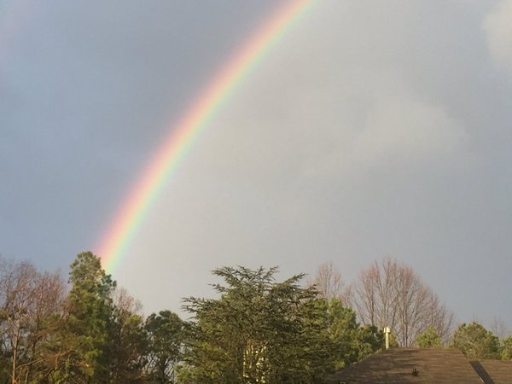
“For since the beginning of the world men have not heard nor perceived by the ear, Nor has the eye seen any God besides You, who acts for the one who waits for Him. You meet him who rejoices and does righteousness, who remembers You in Your ways, You are indeed angry, for we have sinned—in these ways we continue; And we need to be saved. But we are all like an unclean thing, And all our righteousness are like filthy rags; We all fade as a leaf, and our iniquities, like the wind, have taken us away. Isaiah 64:4-9

Slide 10
And there is no one who calls on Your name, Who stirs himself up to take hold of You; For You have hidden Your face from us, and have consumed us because of our iniquities. But now, O Lord You are our Father; We are the clay, and You our potter; and we are all the work of Your hand. Do not be furious, O Lord, Nor remember iniquity forever; indeed, please look—we are all Your people!”
Isaiah 64:4-9

Slide 11
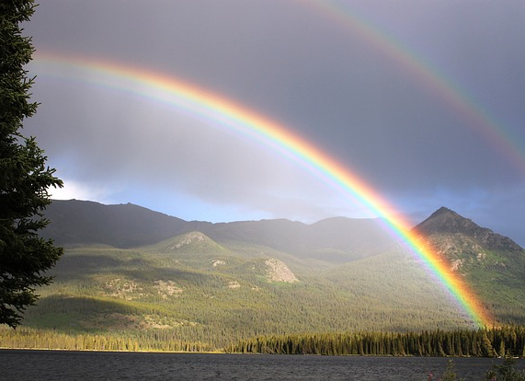
2. God is the Ultimate Promise Keeper

Slide 14
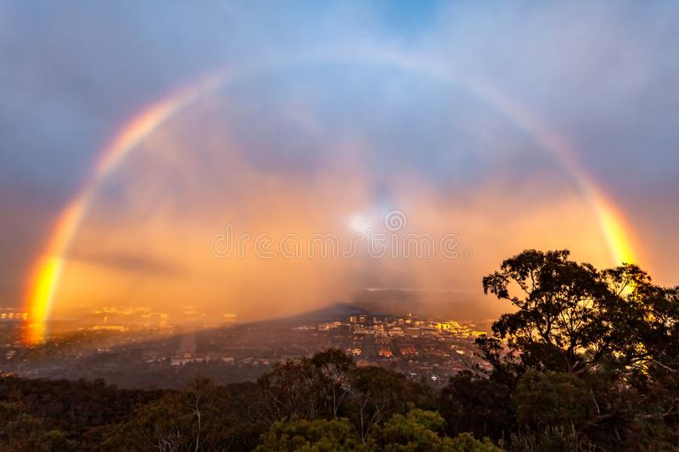
PSALM 145:13
For your kingdom is an everlasting kingdom. You rule throughout all generations. The LORD always keeps his promises; he is gracious in all he does.

Slide 18
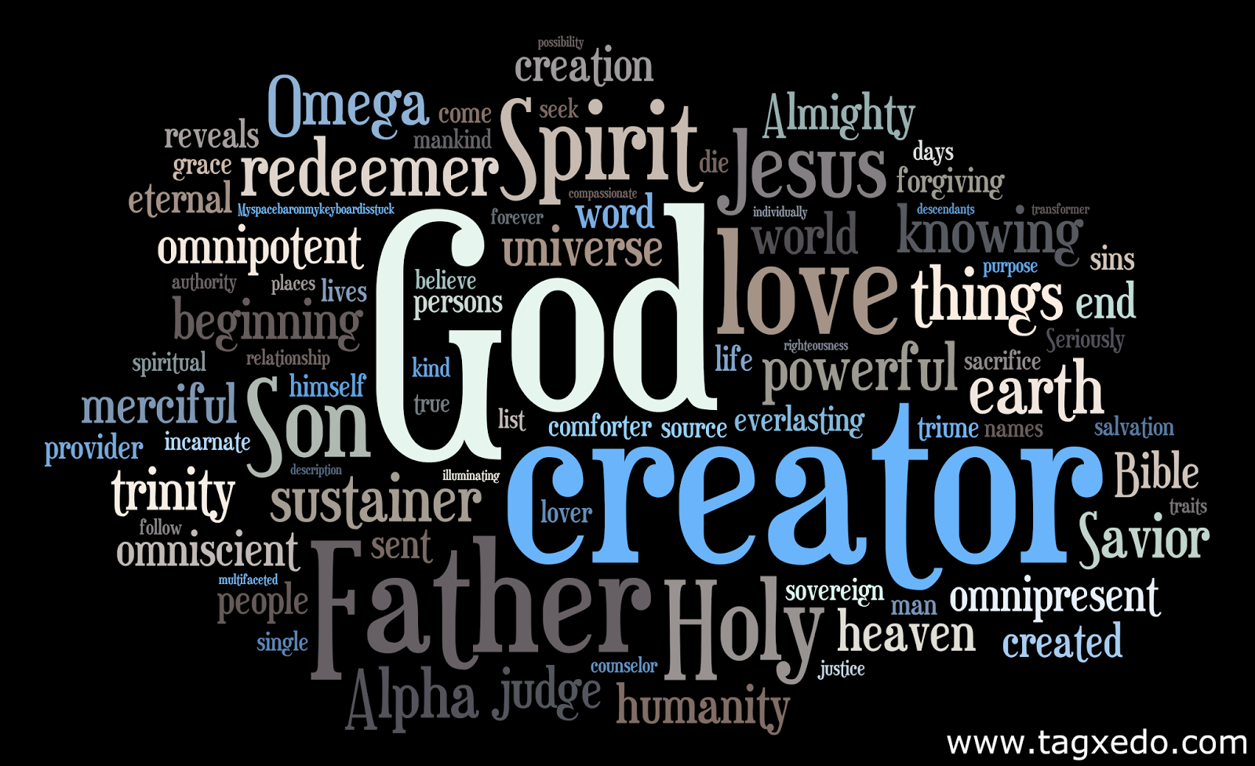
3. God Expects His Children to Display His Attributes

Slide 19
Paul implores Christ followers…

Slide 20
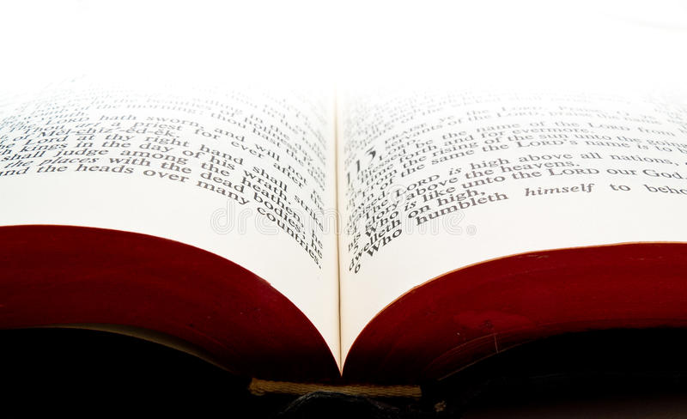
Romans 12:3 (NKJV) ³ For I say, through the grace given to me, to everyone who is among you, not to think of himself more highly than he ought to think, but to think soberly, as God has dealt to each one a measure of faith. Philippians 2:3 (NKJV) ³ Let nothing be done through selfish ambition or conceit, but in lowliness of mind let each esteem others better than himself.

Slide 21
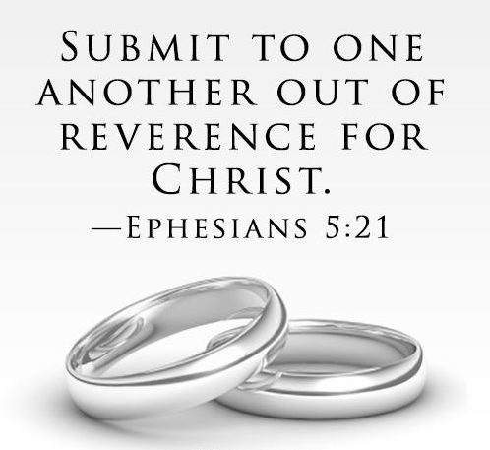

Slide 22
4.What exactly does this look like?

Slide 23
Accountability is to the church, what tracks are to a train: without it, we flounder, lose focus, detract from moral purity, and fail to achieve true unity
and cohesion.

Slide 25
Christians are to go after a wayward brother
or sister and seek to bring them back.

Slide 26
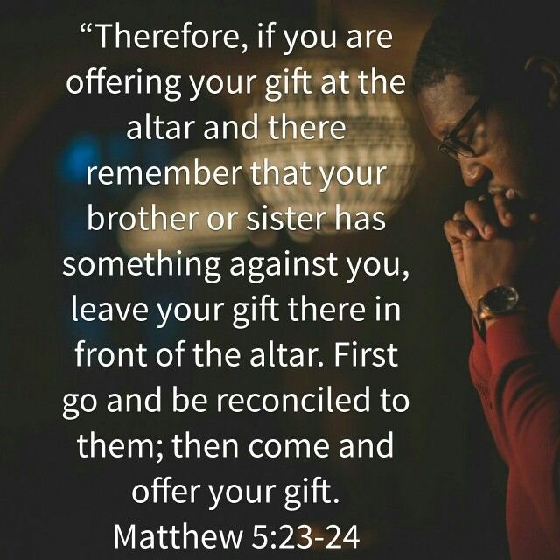

Slide 28
1 Thessalonians 5:11
Encourage each other.

Slide 29
Hebrews 10:25

Slide 30
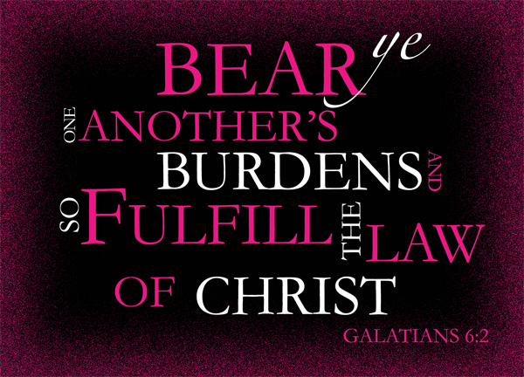

Slide 33
