Slide 1
LUKE 12:40-56

Slide 3
⁵¹ Do you suppose that I came to give peace on earth? I tell you, not at all, but rather division. ⁵² For from now on five in one house will be divided: three against two, and two against three. ⁵³ Father will be divided against son and son against father, mother against daughter and daughter against mother, mother-in-law against her daughter-in-law and daughter-in-law against her mother-in-law."
LUKE 12:51-53

Slide 5
Luke 12:51 (NKJV) ⁵¹ Do you suppose that I came to give peace on earth? I tell you, not at all, but rather division. Matthew 10:34 (NKJV) ³⁴ "Do not think that I came to bring peace on earth. I did not come to bring peace but a sword.

Slide 7
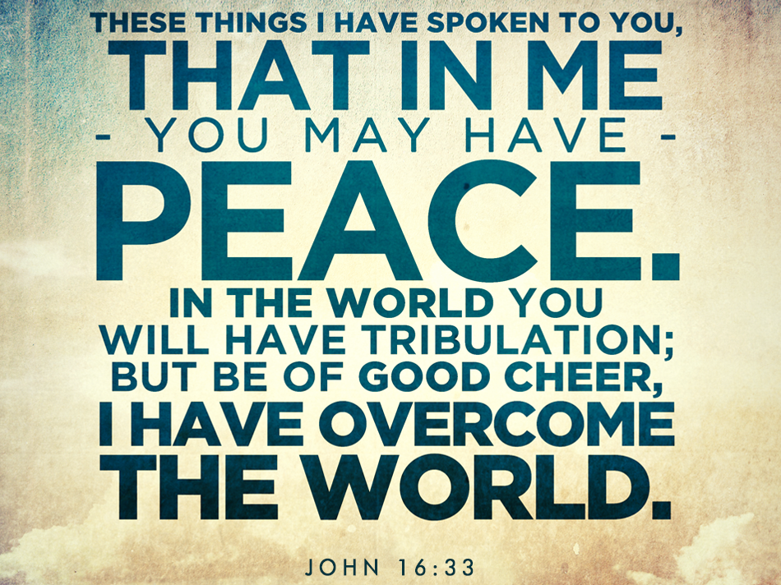

Slide 8
The Jews envisioned a Messianic utopia.

Slide 12
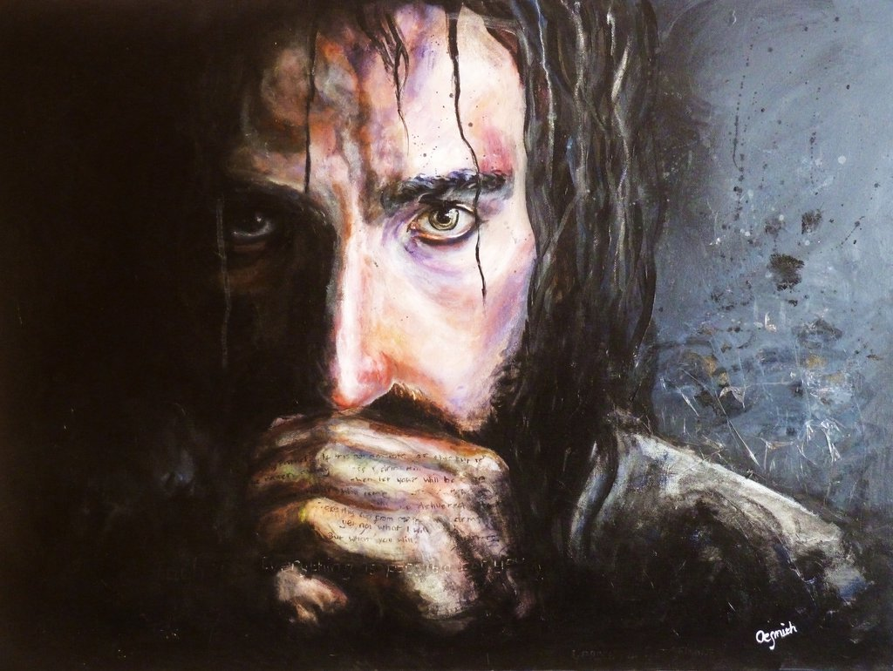

Slide 13
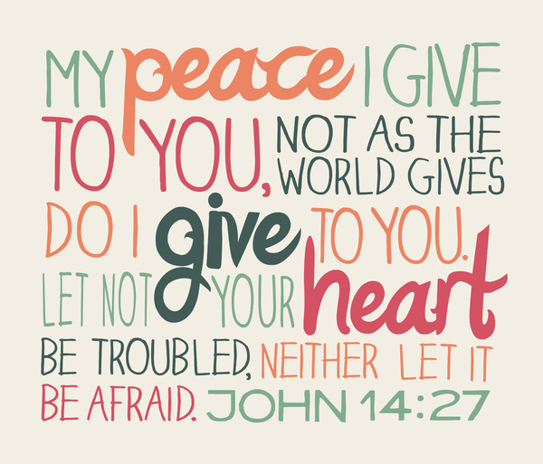

Slide 14
“You have heard Me say to you, I am going away and coming back to you.’ If you loved Me, you would REJOICE because I said, “I am going to the Father, for My Father is greater than I. ²⁹And now I have told you before it comes, that when it does come to pass you may believe.”

Slide 16
⁴ Rejoice in the Lord always. Again I will say, rejoice! ⁵ Let your gentleness be known to all men. The Lord is at hand. ⁶ Be anxious for nothing, but in everything by prayer and supplication, with thanksgiving, let your requests be made known to God; ⁷ and the peace of God, which surpasses all understanding, will guard your hearts and minds through Christ Jesus.

Slide 17
There will be no global peace,
no national peace, or domestic peace,
until there’s personal peace within.

Slide 18
Who are

Slide 19
What are Christ followers to do in the midst of
?

Slide 20
Ephesians 2:10 For we are his workmanship, created in Christ Jesus for good works, which God prepared ahead of time for us to do.

Slide 21
The fruit of salvation is GOOD WORKS.

Slide 25
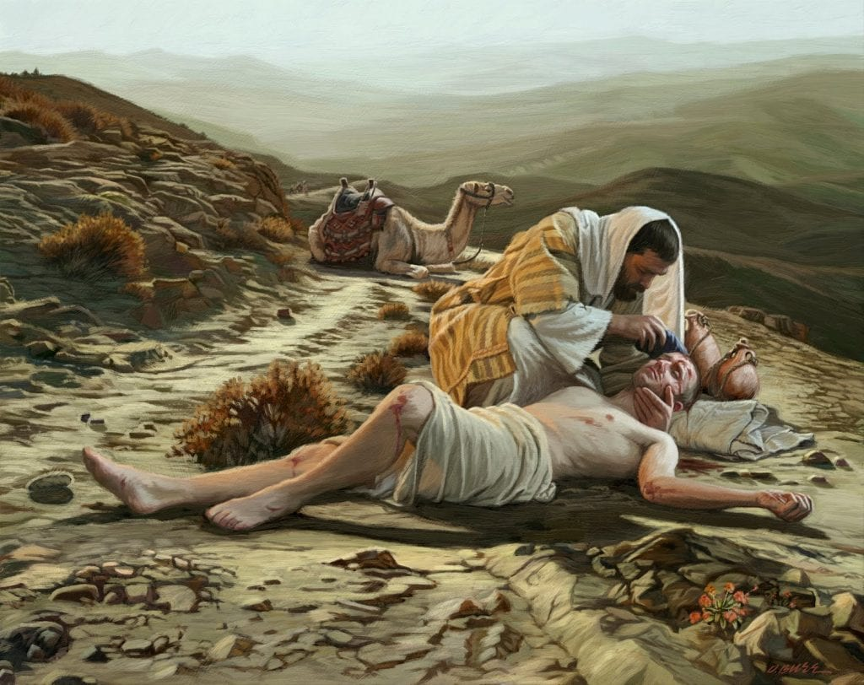
What good are believers
to do for unbelievers?

Slide 26
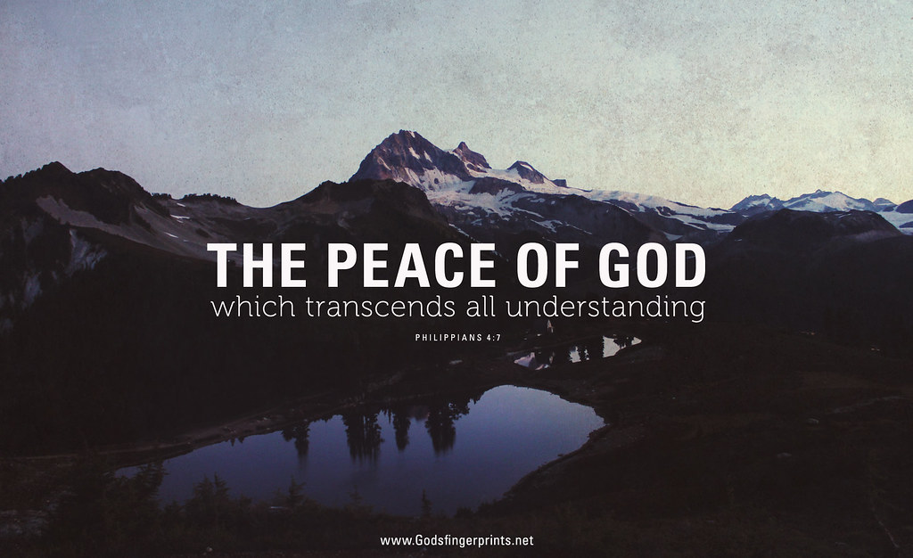
How can a person have the peace that surpasses all understanding?

Slide 27
How can a person have the peace that surpasses all understanding?
Commit everything to God in prayer!

