Slide 2
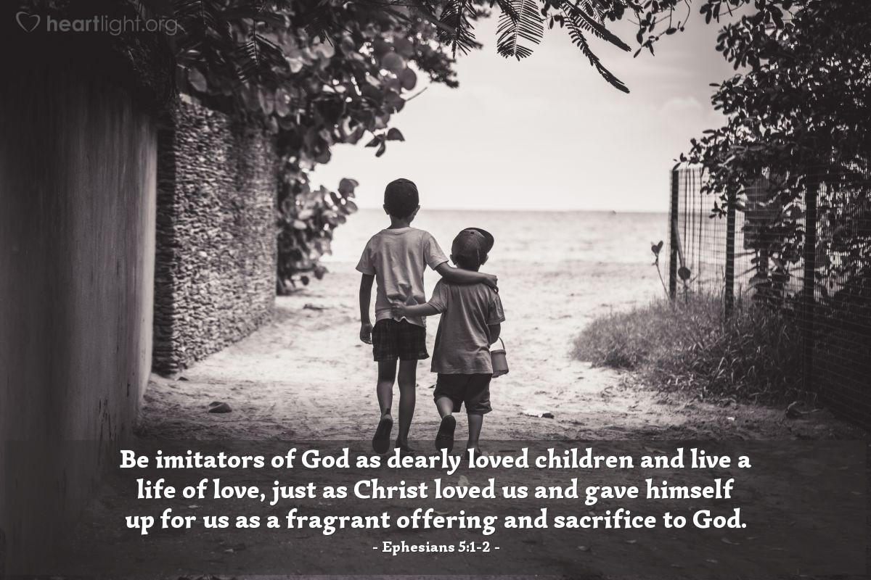

Slide 3
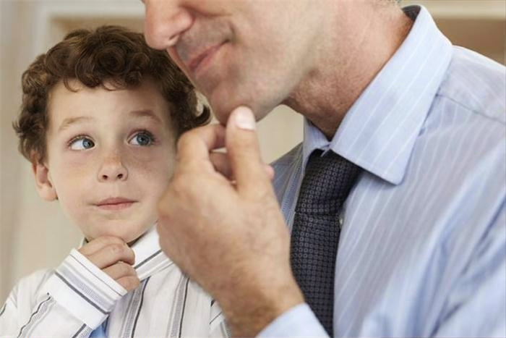
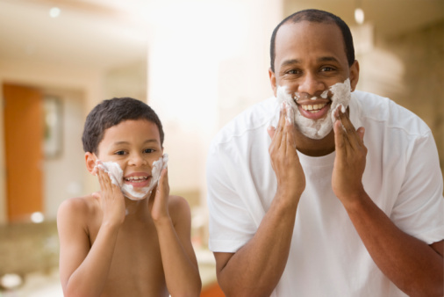
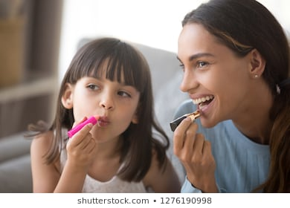

Slide 4
“His divine power has given us everything we need for life and godliness through our knowledge of him who called us by his own glory and goodness. Through these he has given us his very great and precious promises, so that through them you may participate in the divine nature and escape the corruption in the world caused by evil desires.”
2 Peter 1:3-4

Slide 6
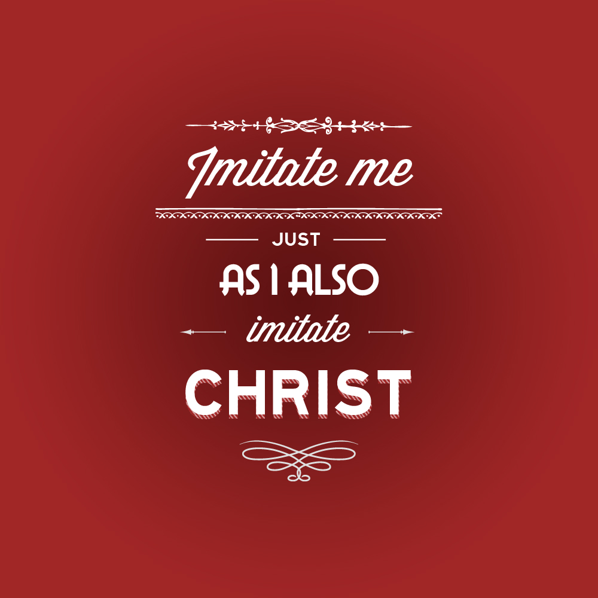

Slide 7
Brethren, join in following my example, and note those who so walk, as you have us for a pattern. For many walk of whom I have told you often, and now tell you even weeping, that they are the enemies of the cross of Christ: whose end is destruction, whose god is their belly, and whose glory is in their shame—who set their mind on earthly things.
Philippians 3:17-21

Slide 8
For our citizenship is in heaven, from which we also eagerly wait for the Savior, the Lord Jesus Christ, who will transform our lowly body that it may be conformed to His glorious body, according to the working by which He is even to subdue all things to Himself.
Philippians 3:17-21

Slide 9
Ephesians 4:31-32
“Let all bitterness, wrath, anger, clamor, and evil speaking be put away from you, with all malice. And be kind to one another, tenderhearted, forgiving one another, even as God in Christ forgave you.”

Slide 11
Ephesians 4:28-29
“To him who stole steal no longer, but rather let him labor, working with his hands what is good, that he may have something to give him who has need. Let no corrupt word proceed out of your mouth, but only what is good for necessary edification, that it may impart grace to the hearers.”

Slide 16
The first step in imitating God is to acknowledge that we have the capacity to love as Christ loved us. To forgive as Christ forgave.

Slide 17
The Second Step is to do as Jesus did.

Slide 19
When We

Slide 20
When We
We imitate Jesus

Slide 23
Two Types of Speech
that are unacceptable to God
Obscenity
Crude
Joking
or
Foolish talk

Slide 24
“The gift of wit is a blessing, but when it is attached to a filthy mind or a base motive, it becomes
a curse.”

Slide 28
A Christian woman who attended an anniversary dinner in honor of a friend…
The Wiersbe N.T. Bible Commentary pg. 613

Slide 29
By…

Slide 30
Standing joyfully on the side of TRUTH
Loving others as GOD loves!
Abstaining from sexual immorality, or any kind of impurity or greed.
Not associating with people who do such things.
By…

Slide 31
Keeping your speech constructive, helpful and kind.
Standing up for those who are abused and deceived.
Defending the Helpless
Offering HOPE to the hopeless, Reaching out to the LONELY
Believing the BEST of others, instead of assuming the worst.

