Slide 1
THE MEASURE
OF MATURITY
EPHESIANS 4:11-16

Slide 2
Measure of Maturity
First, What should the ultimate “goal of life” be for a child of God?

Slide 3
The Measure of Maturity

Slide 4
The Measure of Maturity

Slide 5
Measure of Maturity
Second, how do we measure or assess spiritual maturity
in a believer?

Slide 7
Christ is the measuring stick of spiritual maturity.

Slide 8
Have we grown up in every way into him who is the head, into Christ?

Slide 9
The church that is not growing numerically is not growing spiritually.

Slide 10
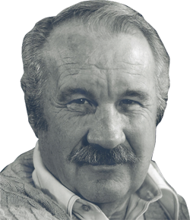
Evangelical Christian pastor,
and author of several books.

Slide 11
It is important to realize that, according to this passage in Ephesians, the supreme purpose of the church is not the evangelization of the world. The Great Commission is often held up to us as the supreme aim and purpose of the church, and it is certainly a crucial and essential task. Jesus has clearly sent us out to preach the Gospel to every creature. But the Great Commission is not God's supreme and ultimate goal.

Slide 12
Romans 8:29 tells us that God's ultimate plan for us is that we be "conformed to the image of his Son." Evangelization is a means of bringing people into a relationship with God, so that God's ultimate goal for them--Christlikeness--can be achieved in their lives.

Slide 13
Nor does Paul say anything here about accomplishing world peace and universal justice. He does not say the church will ultimately introduce the millennium. We may well believe in the great vision of the prophets that there is a day coming when peace shall reign on the earth and men shall beat their swords into plowshares and make war no more.

Slide 14
That one day righteousness shall prevail over all the earth and all of today's headlines of injustice, tragedy, war, mass murder, terrorism, crime, racism, and hate will be forgotten. But that is not the great and final purpose for the existence of the church. God's overarching goal is to produce men and women who demonstrate the character qualities of Jesus Christ.

Slide 15
God does not want a church filled with white robed saints. He does not want a church filled with theological authorities or cultured clergyman. He wants a church filled with ordinary men and women who exemplify the extraordinary integrity, temperament, wholeness, compassion, individuality, boldness, righteousness, earnestness, love, forgiveness, selflessness, and faithfulness of Jesus Christ!

Slide 16
The Measure of Maturity
Faith and humility are foundational
to spiritual development.

Slide 17
The Measure of Maturity

Slide 18
Luke 9:23
Living Bible
Then Jesus said to all, "Anyone who wants to follow me must put aside his own desires and conveniences and carry his cross with him every day and keep close to me!

Slide 19
James 4:10, 1 Peter 5:6
Paraphrases
Humble yourselves before the Lord and He will lift you up. Humble yourselves before the Lord and in time, He will grow you up.

Slide 21
Steps to Maturity
ADMIT IT!
Nothing changes until we admit the need to change.

Slide 22
Steps to Maturity
ACCEPT
That you can’t grow alone!
ADMIT
That you need to grow up in Jesus

Slide 23
The Measure of Maturity

Slide 24
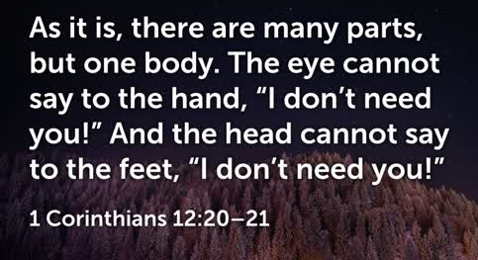
The Measure of Maturity

Slide 25
Steps to Maturity
ACKNOWLEDGE
That you have a functional role in building up the body.
ACCEPT
That you can’t grow alone!
ADMIT
That you need to grow up in Jesus

Slide 26
The Measure of Maturity

Slide 27
“How can I contribute to the growth of
another believer?”

Slide 28
The Measure of Maturity

Slide 29
The Measure of Maturity

Slide 30
“What has helped you grow the most?”

Slide 31
Steps to Maturity
ACKNOWLEDGE
That you have a functional role in building up the body.
ACCEPT
That you can’t grow alone!
ADMIT
That you need to grow up in Jesus

Slide 32
The Measure of Maturity
RECOMMEND A BOOK
THAT HELPED YOU GROW

