Slide 1
The Major Objective
of the Christian Life
Ephesians 1:15-23

Slide 3
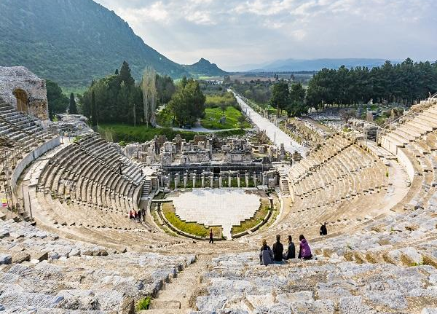
Ancient Amphitheatre in Ephesus

Slide 6
The reason that
we exist…
Created to know God better!

Slide 7
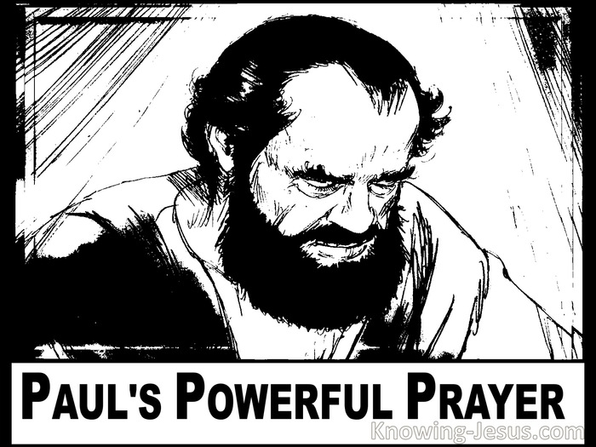
1. Paul’s Prayer

Slide 9
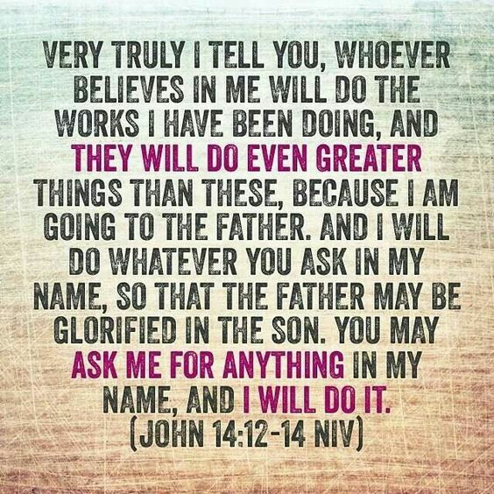

Slide 10
WHAT WE NEED TO
KNOW
ABOUT GOD

Slide 11
WHAT WE NEED TO
KNOW
ABOUT GOD
First, that we would understand the hope to which we are called.

Slide 12
WHAT WE NEED TO
KNOW
ABOUT GOD
Second, that we would comprehend the riches of this glorious inheritance we have in Christ.

Slide 13
WHAT WE NEED TO
KNOW
ABOUT GOD
Third, that we would understand the incomparable power that indwells us.

Slide 14
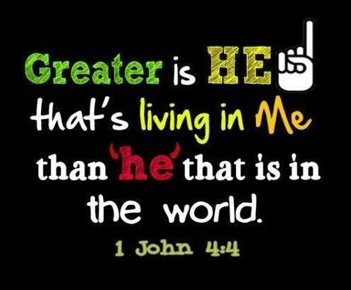

Slide 16
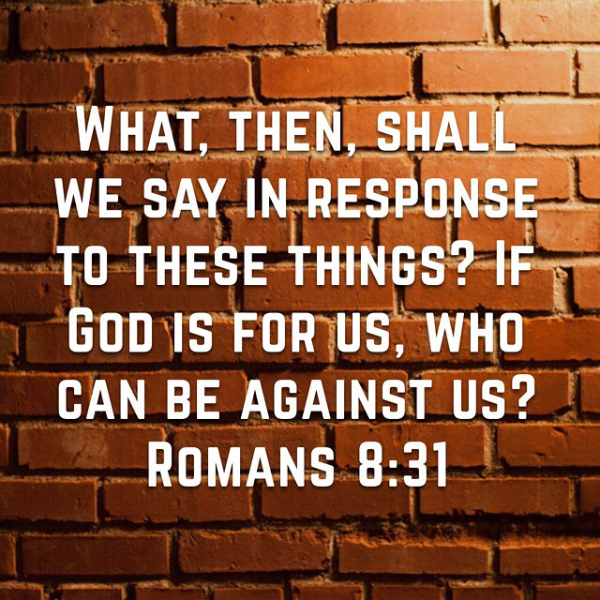

Slide 18
3. HOW ARE WE
TO SEE THE WORLD

Slide 19
“this light affliction which is but for a moment is working for us an exceeding great and eternal weight of glory,”
2 Cor. 4:17
“the sufferings of this present time are not worthy to be compared with the glory which shall be revealed in us.” Rom. 8:18

Slide 21
4. Our Destiny in Christ

Slide 22
Power is the word
of the times.

Slide 23
“He lives with you and will be in you”
John 14:17

Slide 24
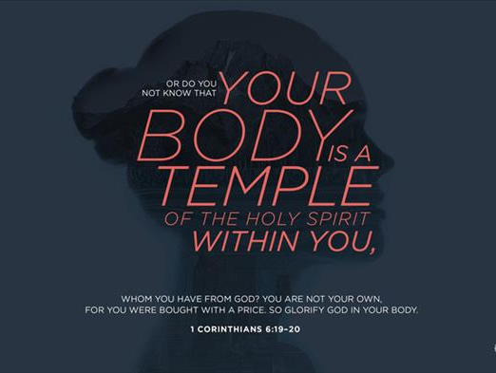

Slide 25
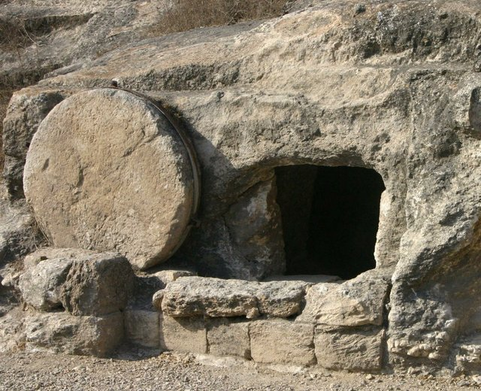

Slide 26
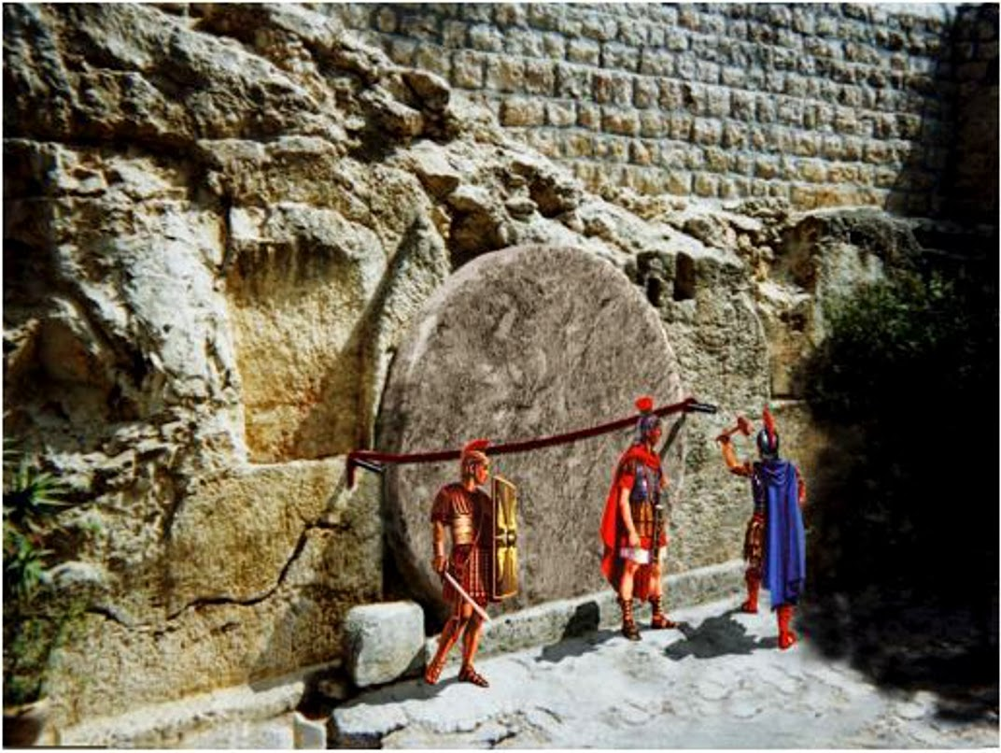

Slide 27
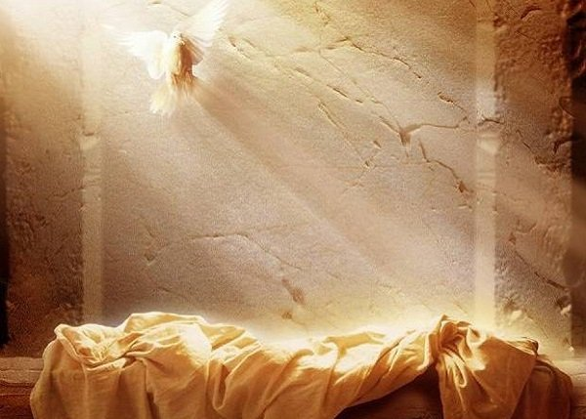

Slide 30
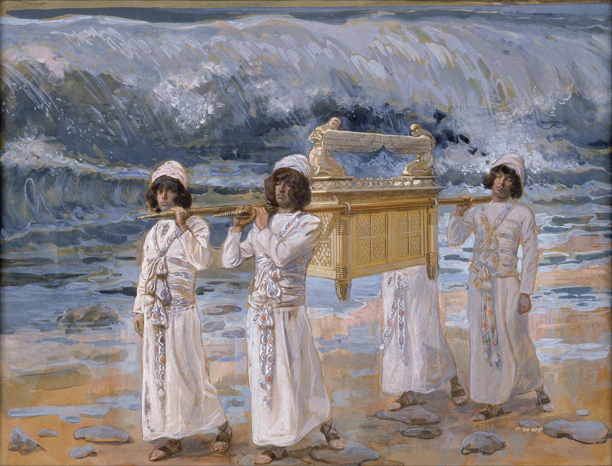

Slide 31
It starts with FAITH
“The Spirit searches all things, even the deep things of God”
1 Corinthians 2:10

Slide 32
Study The Word of God
“So faith comes from hearing,
and hearing by the Word of Christ.” Rom. 10:17

Slide 33
Pray for the Holy Spirit’s Help
Romans 8:26

