Slide 1
Morning Theme Song
“RUN THE RACE” by Holly Star
https://www.youtube.com/watch?v=Dl-ElqJPtuc

Slide 2
DISTINGUISHED SERVICE
2 Timothy 4:18

Slide 3
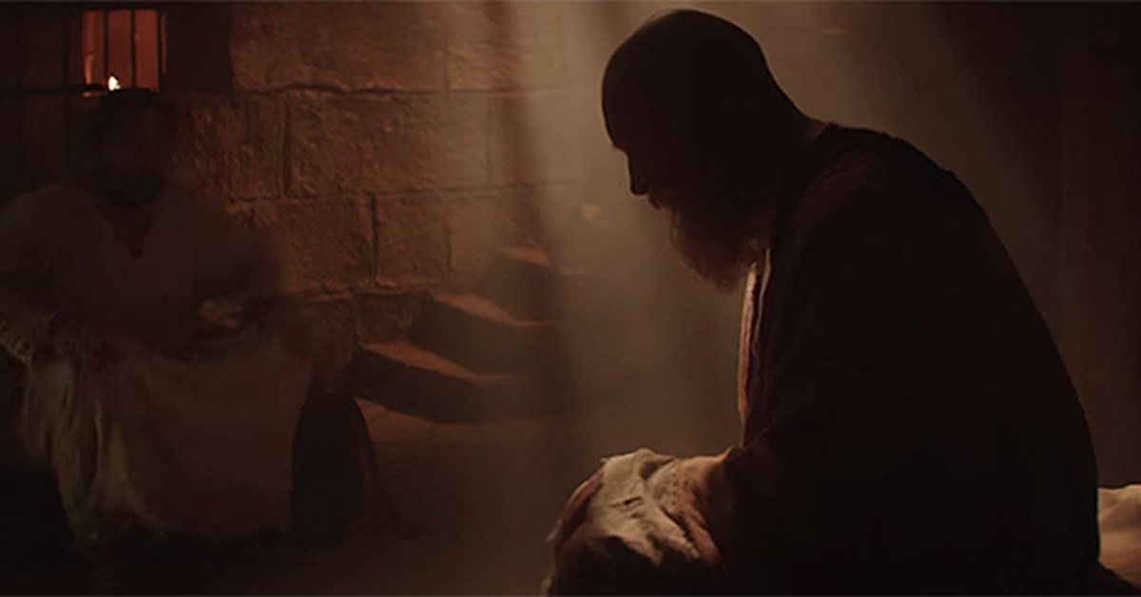
Paul’s 2nd letter to Timothy
from prison… “Stay faithful”

Slide 5
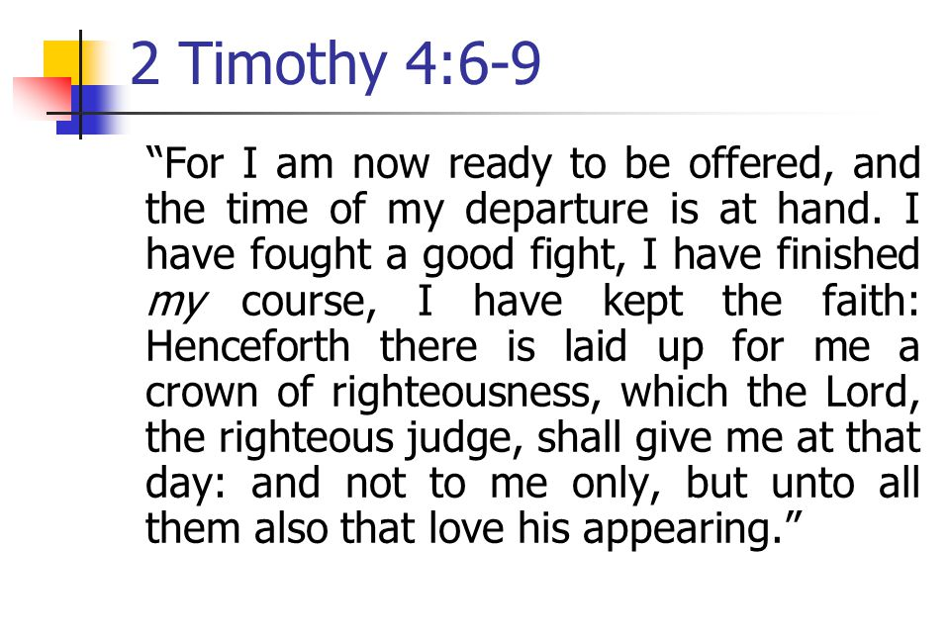
Children’s Bible
⁶ I say this because I won’t be around to help you very much longer. My time has almost run out. Very soon now I will be on my way to Heaven. ⁷ I have fought long and hard for my Lord, and through it all I have kept true to him. And now the time has come for me to stop fighting and rest.

Slide 6
Children’s Bible
⁸ In Heaven a crown is waiting for me, which the Lord, the righteous Judge, will give me on that great day of his return. And not just to me but to all those whose lives show that they are eagerly looking forward to his coming back again.

Slide 10
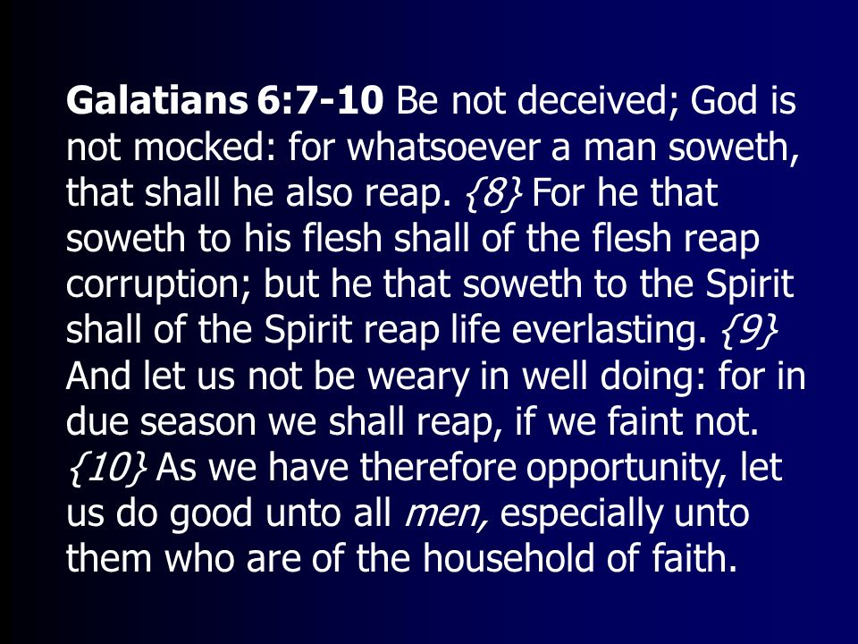

Slide 11
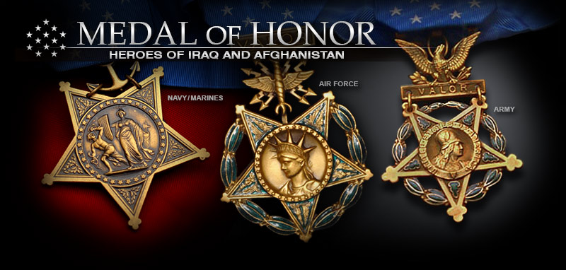
Those who have distinguished themselves by acts of valor
The Medal of Honor is the United States of America's highest and most prestigious personal military decoration that may be awarded to recognize U.S. military service members who have distinguished themselves by acts of valor.

Slide 12
2 Timothy 4:8
1 Corinthians 9:25
James 1:12
Revelation 2:10
1 Thessalonians 2:19
1 Peter 5:4

Slide 20
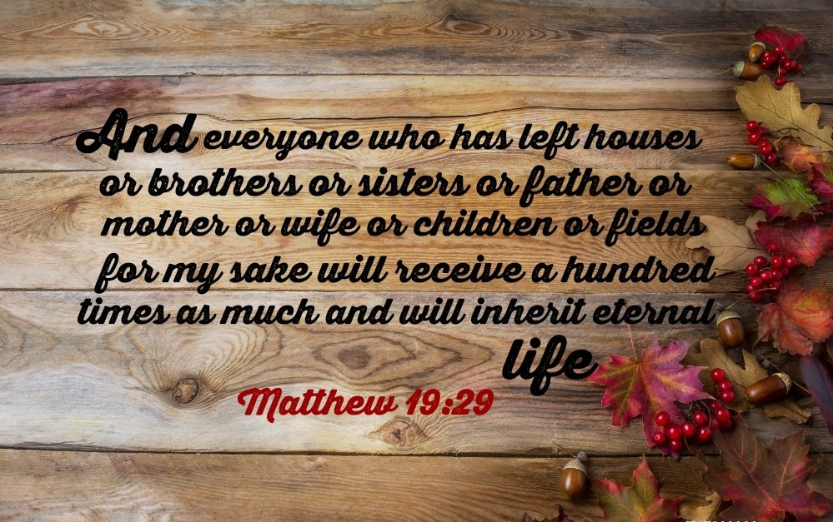

Slide 21
Exercise
Self-control

Slide 22
Exercise
Self-control

Slide 23
Exercise
Self-control

Slide 24
Exercise
Self-control

Slide 25
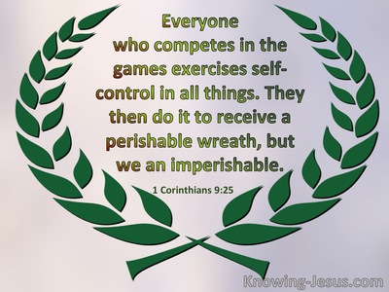

Slide 26
Doug Coover
Plays the piano while the
elements are being served.
Delete this note after you read it.
And leave slide up during the Lord’s Supper

