Slide 1
THINGS THAT MAKE THE
2 Timothy 2:14-26

Slide 2
Things That Poison the Soul
2 Timothy 2:17 The Message

Slide 3
The soul is
the real you.
The eternal you.
The inner
You.
The soul is the
breath of God
in you.

Slide 6
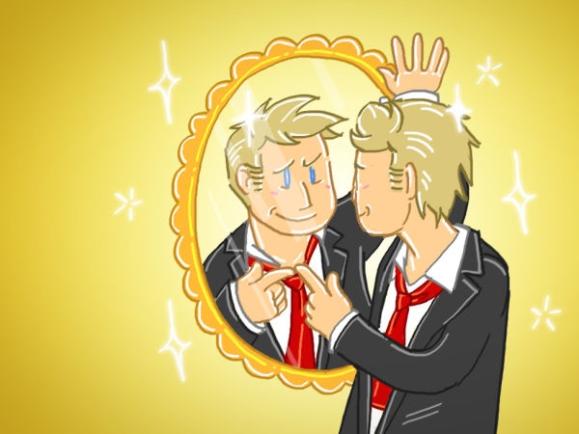

Slide 8
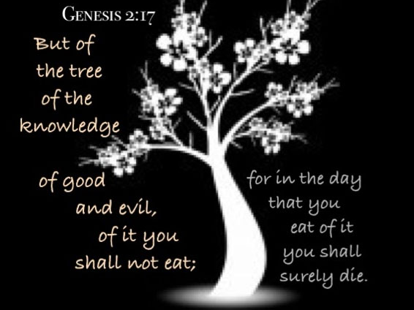

Slide 13
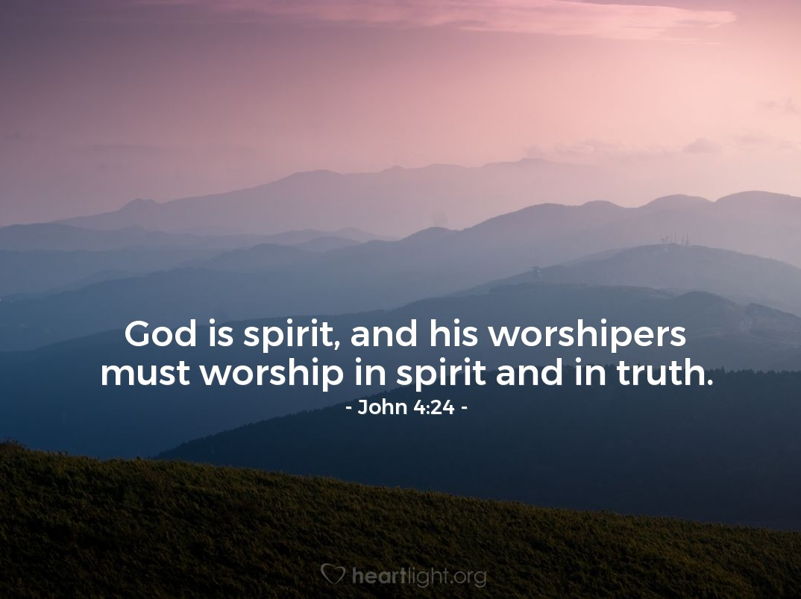

Slide 18
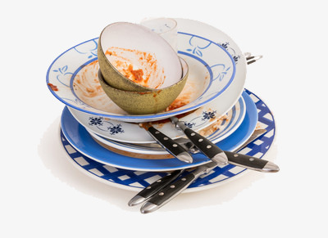
Unclean Vessels

Slide 19
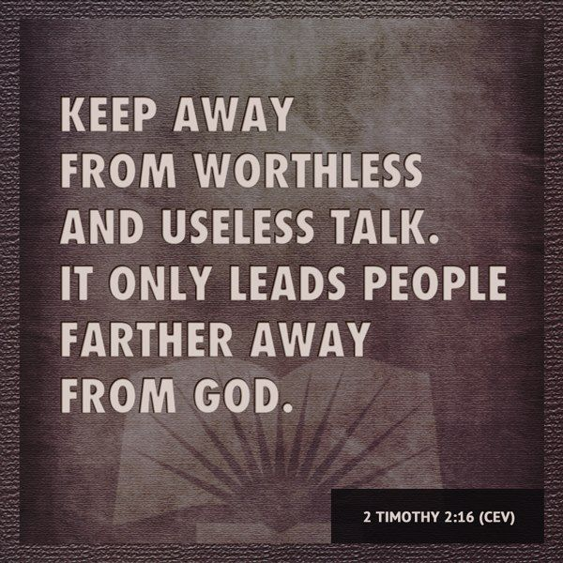

Slide 20
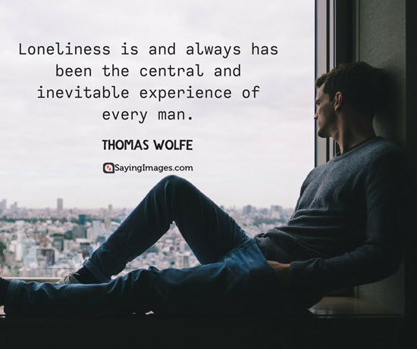
Soul sickness, is characterized by feelings of hopelessness and helplessness and a perceived sense of incompetence.

Slide 22
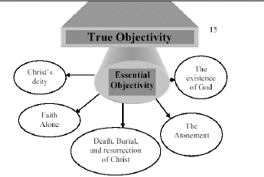
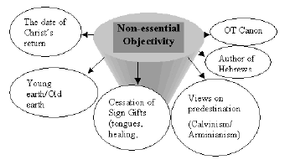
ESSENTIAL DOCTRINE
Salvation
related
Thousand year
Reign of Christ
Not related to
salvation
The Great Tribulation

Slide 23
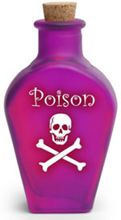
EGO

Slide 24
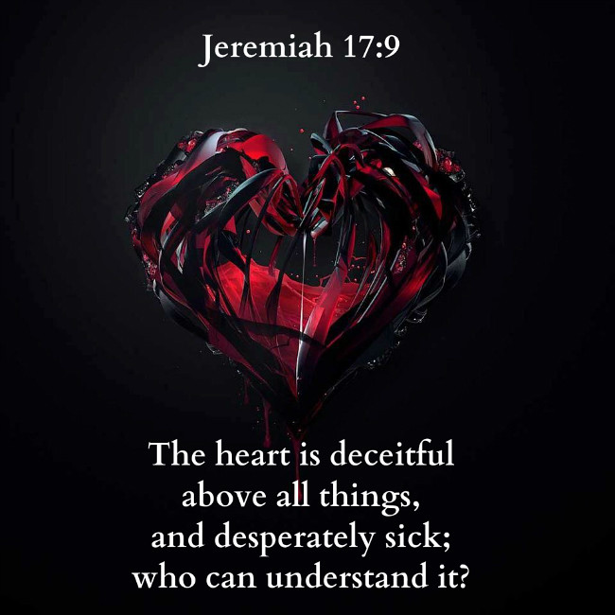

Slide 27
THINGS THAT MAKE THE SOUL SICK!

Slide 29
Blessed are the poor in spirit, Blessed are those who hunger and thirst after righteousness, Blessed are those who mourn their sins and seek forgiveness, Blessed are the pure in heart, Blessed are merciful, Their souls will rejoice and be exceedingly glad.
Matthew 5:3-12

Slide 30
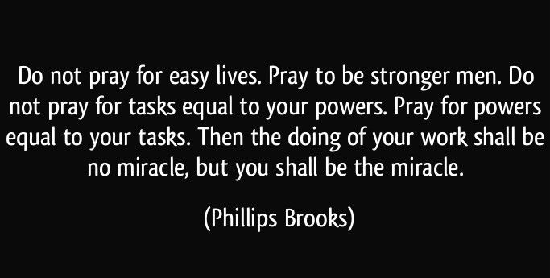

Slide 31
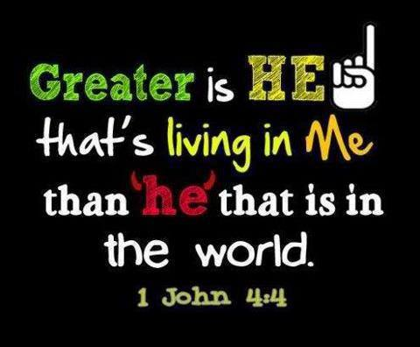

Slide 32
WE
US

Slide 33
“If your eye is pure, there will be sunshine in your soul.”
Matthew 6:22

