Slide 2
“Go into all the world and preach the gospel to every creature.” He who believes and is baptized will be saved; but he who does not believe will be condemned.
Mark 16:15

Slide 3
And these signs will follow those who believe: In My name they will cast out demons; they will speak with new tongues; they will take up serpents; and if they drink anything deadly, it will by no means hurt them; they will lay hands on the sick, and they will recover.”
Mark 16:15 -18

Slide 4
Preach

Slide 5
Preach
Their mission was to proclaim, to promote, to spread
the good news.

Slide 6
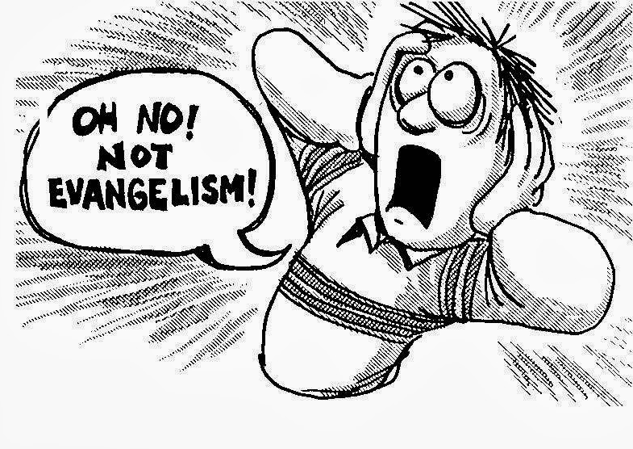
Too often Christians mistakenly believe that to “evangelize” is to convert someone.

Slide 7
To evangelize is
to share good news!

Slide 8
MATTHEW 13

Slide 9
Great News!
of God’s grace,
mercy and love!

Slide 10
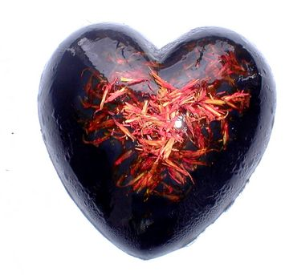
THE HEART OF HUMANITY

Slide 11
“The human heart is the most deceitful
of all things, and desperately wicked.
Who really knows how bad it is?”
Jeremiah 17:9

Slide 14
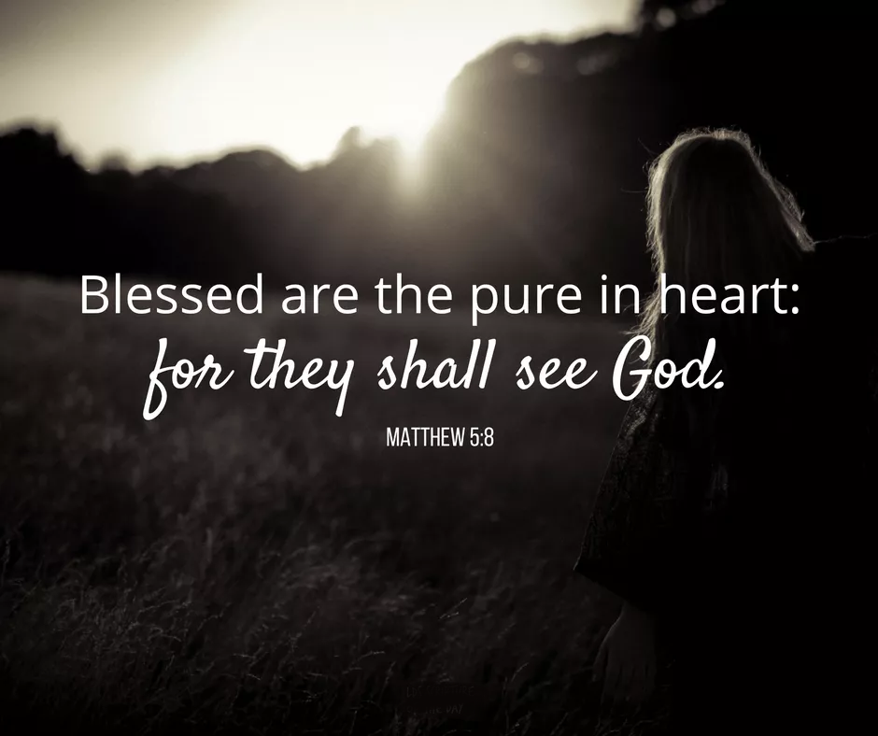

Slide 15
Only God can heal a corrupt heart!

Slide 16
Matthew 12:43-45 (NKJV) ⁴³ "When an unclean spirit goes out of a man, he goes through dry places, seeking rest, and finds none. ⁴⁴ Then he says, 'I will return to my house from which I came.' And when he comes, he finds it empty, swept, and put in order.

Slide 17
Matthew 12:43-45 (NKJV) ⁴⁵ Then he goes and takes with him seven other spirits more wicked than himself, and they enter and dwell there; and the last state of that man is worse than the first. So shall it also be with this wicked generation."

Slide 18
Missionaries
Sharing the
Good News!
of God’s grace,
mercy and love!

Slide 20
Mark 3:13-14 (NKJV) “And He went up on the mountain and called to Him those whom He desired, and they came to Him. ¹⁴ And He appointed twelve (whom he also named apostles) so that they might be with Him and He might send them out to preach.”

Slide 21
Luke 10:6 ⁶ And if a son of peace is there, your peace will rest upon him. But if not, it will return to you.

Slide 23
Our Small Groups Have
3 Objectives
TO BE BIBLICAL
TO BE RELATIONAL
TO BE MISSIONAL

Slide 24
Eternal Dwellings Available

Slide 27
John 14:2-3 Let not your heart be troubled; you are trusting God, now trust in me. There are many mansions up there where my Father lives, and I am going to prepare them for your arrival.

Slide 28
John 14:2-3 When everything is ready, then I will come and get you, so that you can always be with me where I am.

