Slide 1
Can Do That
MARK 2:1-12

Slide 2
What are some things that
Can Do ?

Slide 3
National
Champions
2016
2018

Slide 6
APPLICATION
What do you want God to do
in your life today, that only He can do?

Slide 7
When you say “I can’t”
is when God says, “I can!”

Slide 8
THE HARDEST PART IS WAITING
ACTS 1:4-8

Slide 9
⁴And being assembled together with them, He commanded them not to depart from Jerusalem, but to wait for the Promise of the Father, "which," He said, "you have heard from Me; ⁵ for John truly baptized with water, but you shall be baptized with the Holy Spirit not many days from now."
Acts 1:4-8

Slide 10
⁶ Therefore, when they had come together, they asked Him, saying, "Lord, will You at this time restore the kingdom to Israel?" ⁷ And He said to them, "It is not for you to know times or seasons which the Father has put in His own authority.
Acts 1:4-8

Slide 11
⁸ But you shall receive power when the Holy Spirit has come upon you; and you shall be witnesses to Me in Jerusalem, and in all Judea and Samaria, and to the end of the earth."
Acts 1:4-8

Slide 12
“When God acts, he can do more in a minute than man with all his organizing can do in fifty years.”
- Martyn Lloyd Jones -

Slide 13
God wants us to wait upon Him

Slide 14
Matthew 4:19

Slide 15
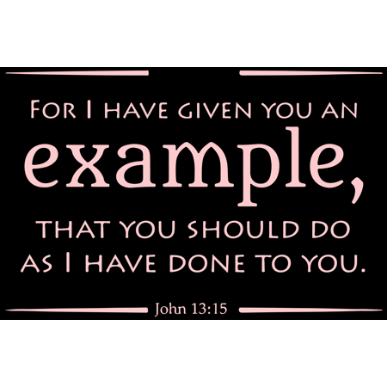

Slide 18
God wants us to work with Him,
not without Him.

Slide 20
Working with God begins with…
Waiting for his leading in your life.

Slide 22
Obey His Word

Slide 23
Request His Help

Slide 25
Keep mindful of what only God can do!

Slide 30
“Lo I am with you always
even to the end of the age.”
^{Matthew 28:20}
“Greater things than these shall you do because I go to My Father!”
^{John 14:12}
“If I am lifted up, all peoples will be
drawn to Me.”
^{John 12:32}

Slide 32
Because some think
it means doing nothing!

Slide 33
What to do while we Wait
REMEMBER WHAT GOD
HAS DONE IN THE PAST

Slide 34
What to do while we Wait
CONTINUE TO PRAY!

Slide 35
What to do while we Wait
READ GOD’S WORD

Slide 36
What to do while we Wait
FOCUS ON THE PROMISES OF GOD

Slide 37
What to do while we Wait
SING YOUR FAVORITE SONGS

Slide 38
What to do while we Wait
VISIT THE HOMEBOUND

Slide 39
In Helping others we help ourselves

