Slide 1
GOD of
Colossians 1:19-23

Slide 3
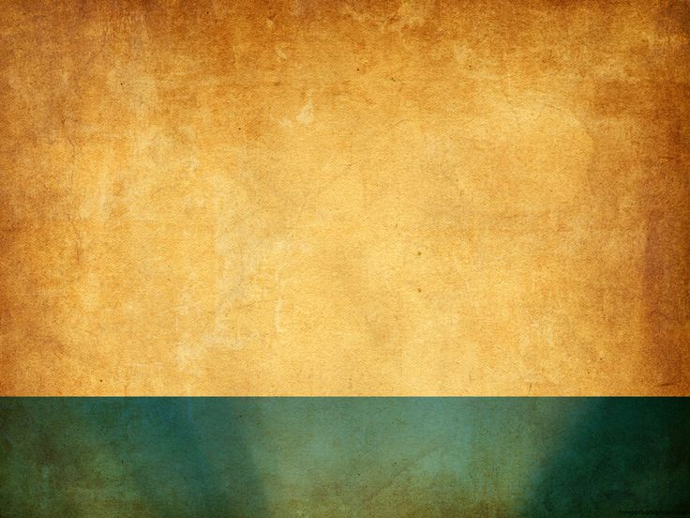
1.
God is a God of Reconciliation
God has given us the Ministry and
the Message of Reconciliation
Reconciliation is an Individual Matter
of Choice
2.
3.
RECONCILIATION

Slide 4
Defining reconciliation:
In bookkeeping, accountants use the term ‘reconciliation’ when attempting to bring debits and credits into harmony on a balance sheet.

Slide 5
Defining reconciliation:
In bookkeeping, accountants use the term ‘reconciliation’ when attempting to bring debits and credits into harmony on a balance sheet.
In theology, a good description of reconciliation is provided by Charles Ryrie: A change of relationship from hostility
to harmony and peace between
two parties.

Slide 6
1. God is a God of Reconciliation

Slide 7
⁶ For while we were still weak, at the right time Christ died for the ungodly. ⁷ For one will scarcely die for a righteous person—though perhaps for a good person one would dare even to die—⁸ but God shows his love for us in that while we were still sinners, Christ died for us. ⁹ Since, therefore, we have now been justified by his blood,
Romans 5:6-11 (ESV)

Slide 8
much more shall we be saved by him from the wrath of God. ¹⁰ For if while we were enemies we were reconciled to God by the death of his Son, much more, now that we are reconciled, shall we be saved by his life. ¹¹ More than that, we also rejoice in God through our Lord Jesus Christ, through whom we have now received reconciliation.
Romans 5:6-11 (ESV)

Slide 9
¹⁹ For in him all the fullness of God was pleased to dwell, ²⁰ and through him to reconcile to himself all things, whether on earth or in heaven, making peace by the blood of his cross. ²¹ And you, who once were alienated and hostile in mind, doing evil deeds, ²² he has now reconciled in his body of flesh by his death, in order to present you holy and blameless and above reproach before him,
Colossians 1:19-22 (ESV)

Slide 10
¹⁸ All this is from God, who through Christ reconciled us to himself and gave us the ministry of reconciliation; ¹⁹ that is, in Christ God was reconciling the world to himself, not counting their trespasses against them, and entrusting to us the message of reconciliation.
2 Corinthians 5:18-21 (ESV)

Slide 11
²⁰ Therefore, we are ambassadors for Christ, God making his appeal through us. We implore you on behalf of Christ, be reconciled to God. ²¹ For our sake he made him to be sin who knew no sin, so that in him we might become the righteousness of God.
2 Corinthians 5:18-21 (ESV)

Slide 12
2. God has given us
the Ministry and the Message
of Reconciliation

Slide 13
²⁰ Therefore, we are ambassadors for Christ, God making his appeal through us. We implore you on behalf of Christ, be reconciled to God. ²¹ For our sake he made him to be sin who knew no sin, so that in him we might become the righteousness of God.
2 Corinthians 5:18-21 (ESV)

Slide 14
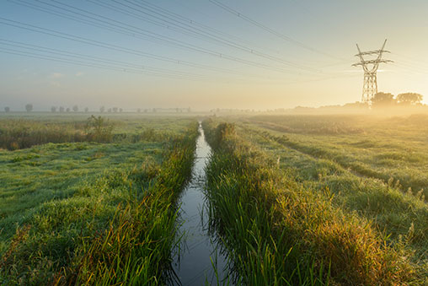
A story is told of two brothers…

Slide 15
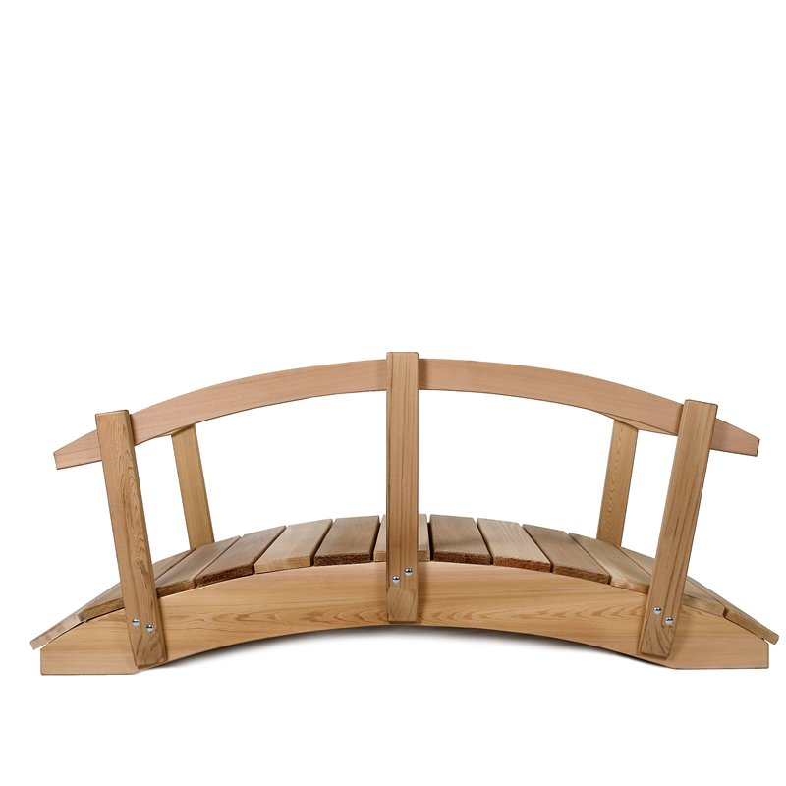

Slide 17
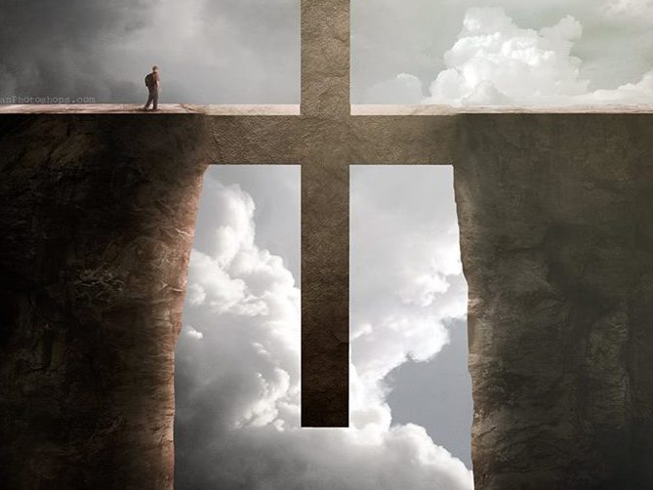

Slide 18
3. Reconciliation is an
Individual Matter of Choice

Slide 19
“Many reconciliations have broken down because both parties have come prepared to forgive and unprepared to be forgiven.”

Slide 20
For as we have been forgiven our debts so we are to forgive the debts of others. For if you do not forgive the debts of others, neither will our Father in Heaven forgive our debts.
Matthew 6:14-15

Slide 21
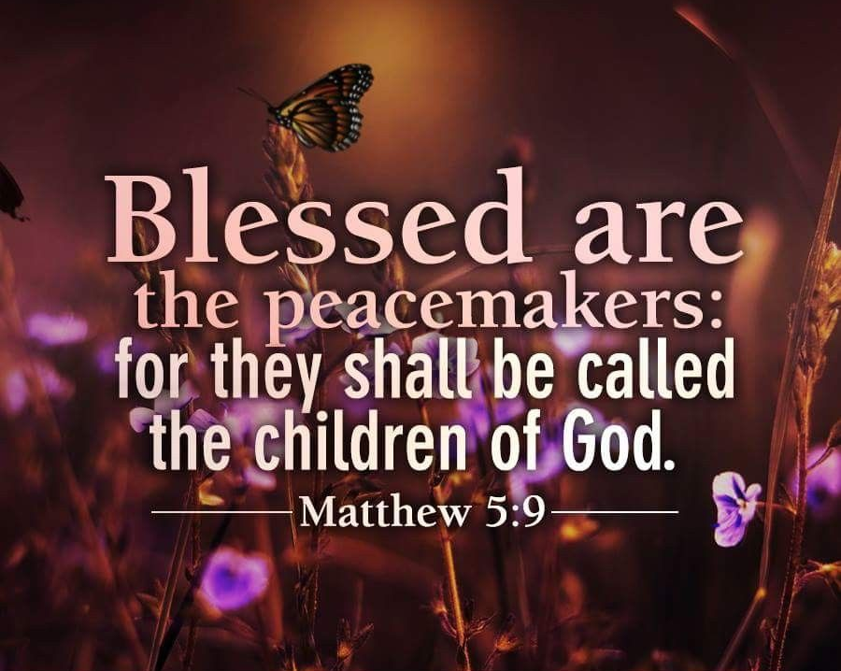

Slide 22
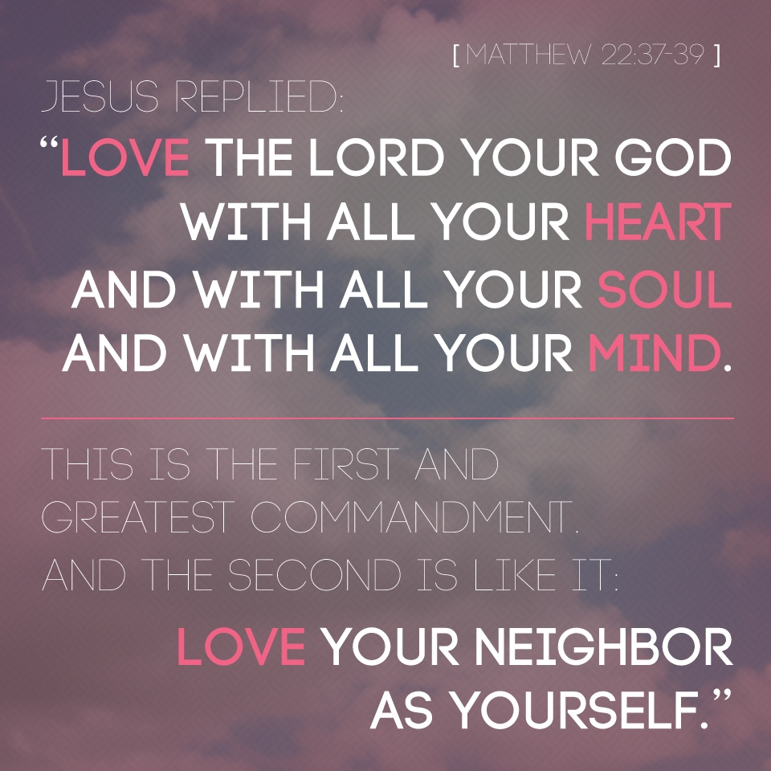

Slide 23
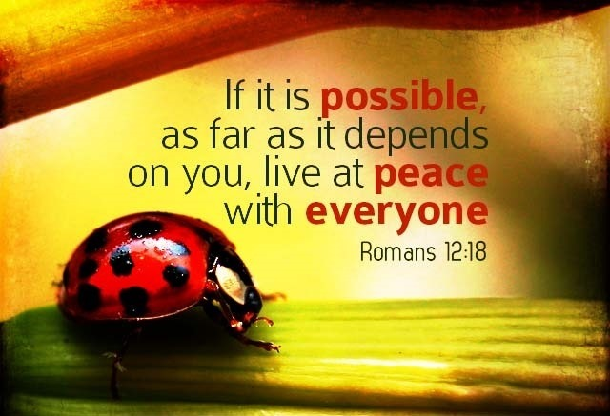

Slide 24
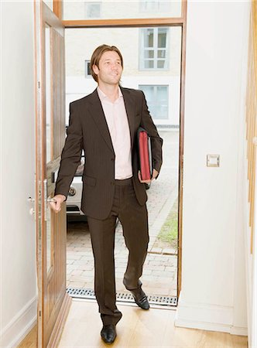
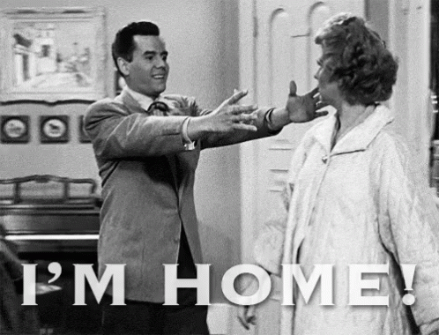

Slide 25
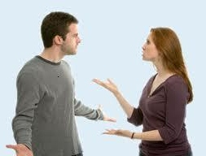

Slide 26
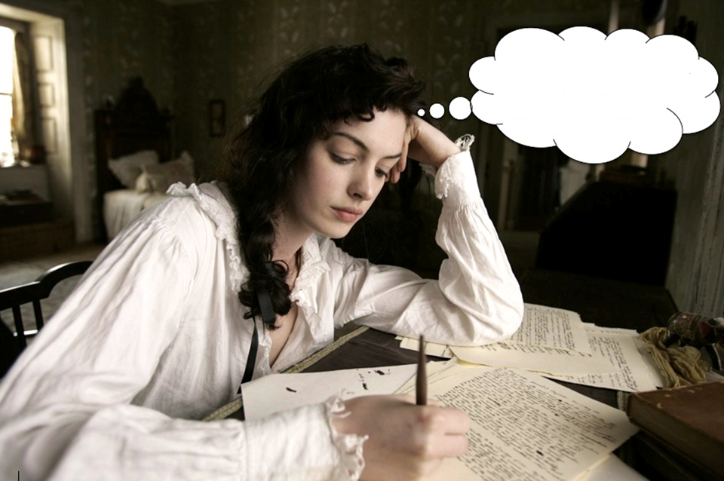
Dear Mom and Dad

Slide 27
Jesus Built A Bridge
Phil Cross
Bridge Building Music, BMI; Chris White Music, BMI
One day they nailed a carpenter to a rugged tree, Thinking He would never build again.
There they held Him through His hands and feet, Still He carried out a master plan.
Chorus Jesus built a bridge to heaven, So that I could have a way up to Him. Jesus built a bridge the only way He could.
With only three nails and three pieces of wood, With one rugged cross, Jesus built a bridge.
The Father looked from heaven to the world below, And it seemed there was no way to claim His own. So to the world God’s Son, the master builder, had to go, To make a way to bring God’s children home.
Repeat Chorus With only three nails and three pieces of wood, With one rugged cross, Jesus built a bridge.

