Slide 1
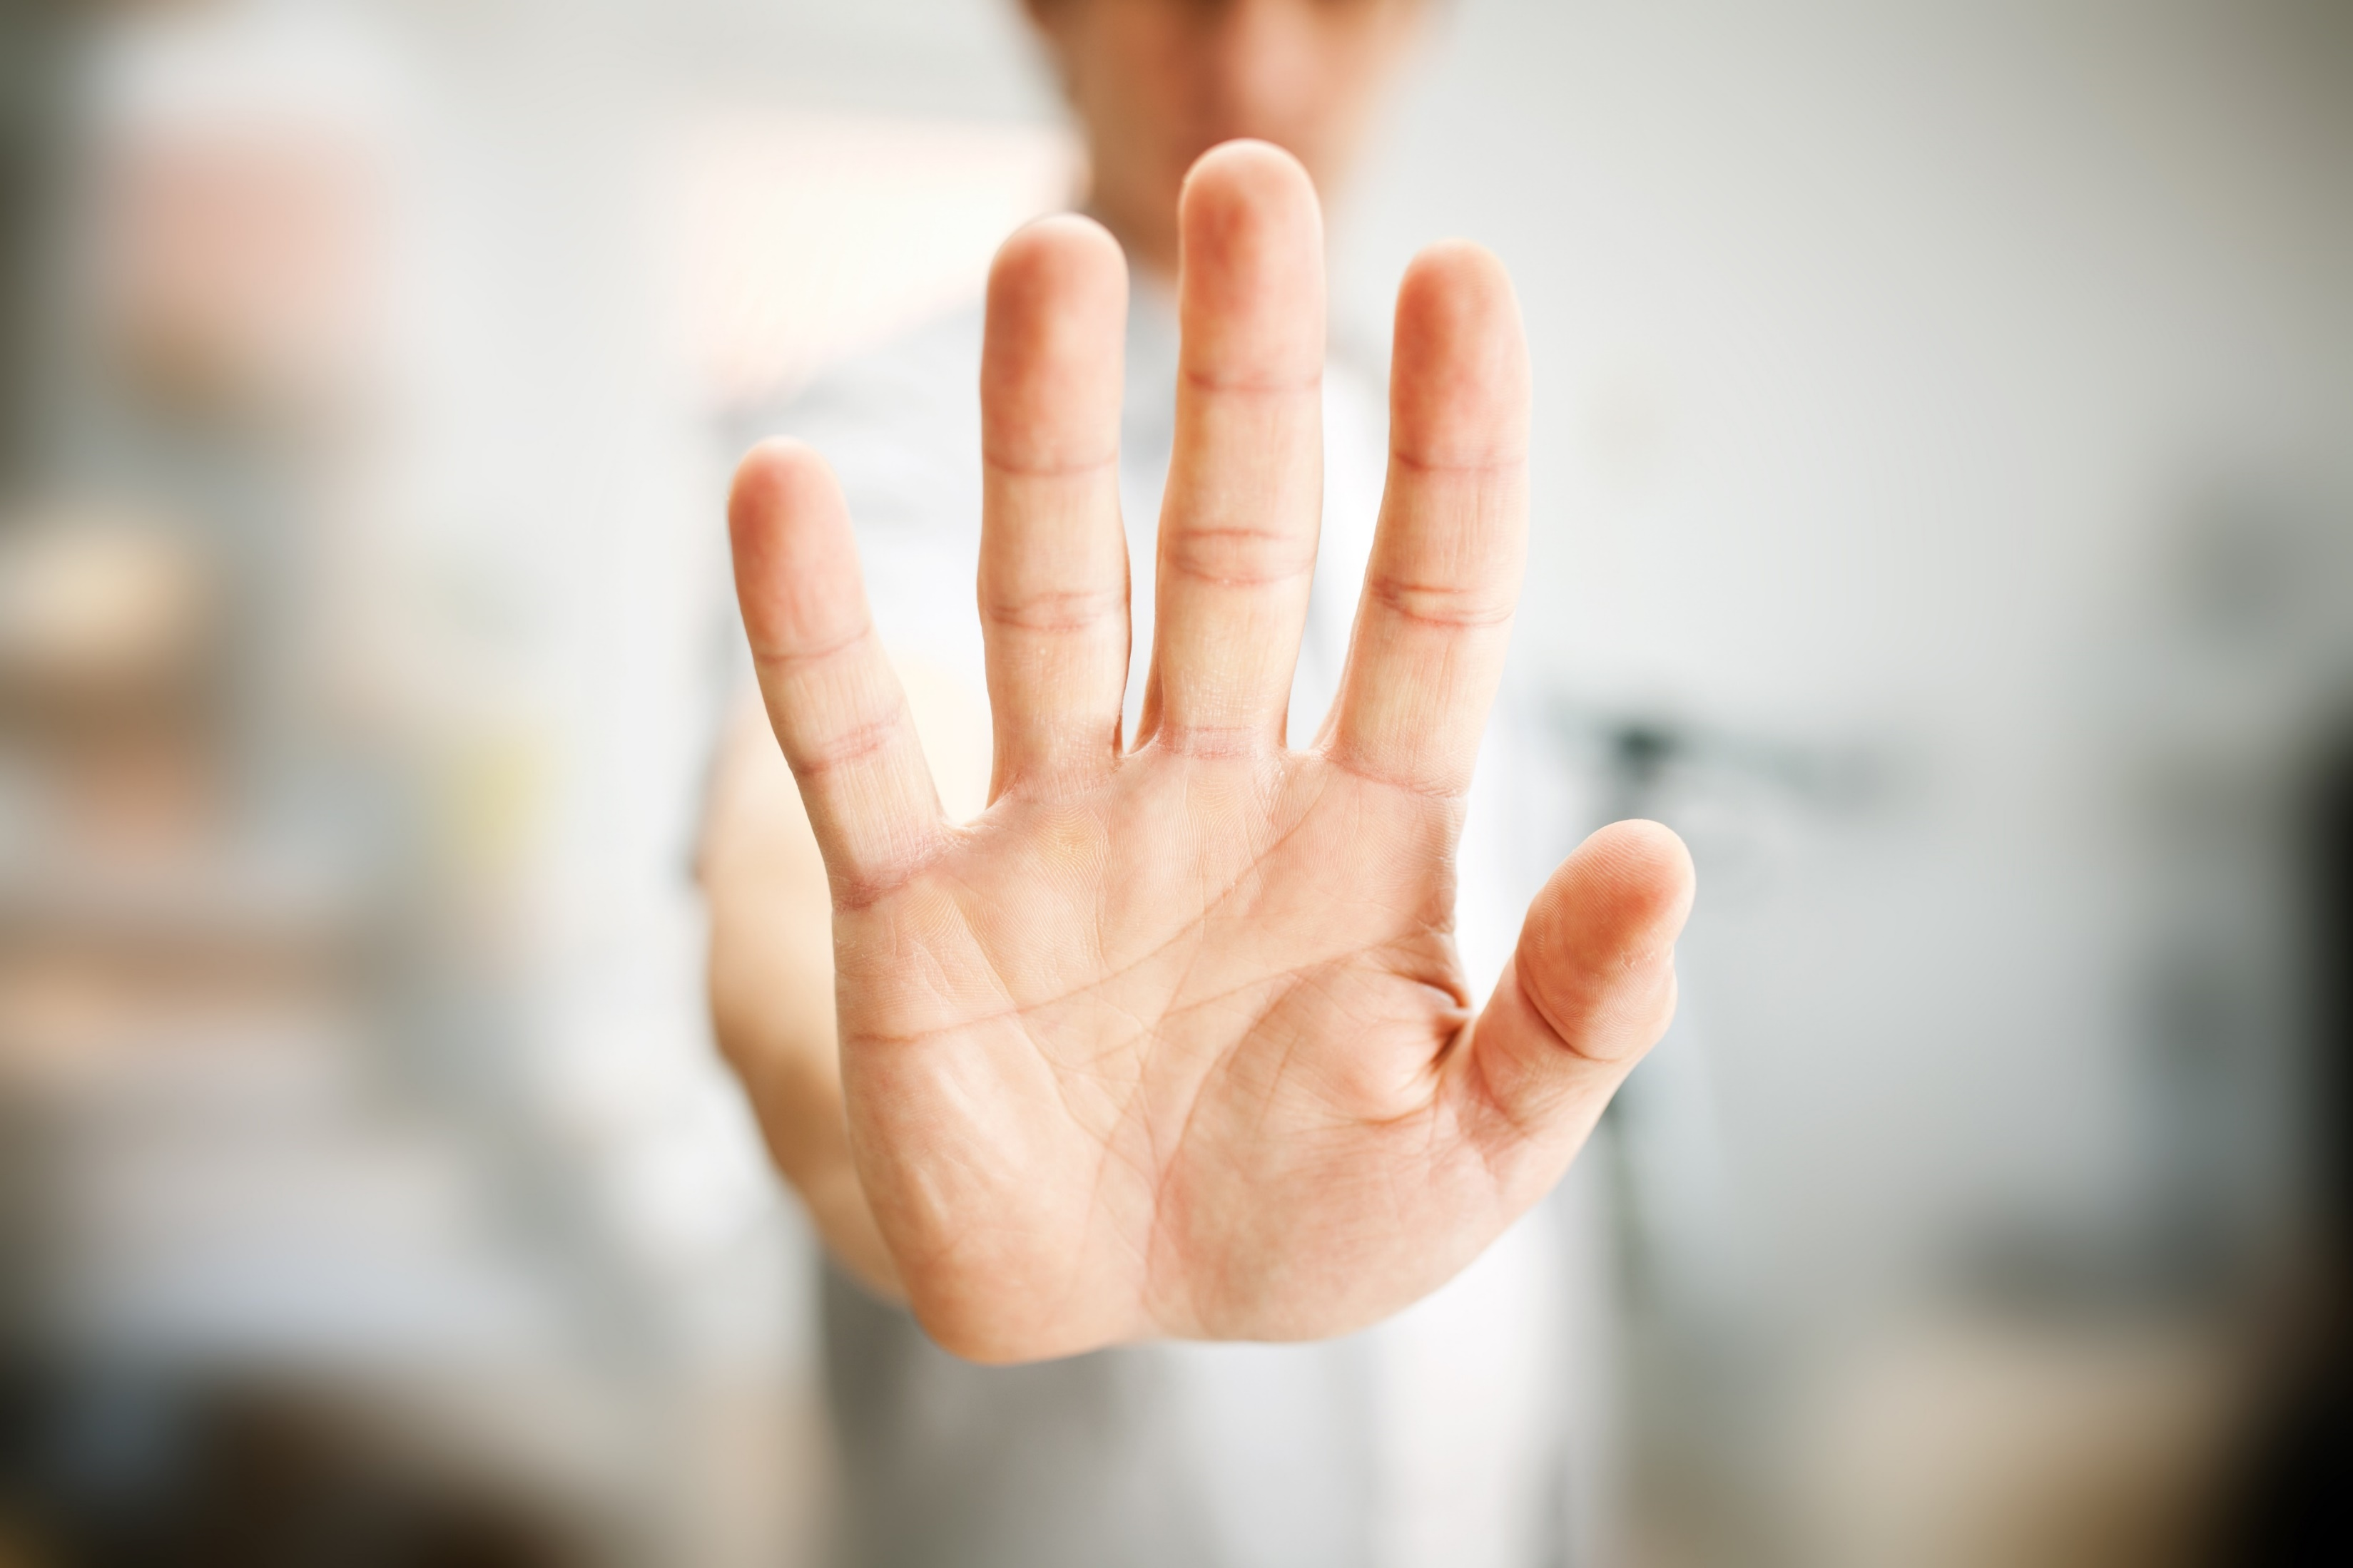
Resisting God
Genesis 32:24-32

Slide 2
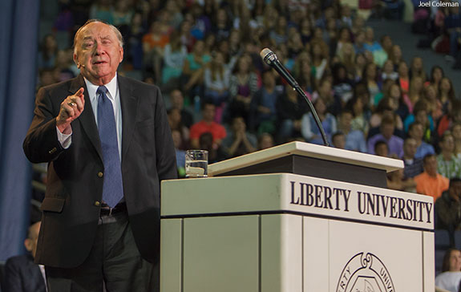
1. A LIFE OF RESISTANCE
ELMER TOWNS ON JACOB

Slide 3
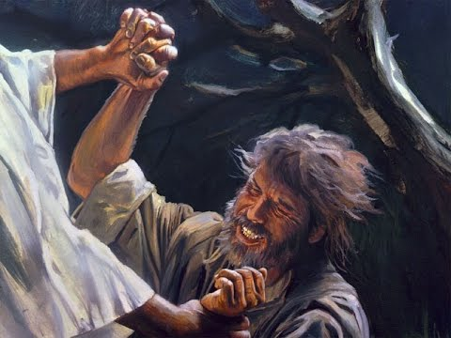
2. The Resistive One is Confronted.

Slide 4
“I saw God face to face,
yet my life was spared”
Genesis 32:30

Slide 5
“and God blessed him there.”
Genesis 32:29

Slide 6
Romans 8:28-29 (NKJV) ²⁸ And we know that all things work together for good to those who love God, to those who are the called according to His purpose. ²⁹ For whom He foreknew, He also predestined to be conformed to the image of His Son, that He might be the firstborn among many brethren.

Slide 7
3. Resisting God brings adversity.

Slide 8
2 Corinthians 11:24-27 (The Message) ²⁴ I've been flogged five times with the Jews' thirty-nine lashes, ²⁵ beaten by Roman rods three times, pummeled with rocks once. I've been shipwrecked three times, and immersed (adrift) in the open sea for a night and a day. ²⁶ In hard traveling year in and year out, I've had to ford rivers, fend off robbers,

Slide 9
struggled with friends, struggled with foes. I've been at risk in the city, at risk in the country, endangered by desert sun and sea storm, and betrayed by those I thought were my brothers. ²⁷ I've known drudgery and hard labor, many a long and lonely night without sleep, many a missed meal, blasted by the cold, naked to the weather.

Slide 10
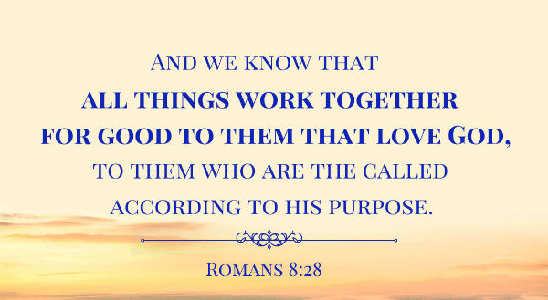

Slide 11
And I am sure that God who began the good work within you will keep right on helping you grow in his grace until his task within you is finally finished on that day when Jesus Christ returns.
PHILIPPIANS 1:6 TLB

Slide 12
4. Everyone experiences adversity.

Slide 13
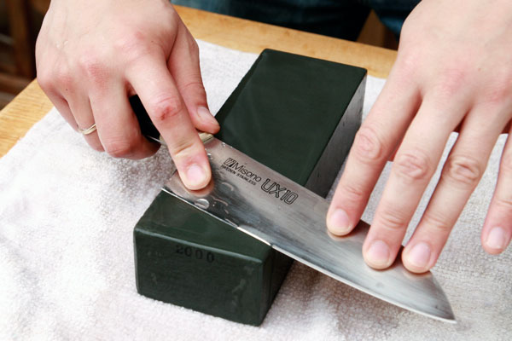

Slide 14
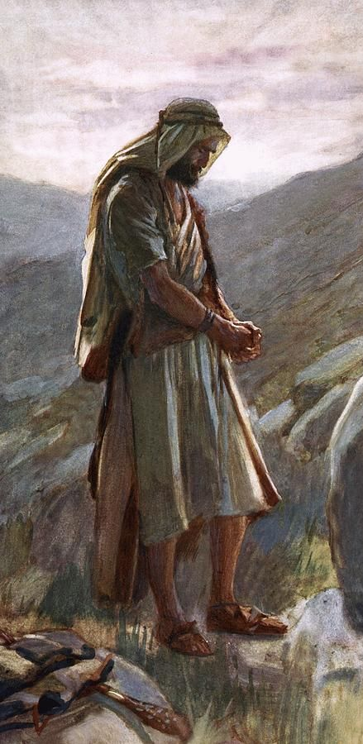
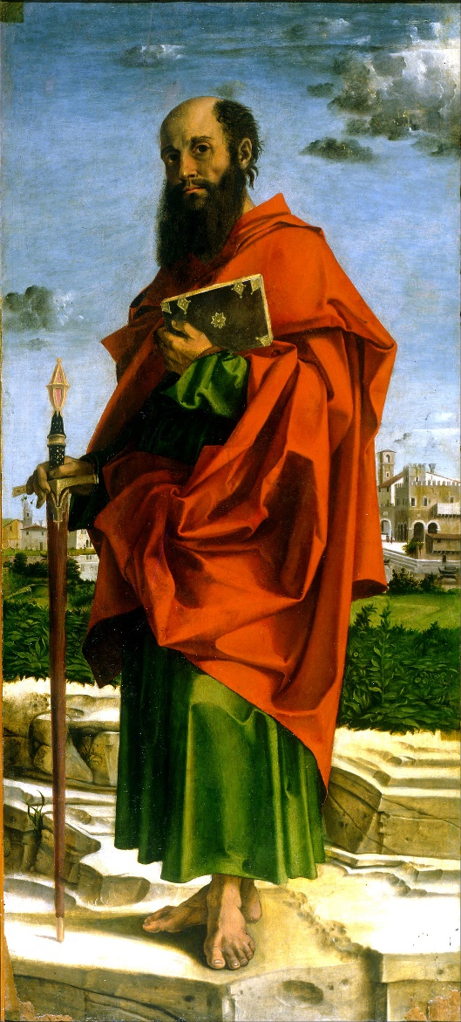
They both had their share of adversity.
JACOB AND SAUL

Slide 15
In both their lives adversity leads them to encounter God
JACOB AND SAUL

Slide 16
Both were ‘confronted’ by God, and physically compelled to surrender to His spiritual presence.
JACOB AND SAUL

Slide 17
Both were interfering with what God was doing in the lives of others.
JACOB AND SAUL

Slide 18
Both were unaware of how God was working around them.
JACOB AND SAUL

Slide 19
Then Jacob was left alone;
and a Man wrestled with him
until the breaking of day.
Genesis 32:24 (NKJV)

Slide 20
Then Jacob was left alone;
and a Man wrestled with him
until the breaking of day.
Genesis 32:24 (NKJV)

Slide 21
Jacob resisted God
by being unwilling
to walk by faith.

Slide 22
Jacob resisted God by using relationships, rather than
building relationships.

Slide 23
Often our problems with people,
are a reflection of our
Struggles with God

Slide 24
Fighting against God
brings unnecessary
Pain!

Slide 25
5. What God cares about most is our Spiritual Growth!

Slide 26
²⁵ When the man saw that he could not defeat him, he struck Jacob's hip socket as they wrestled and dislocated his hip.
Genesis 32:24 (CSB)

Slide 27
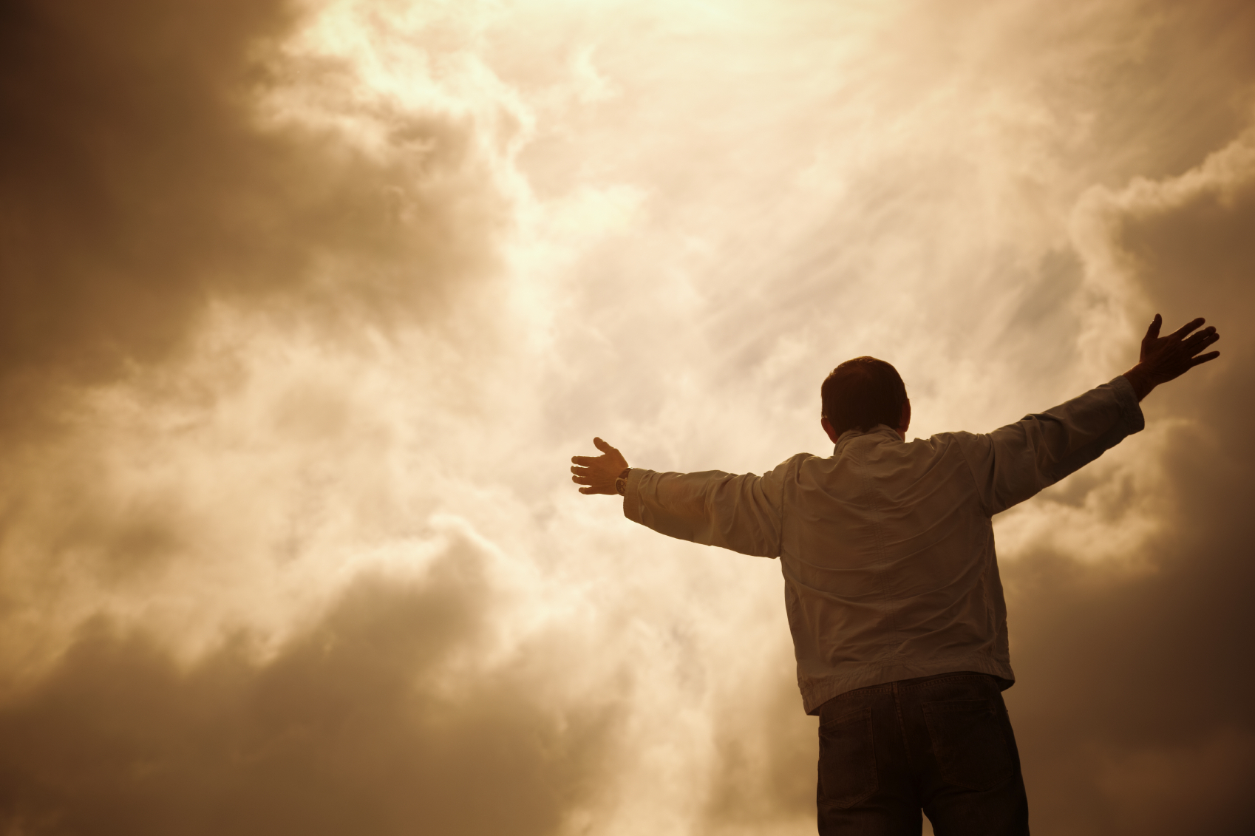
God is Gracious to the One Who Surrenders

Slide 28
Resisting God will cost you everything in the end.

Slide 29
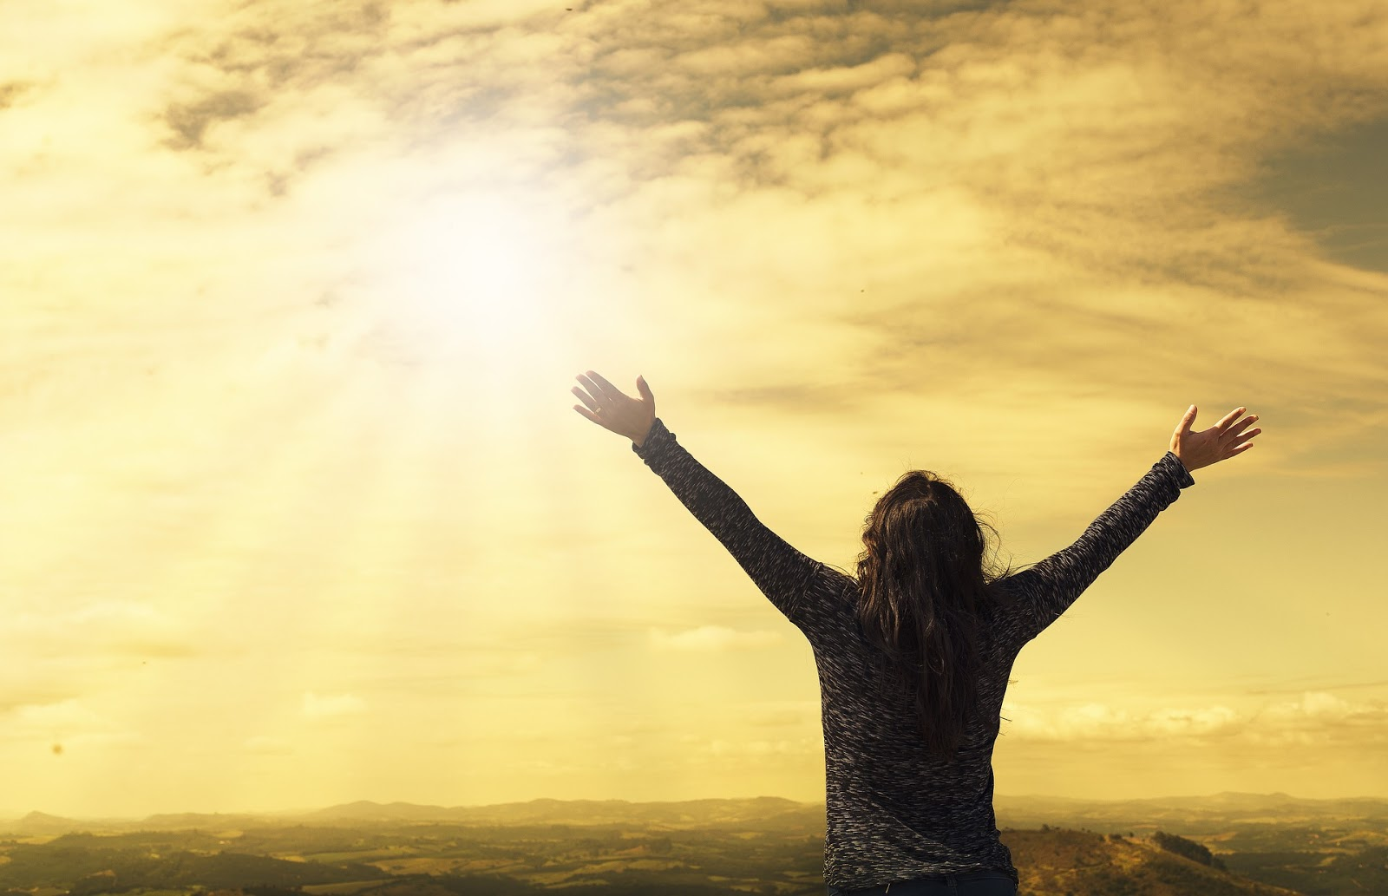
With Surrender Comes Transformation

Slide 30
⁷ He who has an ear, let him hear what the Spirit says to the churches: To him who overcomes, I will give to eat from the Tree of Life which is in the midst of the Paradise of God.
Revelation 2:7 (NKJV)

Slide 31
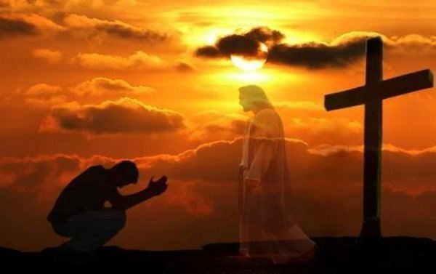
Today’s message is a call to surrender!

Slide 32
¹⁰ I have come that they might have life and have it more abundantly.
John 10:10 (NKJV)

Slide 33
¹¹ He came to his own, and his own people did not receive him. ¹² But to all who did receive him, to those who believe in his name, he gave them the right to be children of God
John 1:11-12 (NKJV)

