Slide 1
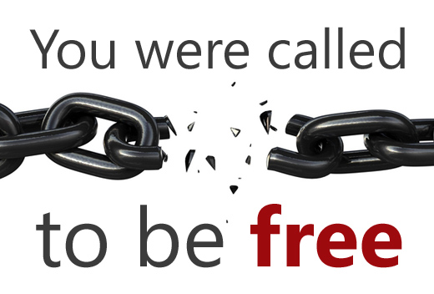
Galatians 5:13-26

Slide 2
Christian Liberty/Freedom

Slide 4
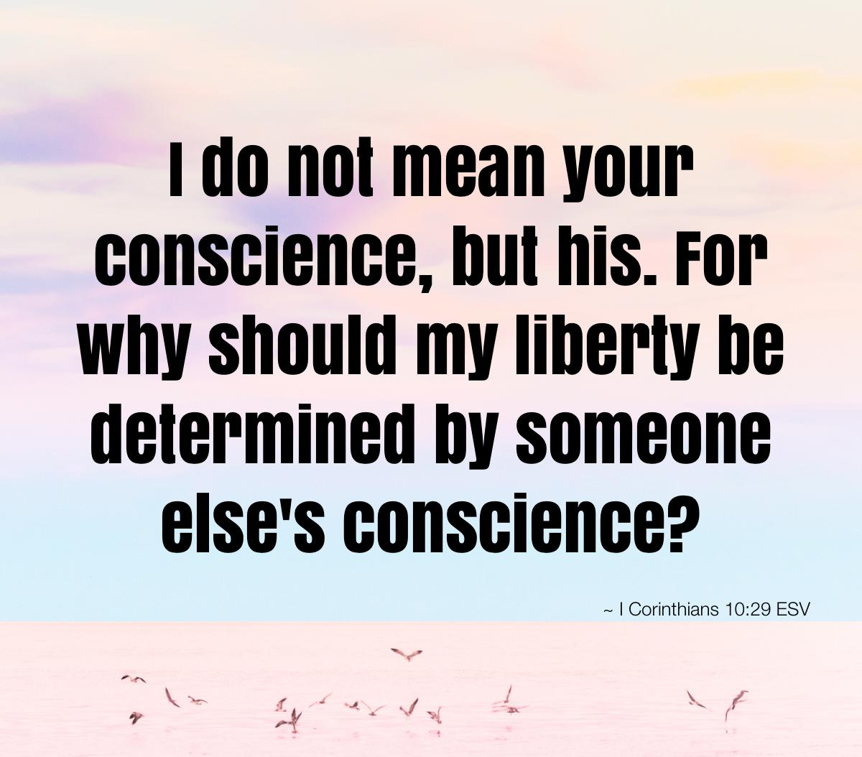

Slide 5
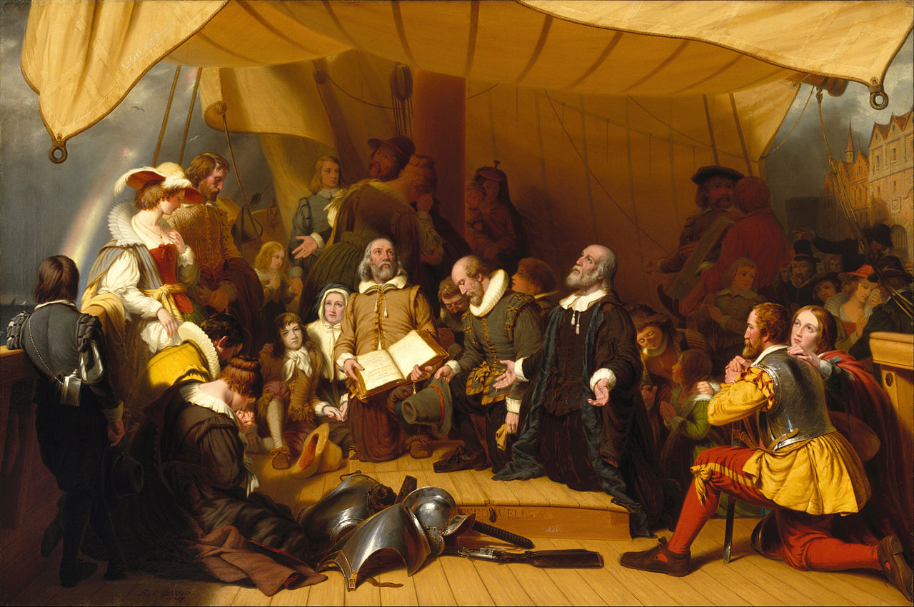

Slide 6
Chapter 5

Slide 9
Liberty comes from love,
not the law

Slide 10
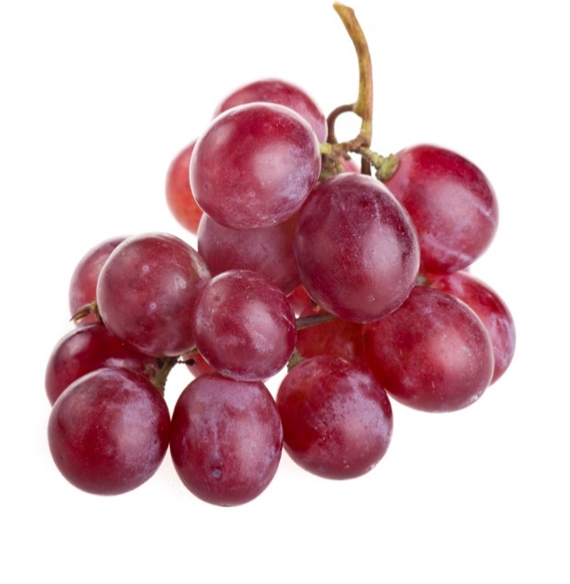
Agape
.. . . _
a-ga-pa
Agape is selfless, sacrificial,
Unconditional love, the highest
Of the four types of love in the Bible.

Slide 11
THE LAW IS POWERLESS TO
CHANGE THE HEART

Slide 12
IN THE ABSENCE OF LOVE, ABUSE LURKS

Slide 13
¹ If I had the gift of being able to speak in other languages without learning them and could speak in every language there is in all of heaven and earth, but didn’t love others, I would only be making noise. ² If I had the gift of prophecy and knew all about what is going to happen in the future, knew everything about everything, but didn’t love others, what good would it do?
1 Corinthians 13:1-3

Slide 14
Even if I had the gift of faith so that I could speak to a mountain and make it move, I would still be worth nothing at all without love. ³ If I gave everything I have to poor people, and if I were burned alive for preaching the Gospel but didn’t love others, it would be of no value whatever.
1 Corinthians 13:1-3

Slide 15
Evidence of the absence of love

Slide 16
Galatians 5:20
“hatred, contentions, jealousies, outbursts
of wrath, selfish ambitions, and dissensions…”

Slide 18
A DIFFERENT KIND
OF

Slide 19
Galatians 5:13

Slide 20
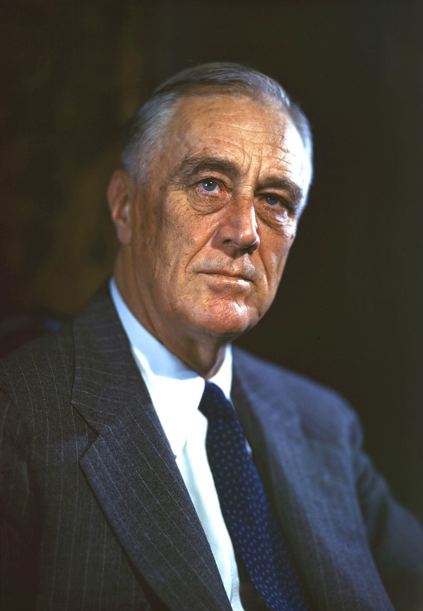
President Franklin D. Roosevelt shared his vision of the kind of world he wanted to see after the war was over. He envisioned four basic freedoms enjoyed by all people: freedom of speech, freedom of worship,
freedom from want, and
freedom from fear.
January 6, 1941

Slide 22
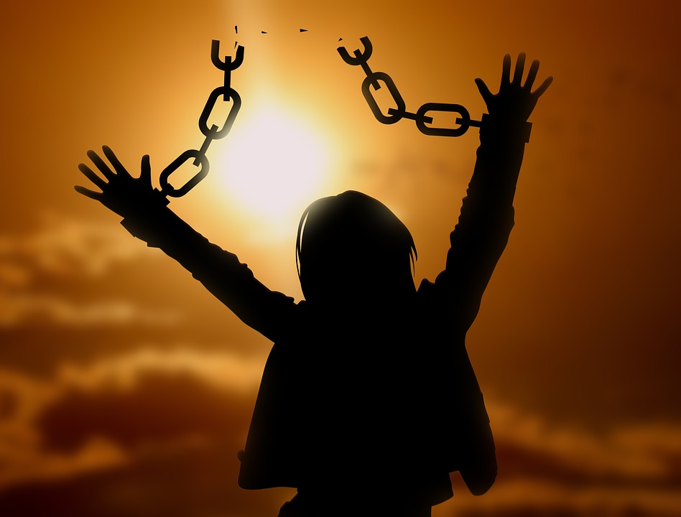
FREEDOM FROM THE CONSTRAINTS OF THE FLESH

Slide 25
⁴God’s love is very patient and kind, never jealous or envious, never boastful or proud, ⁵never haughty or selfish or rude. Godly love does not demand its own way. It is not irritable or touchy. It does not hold grudges and will hardly even notice when others do it wrong. ⁶ It is never glad about injustice, but rejoices whenever truth wins out.
1 Corinthians 13:4-8

Slide 26
⁷ If you love someone, with godly love you will be loyal to them no matter what the cost. You will always believe in them, always expect the best of them, and always stand your ground in defending them. ⁸ All the special gifts and powers from God will someday come to an end, but this love goes on forever.
1 Corinthians 13:4-8

Slide 27
GOD’S LOVE PRODUCES FRUIT

Slide 29
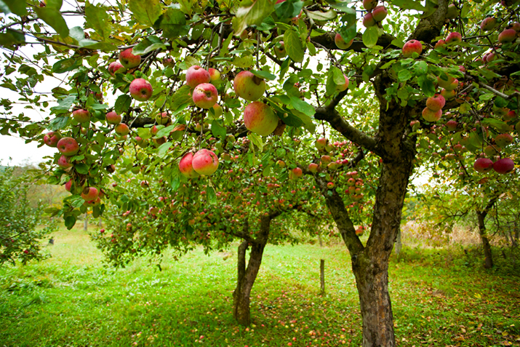
How do we PRODUCE THIS FRUIT IN OUR LIVES?

Slide 30
Letting the Holy Spirit
have control.

Slide 34
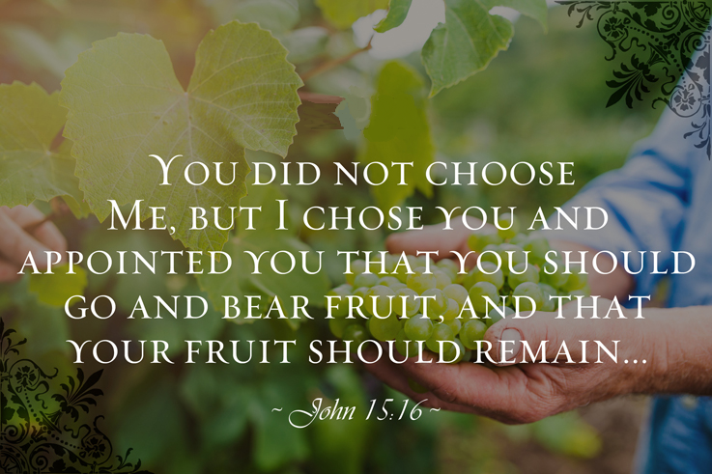

Slide 35
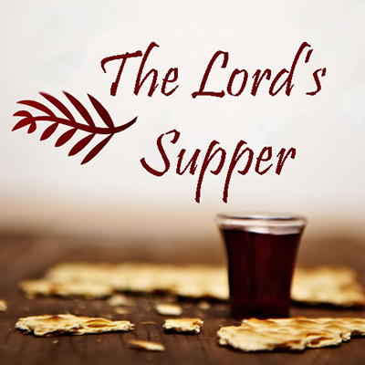

Slide 36
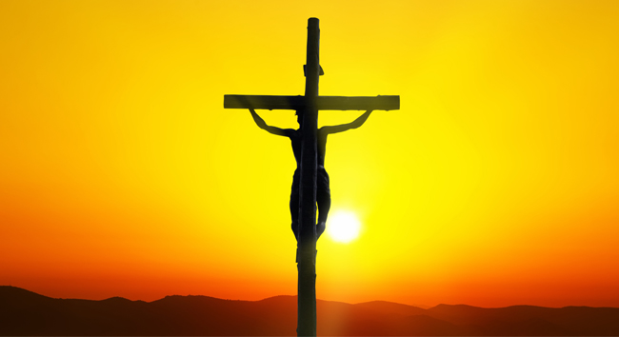
The only fruit that will ever endure to eternal life is fruit which grows out of APPROPRIATING THE TRUTH OF THE CRUCIFIXION OF JESUS TO OUR OWN LIVES.

Slide 37
