Slide 1
JULY 15TH 5:30 p.m.

Slide 2
Poor thinking will cloud your vision.
So much of how we view life is based on how we think—the assumptions we make, the conclusions we draw, how we act based on those conclusions…. This new Bible study will help inform your thinking based on the truth of Jesus and the gospel. You’ll identify strongholds, examine how they came to be, and move toward repentance and the renewing of your mind.

Slide 3
JULY 15^{TH @} 5:30 P.M.
Thinking determines outcome more than anything else. Our actions, attitudes, and self-awareness all flow from the way we think. Change is possible when we start to think differently, because nothing changes until we change our thinking!

Slide 4
JULY 15^{TH @} 5:30 P.M.
BENEFITS
Identify and address the strongholds in your life.
Overcome the strongholds that result from family values and systems.
Learn how to avoid double-mindedness and indecisiveness.

Slide 5
JULY 15^{TH @} 5:30 P.M.
BENEFITS
Learn how to replace strongholds and long-held conclusions with biblical truth.
Adopt strategies for thinking differently from a renewed, Christ-centered perspective.

Slide 6
10 VIDEO SESSIONS (40-55 MINUTES)
Why Is It So Hard to Think Differently?
Destroying the Strongholds in My Disposition
Destroying Family Dysfunction Strongholds, Parts 1 & 2
Ending Double-Mindedness
Strongholds of My Own Making
When Strongholds Start to Crumble
Repentance Breaks Strongholds
When You Fail to Think Differently
How to Renew Your Mind

Slide 7
Seven Promises of Christ to Us
2 Peter 1:1-4

Slide 8
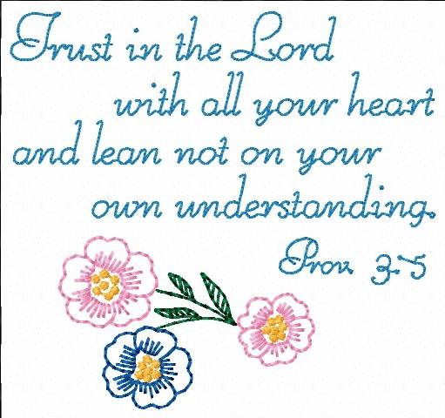
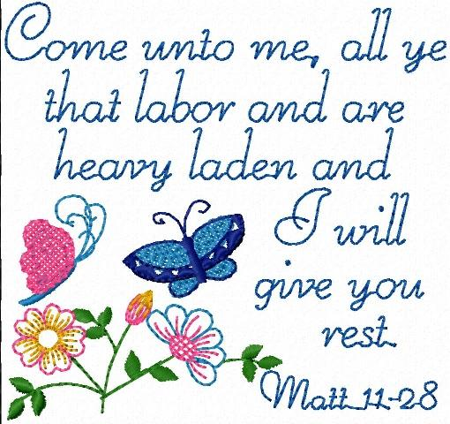
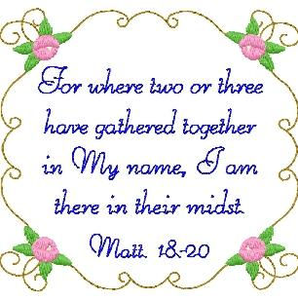

Slide 9
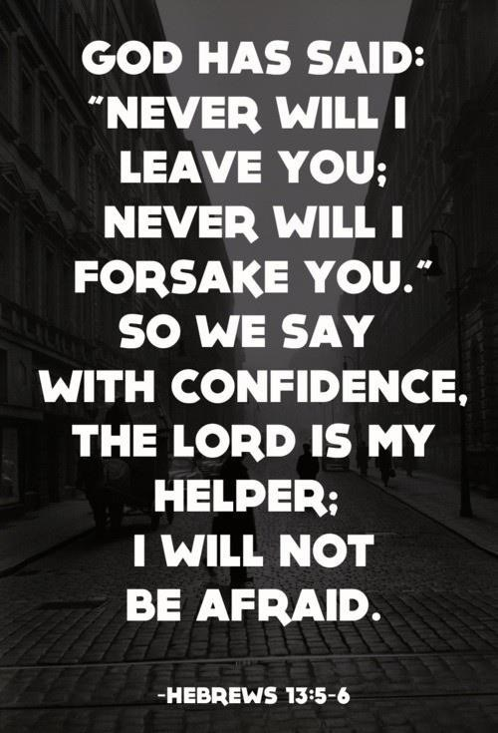

Slide 11
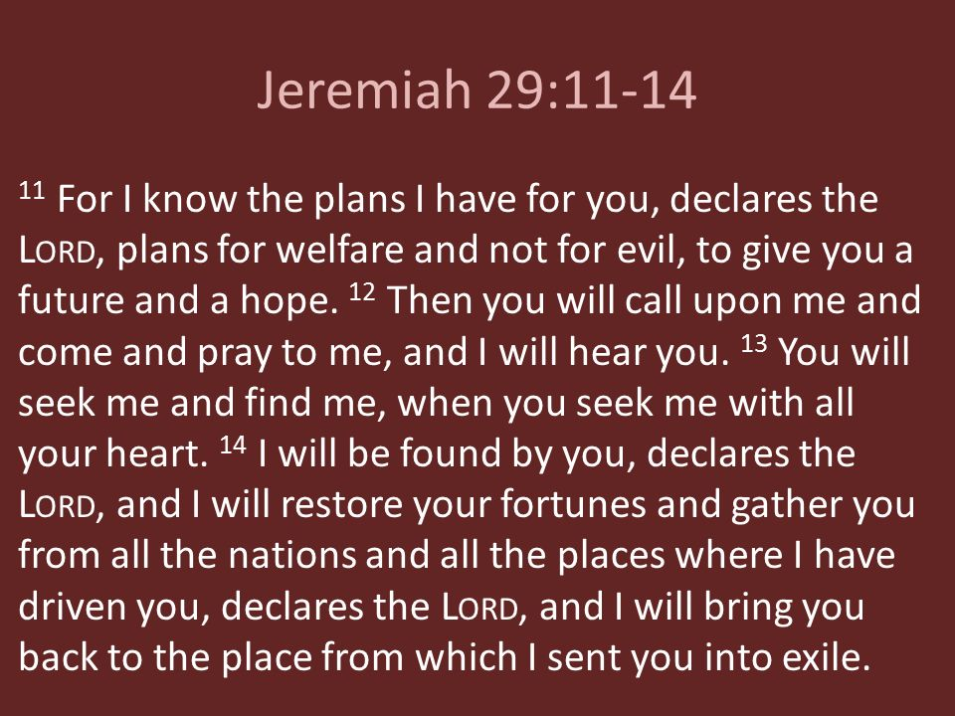

Slide 13
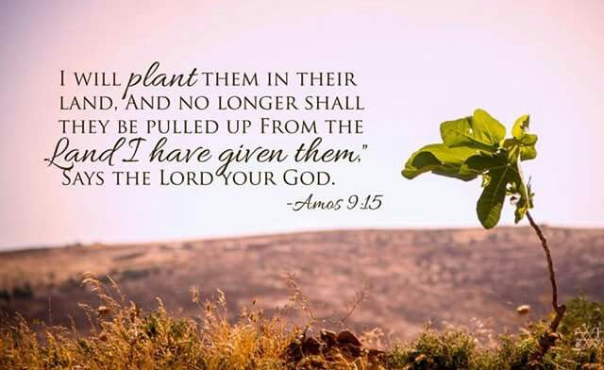

Slide 20
The Devil Tempts Jesus

Slide 21
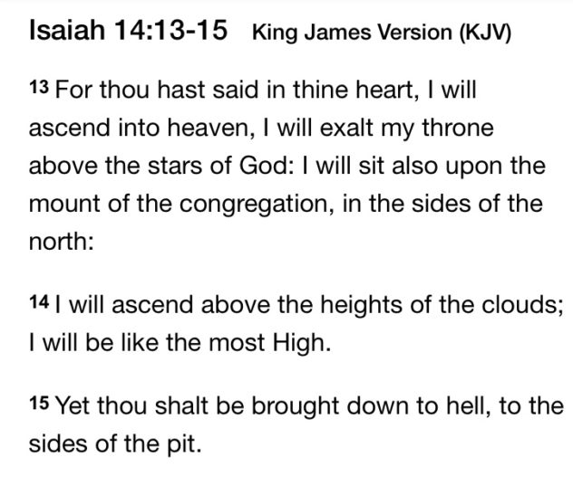

Slide 24
“I can do nothing by Myself; I judge only as I hear, and my judgment is just for I seek not to please myself but him who sent me.” John 5:19, 30.
“I have not spoken on My own, but the Father Himself, having sent Me, gave Me a commandment, what I should say and what I should speak.” John 12:49

Slide 26
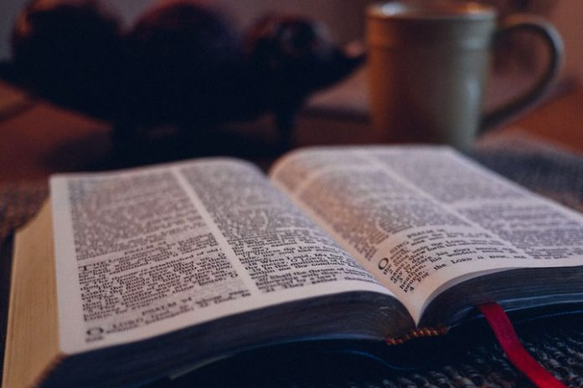
SEVEN PROMISES OF JESUS

Slide 27
I WILL NEVER LEAVE THEE
NOR FORSAKE THEE
HEBREWS 13:5
John 14:6

Slide 28
2. HIM THAT COMETH TO ME
I WILL IN NO WISE CAST OUT
JOHN 6:37

Slide 29
3. I WILL SEND YOU THE COMFORTER
JOHN 15:26

Slide 30
4. COME UNTO ME, ALL YE THAT LABOR
AND ARE HEAVY LADEN, AND I WILL
GIVE YOU REST
MATTHEW 11:28

Slide 31
5. I WILL CONFESS YOU BEFORE
THE FATHER IN HEAVEN
LUKE 12:8

Slide 32
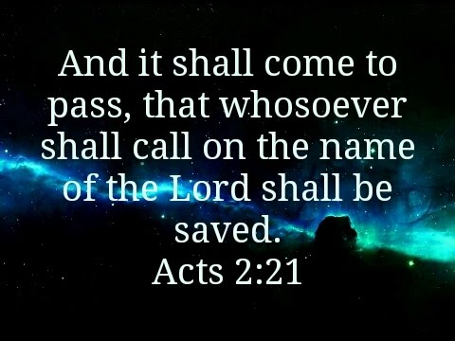

Slide 33
6. I WILL MAKE YOU CLEAN
MATTHEW 8:3

Slide 34
7. I WILL MAKE YOU FISHERS OF MEN
MATTHEW 4:19

Slide 35
REVELATION 21:4

Slide 37
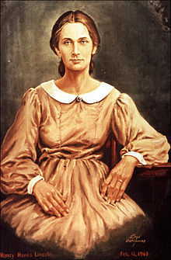
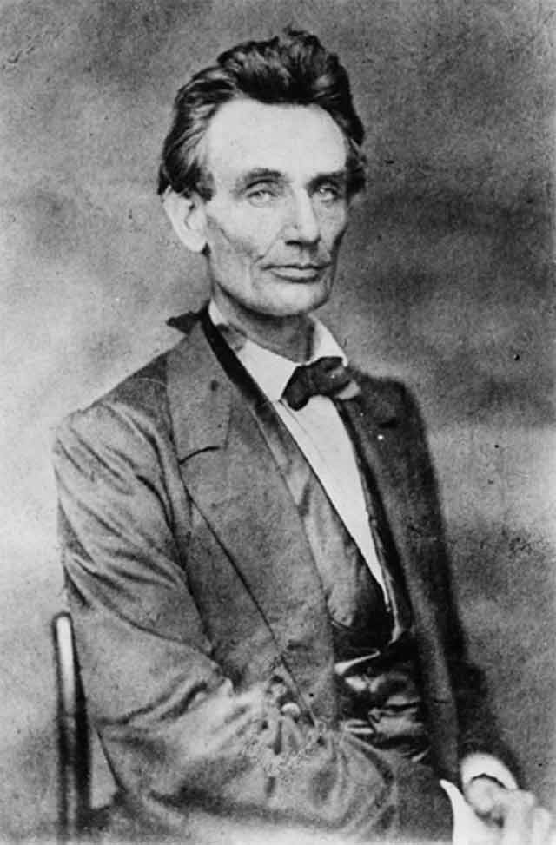

Slide 39
Live for Jesus... that's what matters and when other houses crumble mine is strong
Live for Jesus, that's what matters, that
you see the light in me and come along!

Slide 41
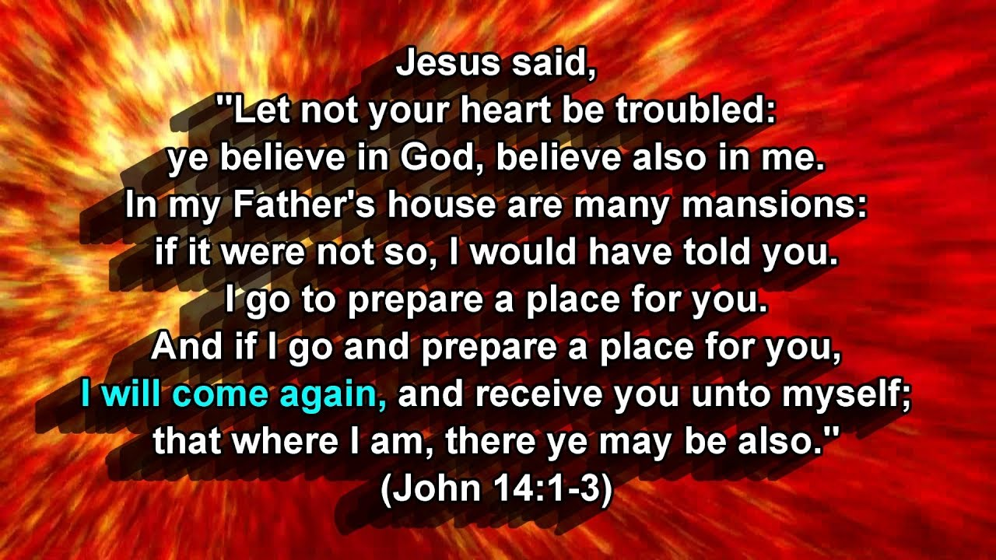

Slide 42
John 15:11

