Slide 1
2 Samuel 1:1-10

Slide 2
EVERYONE IS MOTIVATED
BY SOMETHING.

Slide 3
EVERYONE IS MOTIVATED
BY SOMETHING.
OUR MOTIVATIONS ULTIMATELY
EXPOSE SOMETHING FAR DEEPER…
OUR CHARACTER

Slide 4
REPUTATION
CHARACTER
CHRACTER IS MORE IMPORTANT THAN REPUTATION

Slide 5
When our character
and motivation are in sync
We live and serve through love, faith & obedience

Slide 6
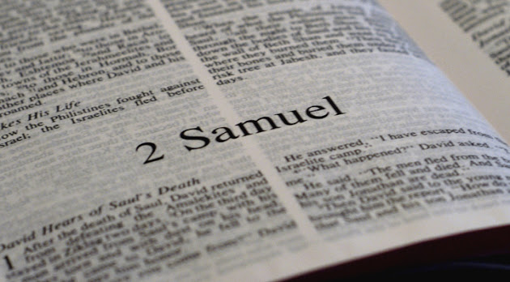

Slide 7
MOTIVES GIVE MEANING
TO OUR BEHAVIORS!
“Test me, Lord, and try me,
examine my heart and my mind.”
Psalm 26:2

Slide 9
“You desire but do not have, so you kill. You covet but you cannot get what you want, so you quarrel and fight. You do not have because you do not ask God. When you ask, you do not receive, because you ask with wrong motives, that you may spend what you get on your pleasures.”
James 4:2-3

Slide 10
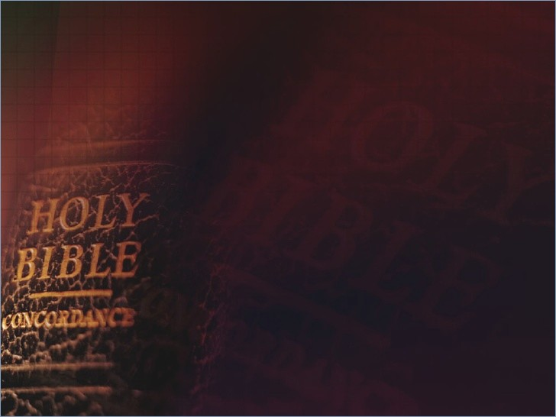
⁷ "Blessed is the man who trusts in the LORD, And whose hope is the LORD. ⁸ For he shall be like a tree planted by the waters, Which spreads out its roots by the river, And will not fear when heat comes; But its leaf will be
green, And will not be anxious in the year of drought,
Jeremiah 17:7-10

Slide 11
Nor will cease from yielding fruit. ⁹ "The heart is deceitful above all things, And desperately wicked; Who can know it? ¹⁰ I, the LORD, search the heart, I test the mind, Even to give every man according to his ways, According to the fruit of his doings.
Jeremiah 17:7-10

Slide 12
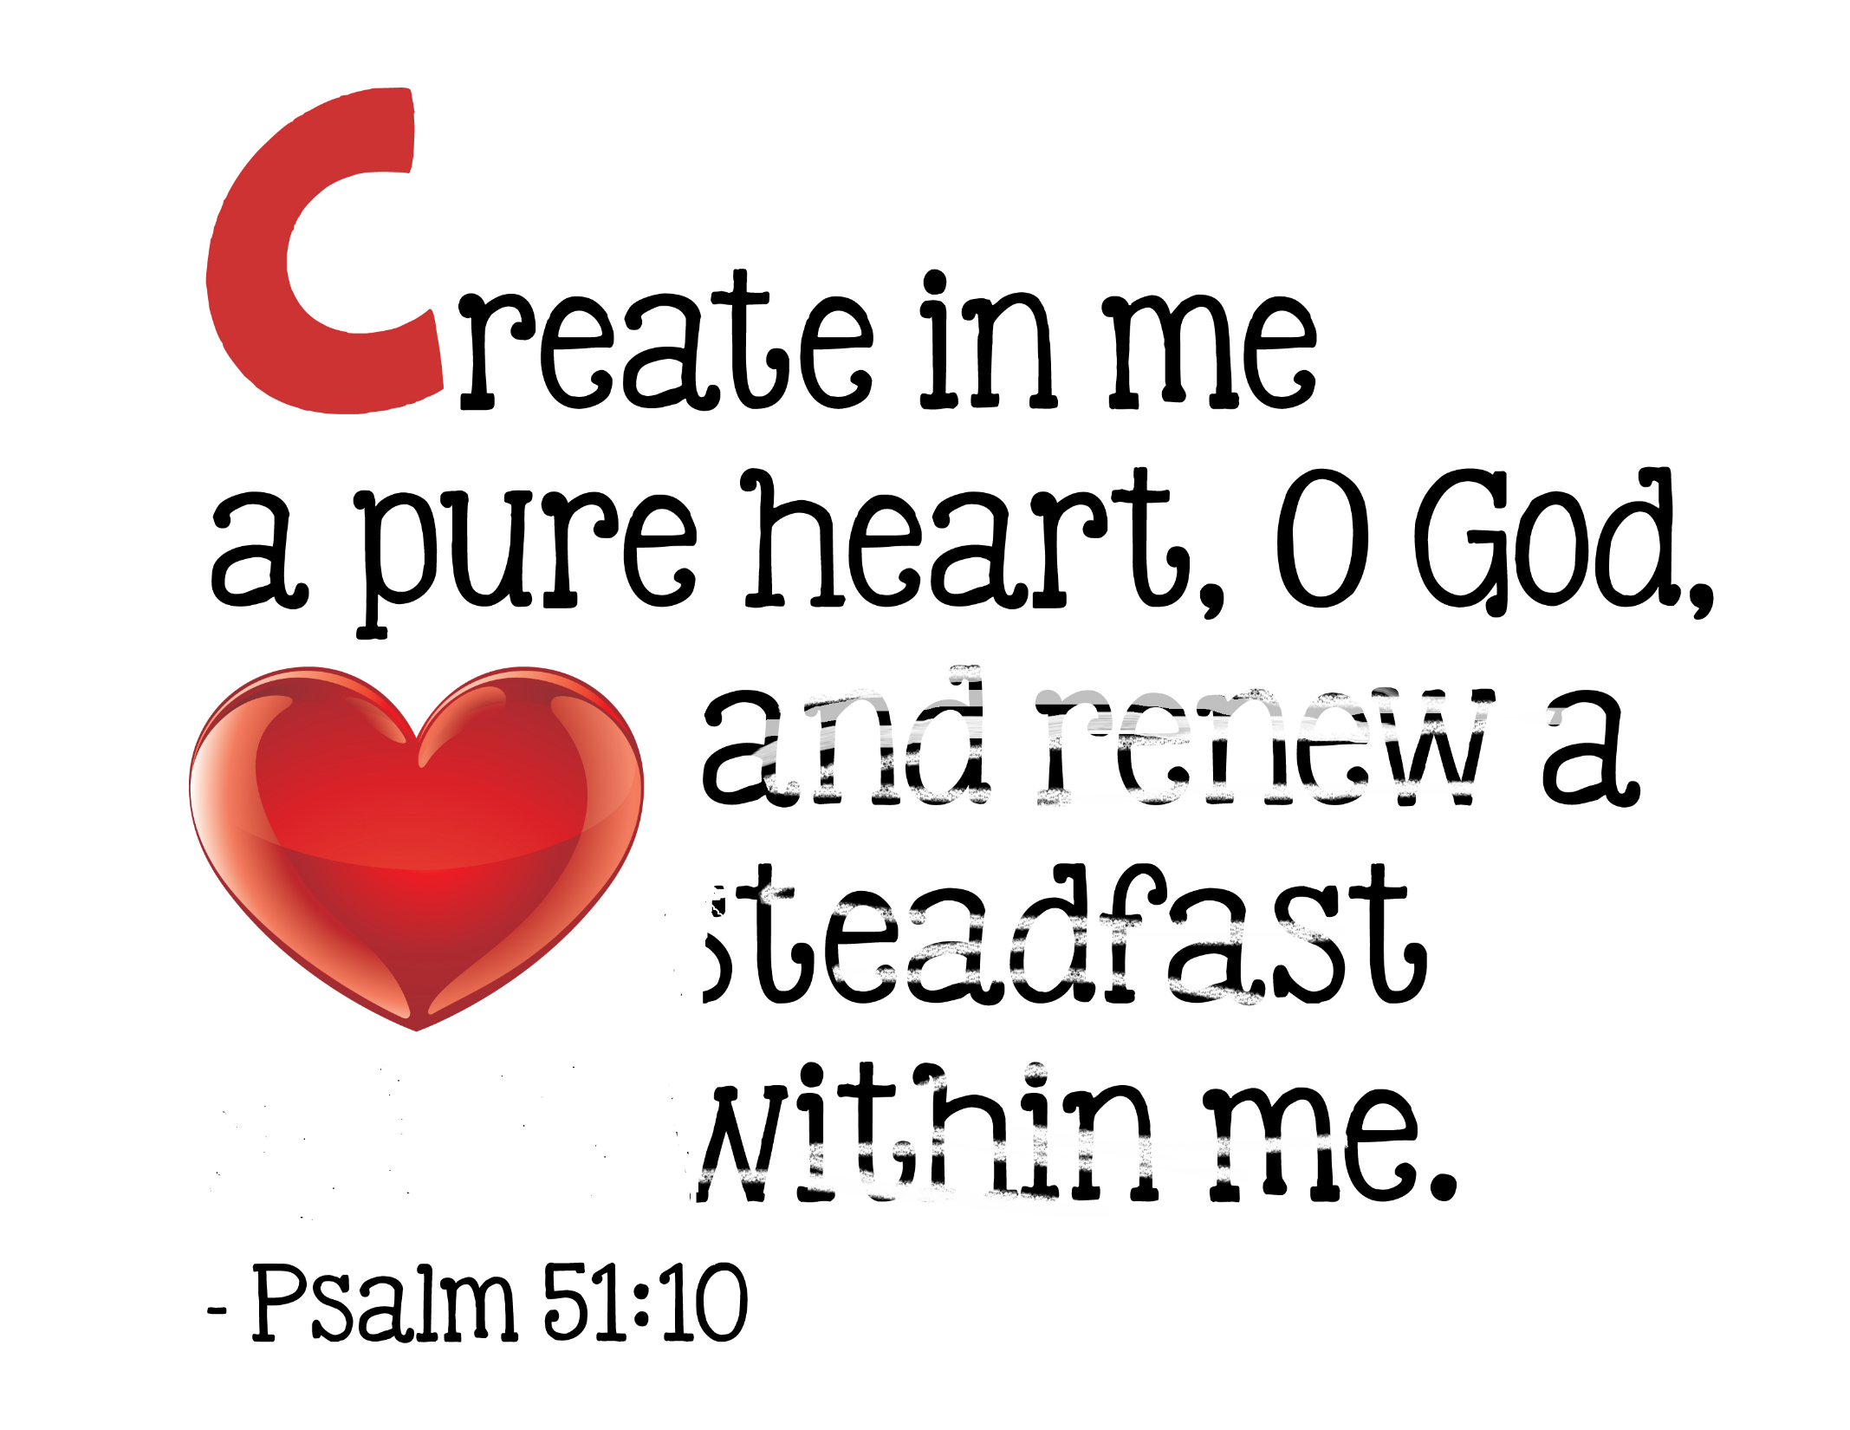
A CLEAN HEART

Slide 13
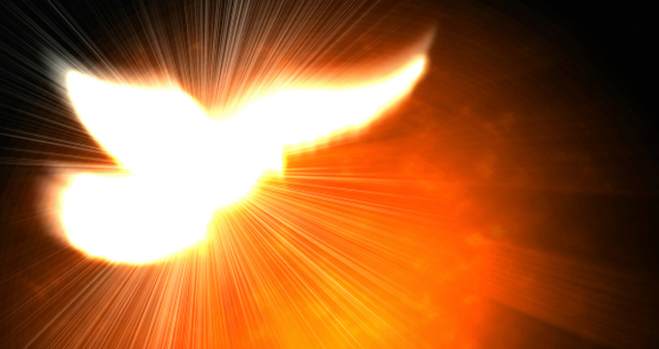
The Holy Spirit
a clean heart,
So that we not only make good
decisions, but we make those
decisions with the right motives.

Slide 14
The Holy Spirit
deals with not just what we do,
but why we do it.

Slide 15
Proverbs 23:7

Slide 16
The key to having
a clean heart is…
#1. Asking God to make
your heart clean.

Slide 17
Psalm 51:10
Today’s Living Bible
“Create in me a new, clean heart, O God, filled with clean thoughts and right desires”

Slide 18
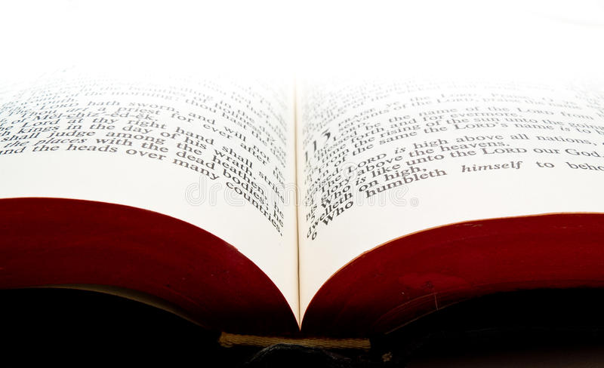
“Christ loves His bride, the church and gave Himself for her, that He might sanctify and cleanse her with the washing of water by the word. He did this to present her to himself as a glorious church without a spot or wrinkle or any other blemish. Instead, she will be holy and without fault.”
Ephesians 5:25-27

Slide 19
The key to having
a clean heart is…
#2. Obeying God by
spending time in the
Word of God.

Slide 20
“Blessed is the man who walks not in the counsel of the ungodly, nor stands in the path of sinners, nor sits in the seat of the scornful; but his delight is in the law of the Lord, and in His law he meditates day and night. He shall be like a tree planted by the rivers of water, that brings froth its fruit in is season, whose leaf also shall not wither; and whatever he does shall prosper.”
Psalm 1:1-3

Slide 22
The key to having
a clean heart is…
#3. Planting the Word
in our heart.

Slide 23
“How can a young man cleanse his way? By living according to your Word. With my whole heart I have sought You; Oh, let me not wander from your commandments! Your word I have hidden in my heart, that I might not sin against You. ”
Psalm 119:9

Slide 24
We act the way we do
because of who we are.
We want our motivations and
actions to match our character

Slide 25
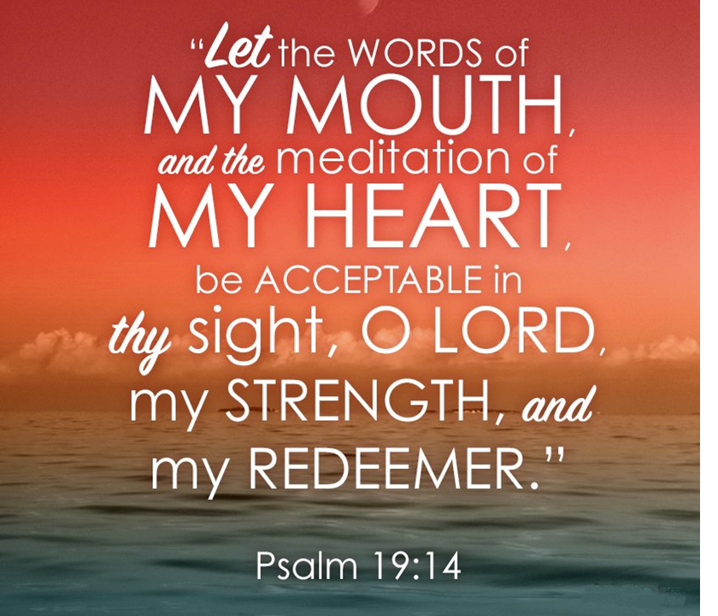

Slide 26
“Beware of practicing your righteousness before other people in order to be seen by them, for then you will have no reward from your Father who is in heaven. “Thus, when you give to the needy, sound no trumpet before you, as the hypocrites do in the synagogues and in the streets, that they may be praised by others.
Matthew 6:1-4

Slide 27
Truly, I say to you, they have received their reward. But when you give to the needy, do not let your left hand know what your right hand is doing, so that your giving may be in secret. And your Father who sees in secret will reward you. “And when you pray, you must not be like the hypocrites.
Matthew 6:1-4

Slide 28
For they love to stand and pray in the synagogues and at the street corners, that they may be seen by others.
Truly, I say to you, they have
received their reward.
Matthew 6:1-4

Slide 29
What motivates you
to do what you do?
They have received
Their reward.

Slide 30
What motivates you
to do what you do?
They loved the praises of men
They desired honor
and attention.

Slide 31
⁴⁰ And Jesus answering said to him, “Simon, I have something to say to you.” And he answered, “Say it, Teacher.” ⁴¹ “A certain moneylender had two debtors. One owed five hundred denarii, and the other fifty. ⁴² When they could not pay, he cancelled the debt of both. Now which of them will love him more?”
Luke 7:40-47 ESV

Slide 32
⁴³ Simon answered, “The one, I suppose, for whom he cancelled the larger debt.” And he said to him, “You have judged rightly.” ⁴⁴ Then turning toward the woman he said to Simon, “Do you see this woman? I entered your house; you gave me no water for my feet, but she has wet my feet with her tears and wiped them with her hair.
Luke 7:40-47 ESV

Slide 33
⁴⁵ You gave me no kiss, but from the time I came in she has not ceased to kiss my feet. ⁴⁶ You did not anoint my head with oil, but she has anointed my feet with ointment. ⁴⁷ Therefore I tell you, her sins, which are many, are forgiven—for she loved much. But he who is forgiven little, loves little.”
Luke 7:40-47 ESV

Slide 34
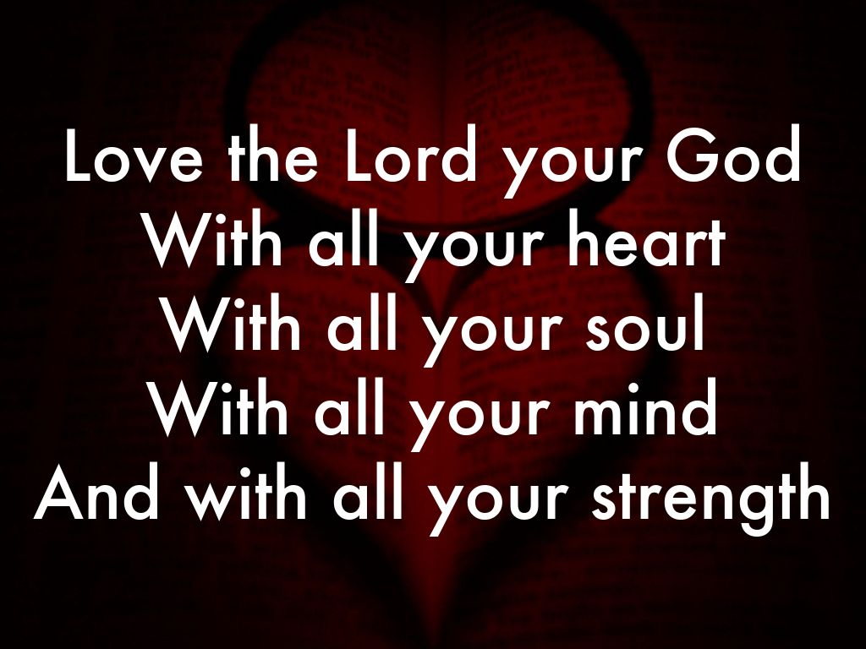
MARK 12:30

