Slide 1
PRELUDE: START 3 MINUTES BEFORE SERVICE BEGINS
https://www.youtube.com/watch?v=-jABcYKhDrI
JOEY+RORY – JESUS LOVES ME (LIVE)

Slide 2
Romans 1:16

Slide 3
MARK 16:9-12

Slide 6
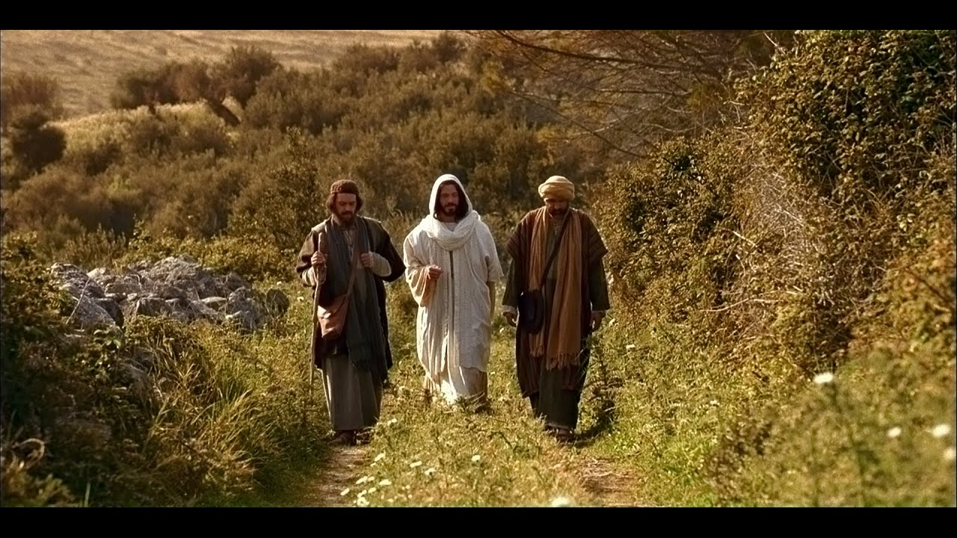
MARK 16:12-13 / LUKE 24:36-43

Slide 7
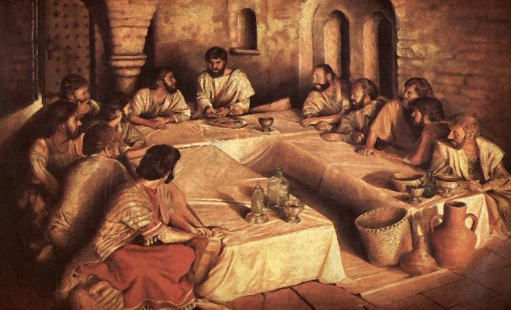

Slide 10
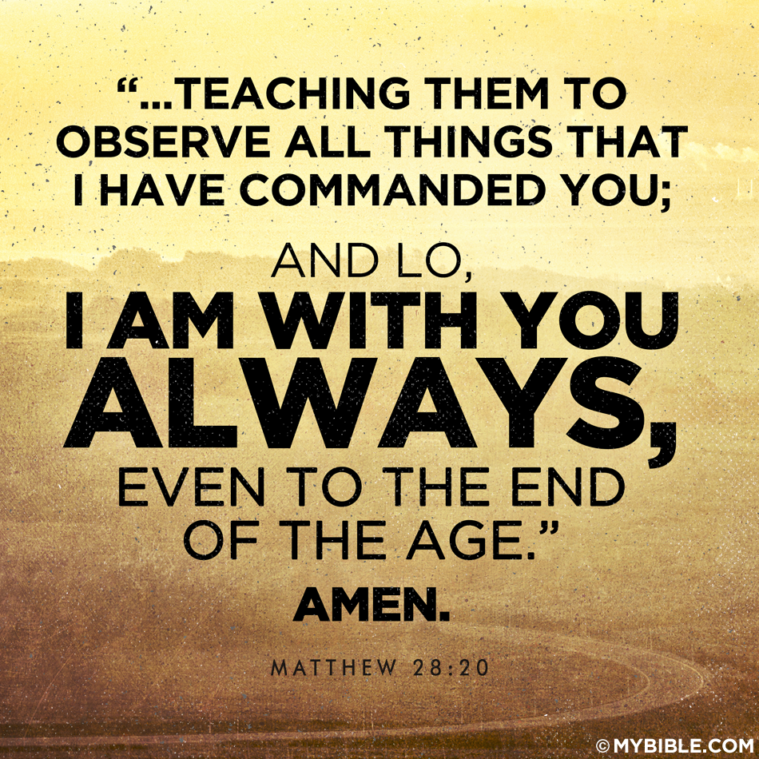

Slide 13
Exalting
Jesus
Lord
as
#1 PREACH THE GOSPEL

Slide 15
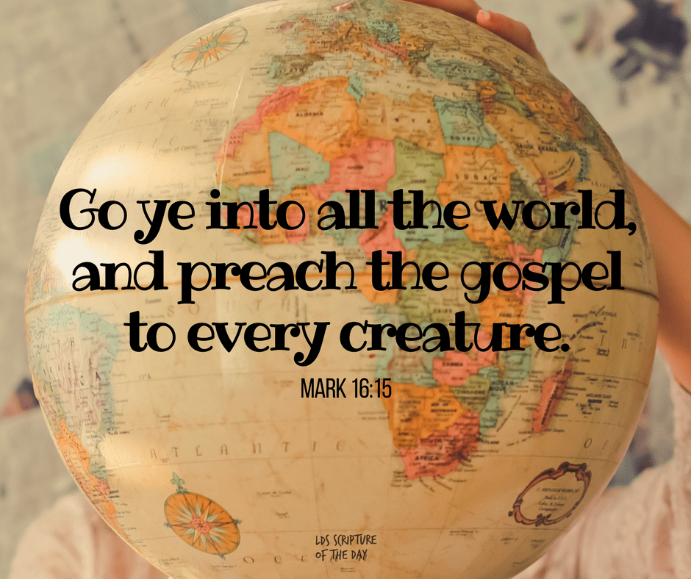
The missional priority of the church

Slide 17
#1 PREACH THE GOSPEL
The missional priority of the church

Slide 18
#2

Slide 19
#3
IS ABOUT GOD!

Slide 21
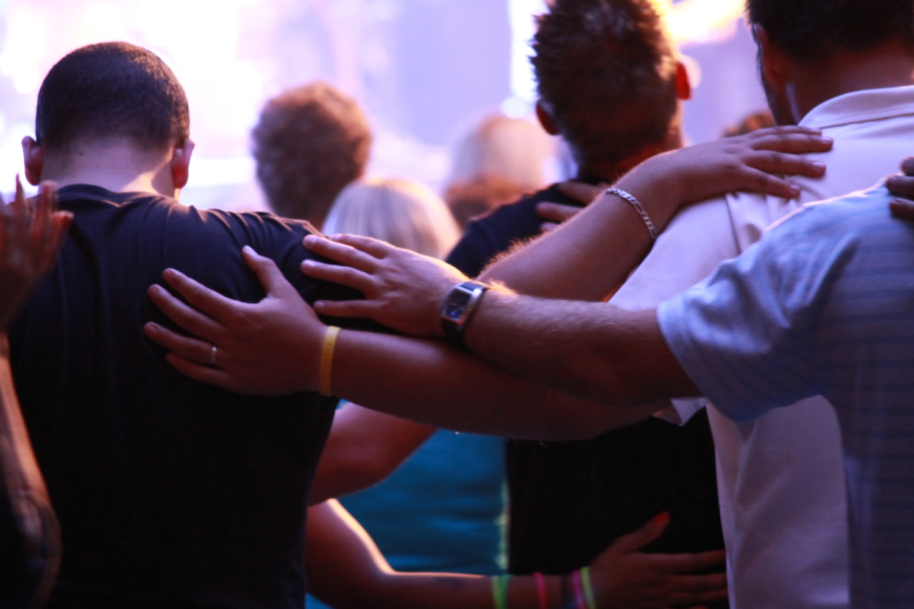
PRAYING TOGETHER

Slide 22
WHAT PLEASES GOD

Slide 23
MARK 16:16

Slide 25
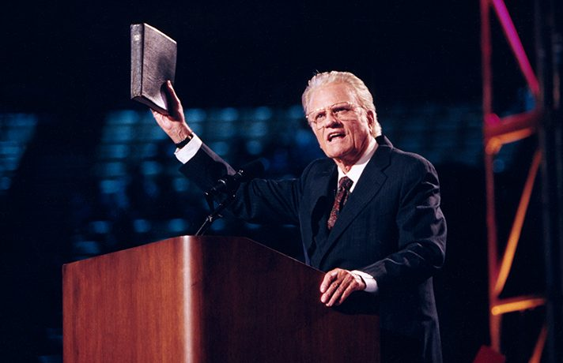
They preached the Gospel

Slide 26
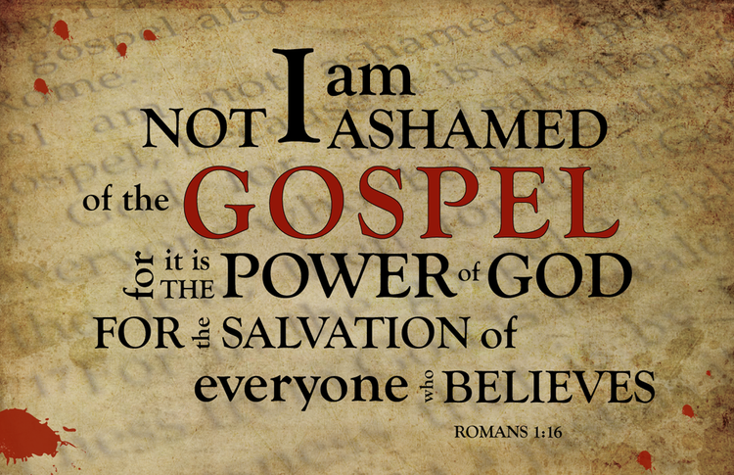

Slide 28
What the Gospel is…
The gospel in the New Testament is the gospel about Jesus,
His person, who He is, His work, what He has done.

Slide 29
The gospel is a clearly defined message.

Slide 30
There’s power in the gospel.

Slide 31
It’s about Jesus who was born according to the Scriptures and who lived a sinless life and preached that the kingdom of God was at hand.

Slide 32
It’s about the ONE who died an atoning death on the cross for our transgressions against a holy God.
Who for our righteousness God raised Him from the dead and carried Him in glory to heaven for His coronation as our King and for His installation as our great High Priest.

Slide 33
It’s about the ONE who ministers and intercedes for us each and every one of us. About the one who will
come again at the end of history to bring the fullness of His kingdom, which is already present, but will not be completely manifested and consummated until His return.

Slide 34
It’s about getting ready,
Jesus is coming again!

Slide 35
I doubt very much if there are five percent of ordained ministers in this country who believe that the gospel is the power of God for salvation.

Slide 36
The Gospel is called the ‘good news’ because it addresses the most serious problem that you and I have as human beings.

Slide 37
The good news of the
Gospel is that Jesus lived a
life of perfect righteousness,
of perfect obedience to God,
not for His own well being
but for His people. He has
done for me what I couldn’t possibly do for myself. But not only has He lived that life of perfect obedience, He offered Himself as a perfect sacrifice to satisfy the justice and the righteousness of God.

Slide 38
The only way you can receive the benefit of Christ’s life and death is
by putting your trust in Him.

Slide 39
It is a glorious gospel
of good news
to all who embrace it.

