Slide 1
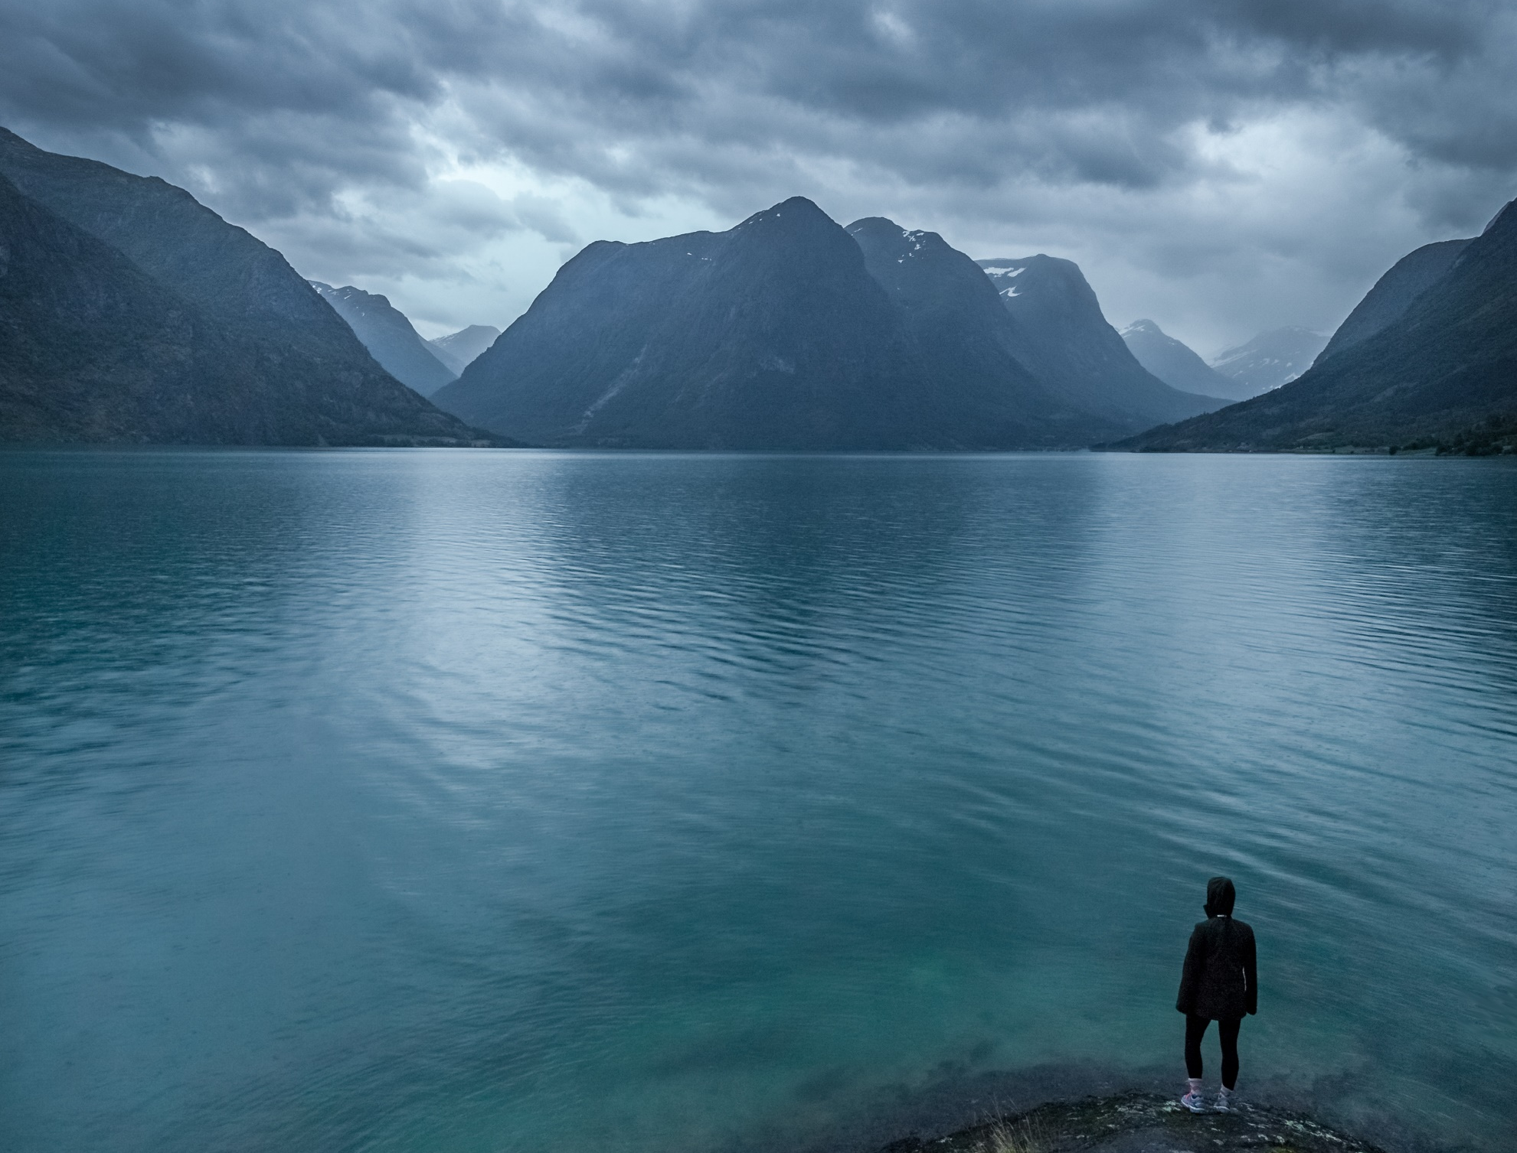
MY COMFORTER
2 Corinthians 1:3-11

Slide 2
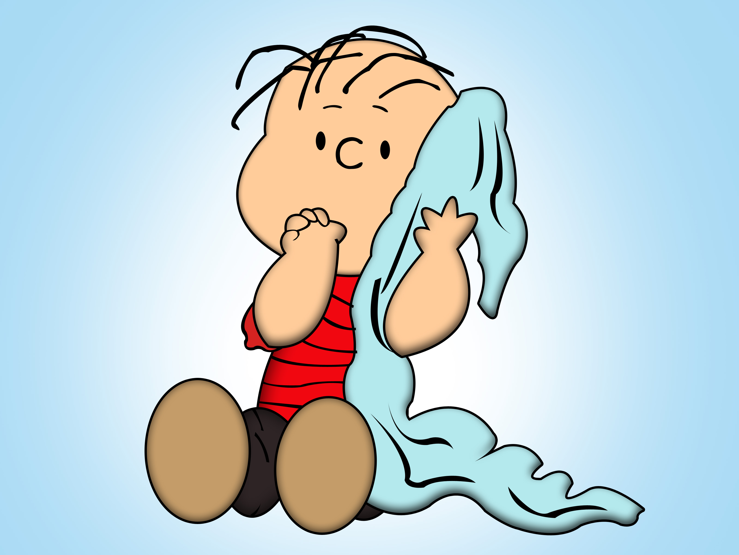
WE ALL NEED COMFORT AT SOME POINT!

Slide 3
2 Corinthians 1:3-4 (NKJV) ³ Blessed be the God and Father of our Lord Jesus Christ, the Father of mercies and God of all comfort, ⁴ who comforts us in all our tribulation, that we may be able to comfort those who are in any trouble, with the comfort with which we ourselves are comforted by God.
Greek word
“thlipsis”
{pressure, compression, distress)

Slide 4
2 Corinthians 1:3-4 (NKJV) ³ Blessed be the God and Father of our Lord Jesus Christ, the Father of mercies and God of all comfort, ⁴ who comforts us in all our tribulation, that we may be able to comfort those who are in any trouble, with the comfort with which we ourselves are comforted by God.
Greek word
“parakaleo”
{comforts, consoles, provides for )

Slide 6
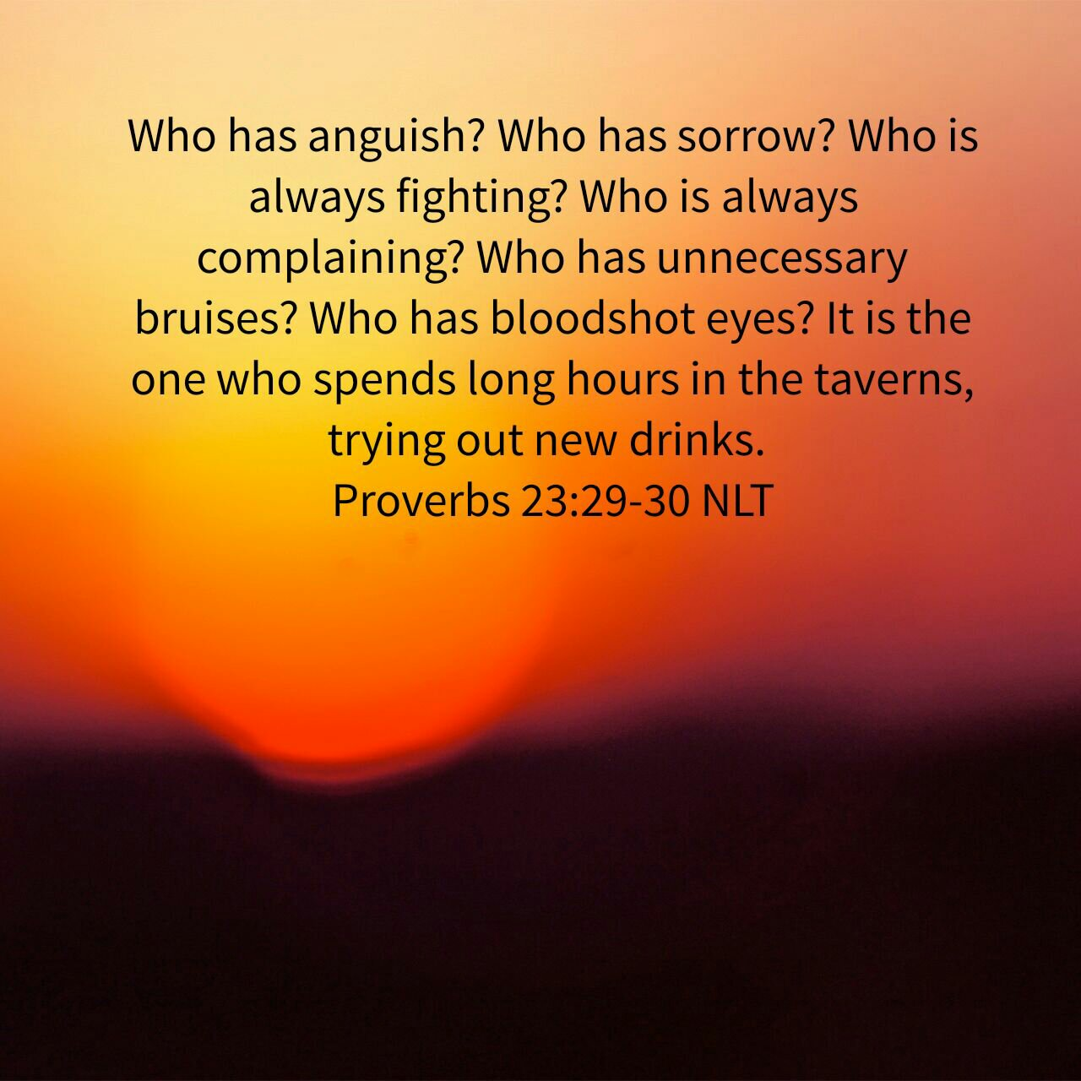

Slide 8
Blessed be the God and Father of our Lord Jesus Christ, the Father of mercies and God of all comfort, who comforts us in all our tribulation.
2 Corinthians.
1:3-4

Slide 9
GROWTH SELDOM
COMES IN THE
COMFORT SEASONS
OF LIFE!

Slide 10
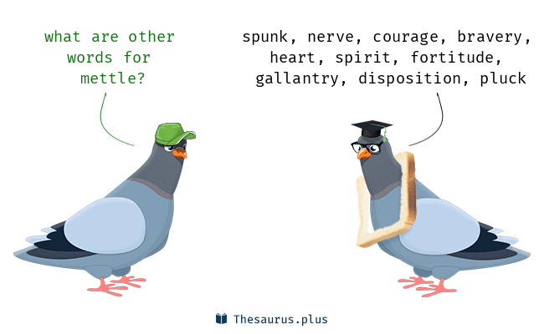
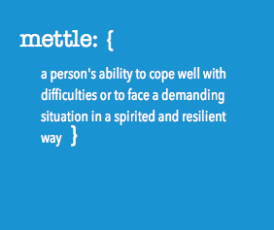
mettle
Mettle is the courage to carry on.
If someone wants to "test your mettle," they want to see if you have the heart to follow through when the going gets tough.

Slide 11
2 Corinthians 11:24-31
“Of the Jews five times received I forty stripes save one. Thrice was I beaten with rods, once was I stoned, thrice I suffered shipwreck, a night and a day I have been in the deep; in journeyings often, in perils of waters, in perils of robbers, in perils by mine own countrymen, in perils by the heathen, in perils in the city, in perils in the wilderness, in perils in the sea, in perils among false brethren;

Slide 12
2 Corinthians 11:24-31
in weariness and painfulness, in watchings often, in hunger and thirst, in fastings often, in cold and nakedness. Beside those things that are without, that which cometh upon me daily, the care of all the churches. Who is weak, and I am not weak? who is offended, and I burn not? If I must needs glory, I will glory of the things which concern mine infirmities. The God and Father of our Lord Jesus Christ, which is blessed for evermore, knoweth that I lie not.” .

Slide 14
³⁶ Some were jeered at, and their backs were cut open with whips. Others were chained in prisons. ³⁷ Some died by stoning, some were sawed in half, and others were killed with the sword. Some went about wearing skins of sheep and goats, destitute and oppressed and mistreated. ³⁸ They were too good for this world,
wandering over deserts and
mountains, hiding in caves and holes in the ground.
Hebrews
11:36-38

Slide 19
How do we comfort others?

Slide 20
Share God’s Word

Slide 21
³⁶ Some were jeered at, and their backs were cut open with whips. Others were chained in prisons. ³⁷ Some died by stoning, some were sawed in half, and others were killed with the sword. Some went about wearing skins of sheep and goats, destitute and oppressed and mistreated. ³⁸ They were too good for this world,
wandering over deserts and
mountains, hiding in caves and holes in the ground.
Hebrews
11:36-38

Slide 23
Pray for them!

Slide 25
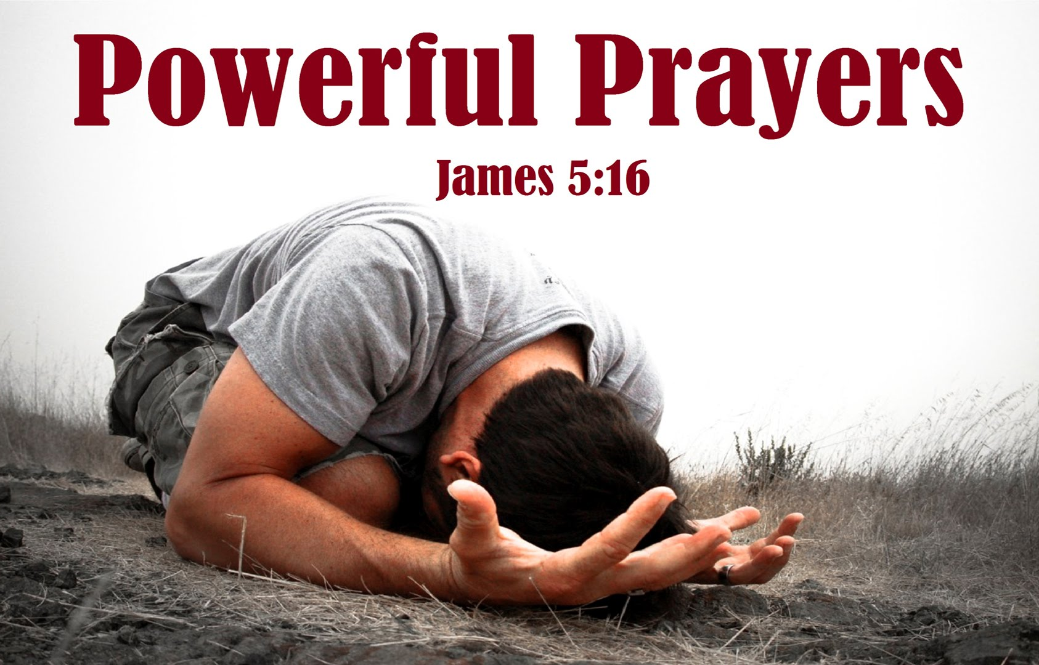

Slide 26
Share resources that have
comforted you.

Slide 29
Share from your
personal experience

Slide 30
We’ve come to understand the power of God, not through the absence of suffering, but through the pain of suffering.

Slide 31
LET ME SAY IT AGAIN, PRAY!

Slide 32
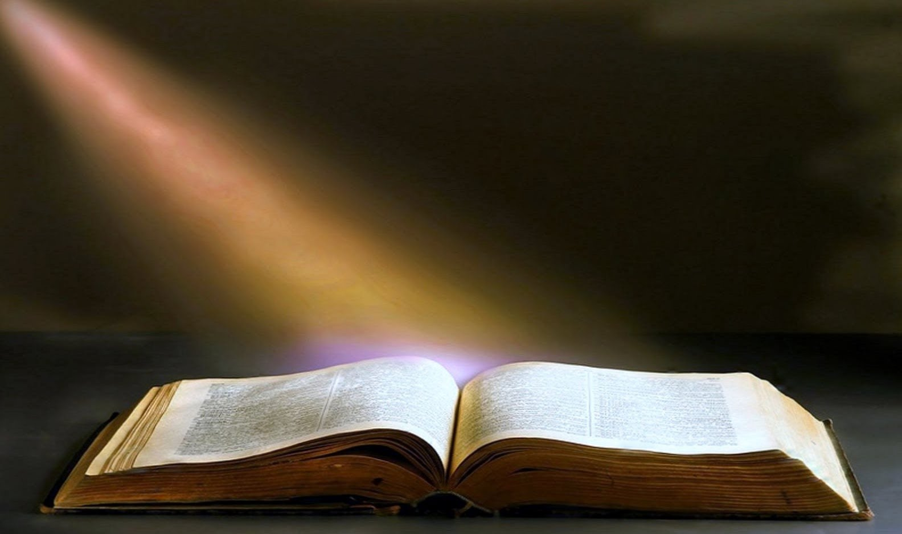
It is NO Secret
what God can do.
What He’s done for others,
He’ll do for you.

Slide 33
I’m asking you to PRAY.
I’m ask you to SHARE.
I asking you to COMFORT others
with the comfort you received.

