Slide 1
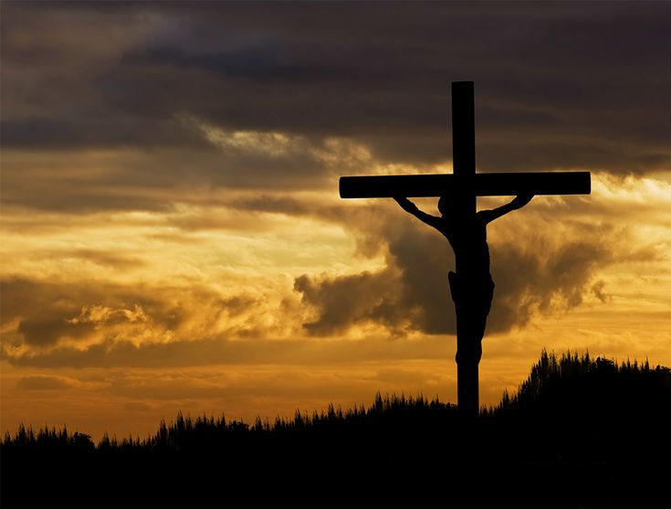
Remembering His Sacrifice
1 Corinthians 15:1-5

Slide 3
Remember

Slide 5
Remember
Reflect

Slide 6
Remember
Reflect
Recommit

Slide 9
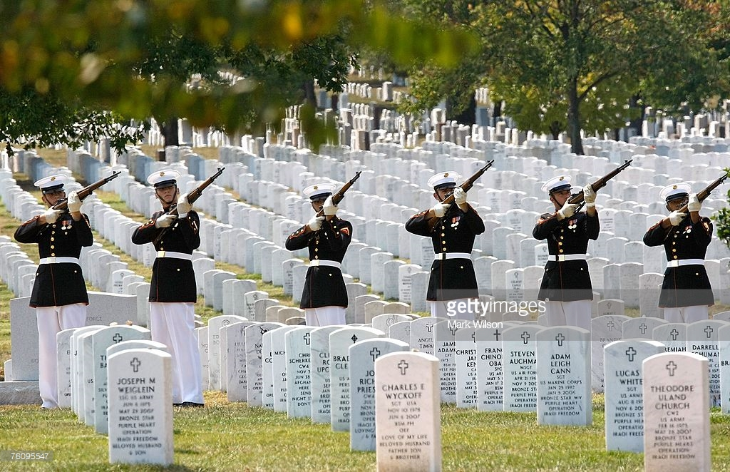
Arlington National Cemetery

Slide 10
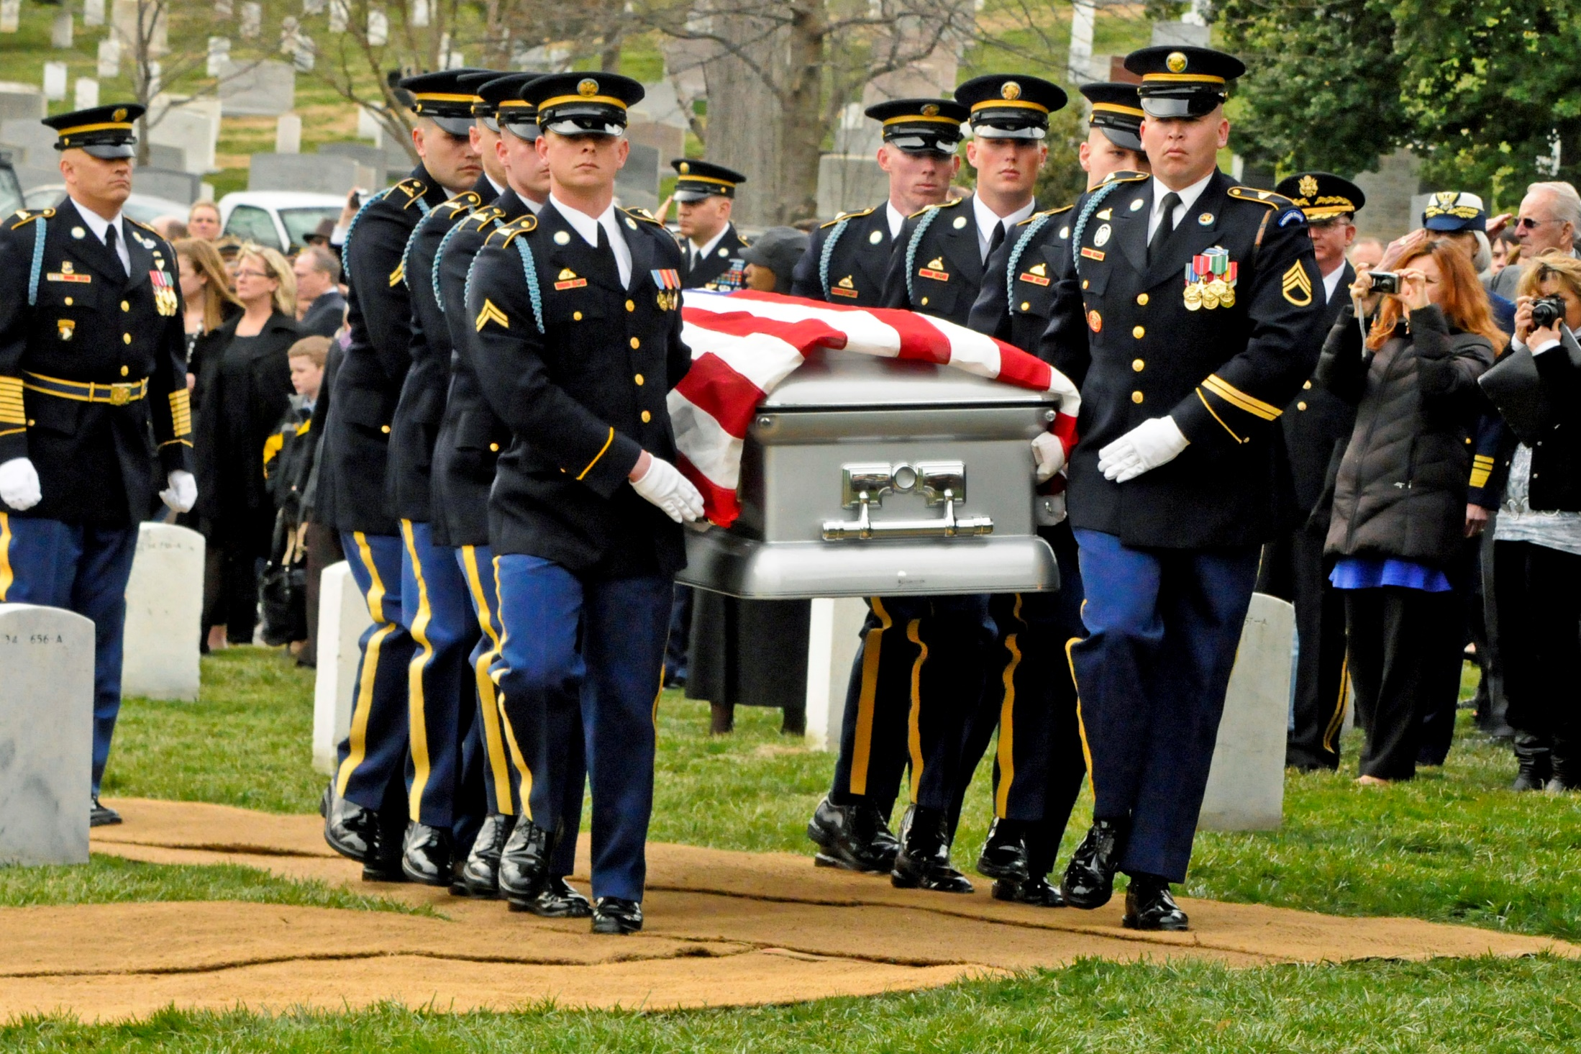
Arlington National

Slide 11
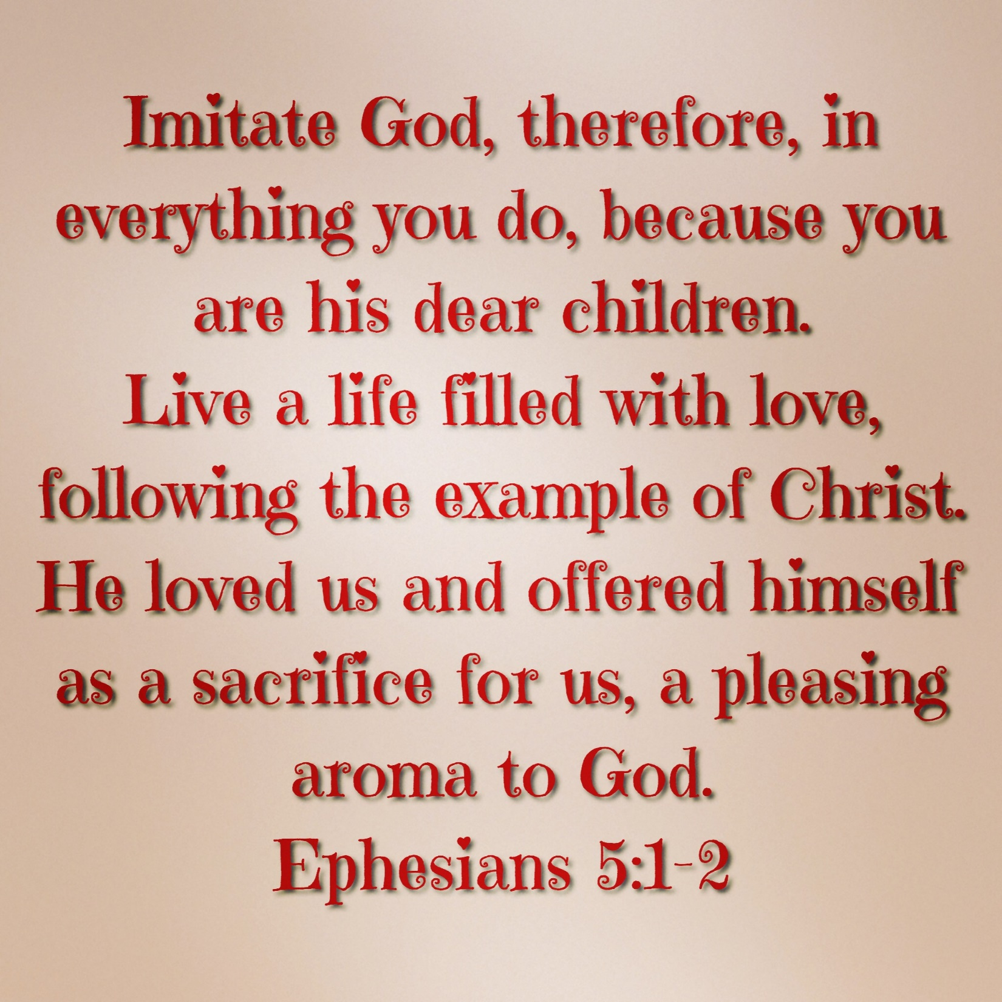

Slide 14
Lord, help us to remember!

