Slide 1
The New

Slide 12
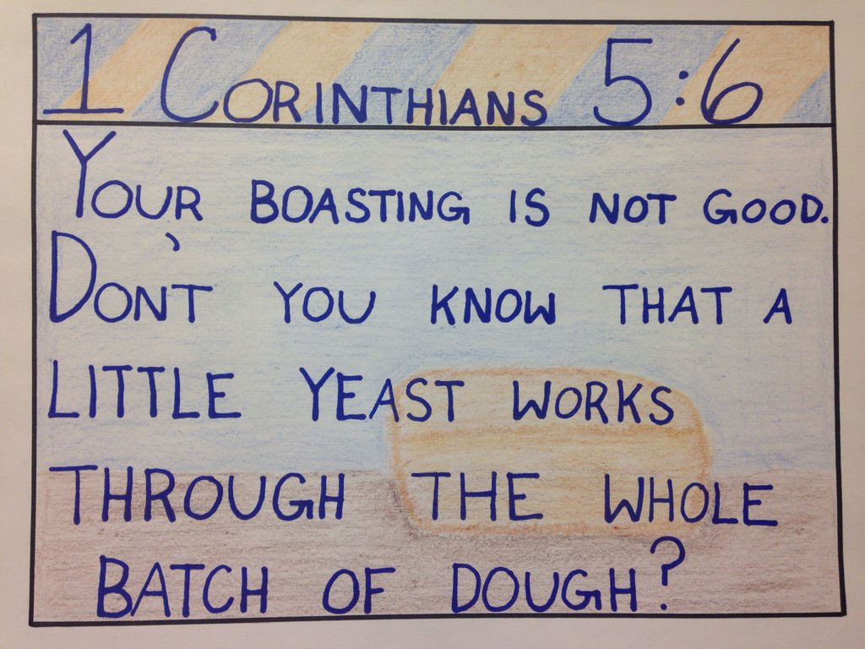

Slide 16
1 Corinthians 6:18 NLT

Slide 18
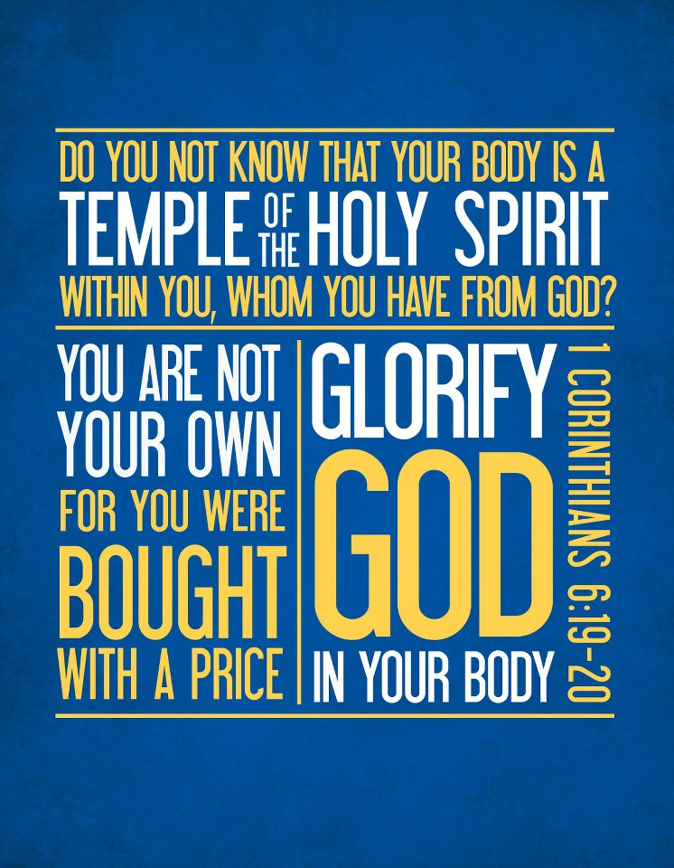
HOW DO I GLORIFY
WITH MY BODY?

Slide 19
HOW DO I GLORIFY
WITH MY BODY?

Slide 21
You are always in a temple,
so always worship.

Slide 22
You are always in a temple,
so always worship.
Remember
Your God Given Value

Slide 23
1 Timothy 2:8-9 (God’s Word)
Clothe your bodies in ways that honor God. Use your bodies in ways that demonstrate your understanding of their spiritual purpose. Give your body the same value that God gives them. Don’t cheapen the temple by dressing it for sensual purposes. Listen to Paul’s council to those with Timothy at Ephesus:

Slide 24
1 Timothy 2:8-9 (God’s Word)
⁸ I want men to offer prayers everywhere. They should raise their hands in prayer after putting aside their anger and any quarrels they have with anyone. ⁹ I want women to show their beauty by dressing in appropriate clothes that are modest and respectable. Their beauty will be shown by what they do, not by their hair styles or the gold jewelry, pearls, or expensive clothes they wear.

Slide 25
You are always in a temple,
so always worship.
Remember
Your God Given Value
Your Body is an instrument
to glorify God by being a
Blessing to others.

Slide 26
I will glorify God with my body!

