Slide 1
Luke 22:14-20 ¹⁴ When the hour had come, He sat down, and the twelve apostles with Him. ¹⁵ Then He said to them, "With fervent desire I have desired to eat this Passover with you before I suffer; ¹⁶ for I say to you, I will no longer eat of it until it is fulfilled in the kingdom of God." ¹⁷ Then He took the cup, and gave thanks, and said, "Take this and divide it among yourselves; ¹⁸ for I say to you, I will not drink of the fruit of the vine until the kingdom of God comes." ¹⁹ And He took bread, gave thanks and broke it, and gave it to them, saying, "This is My body which is given for you; do this in remembrance of Me." ²⁰ Likewise He also took the cup after supper, saying, "This cup is the new covenant in My blood, which is shed for you.

Slide 2
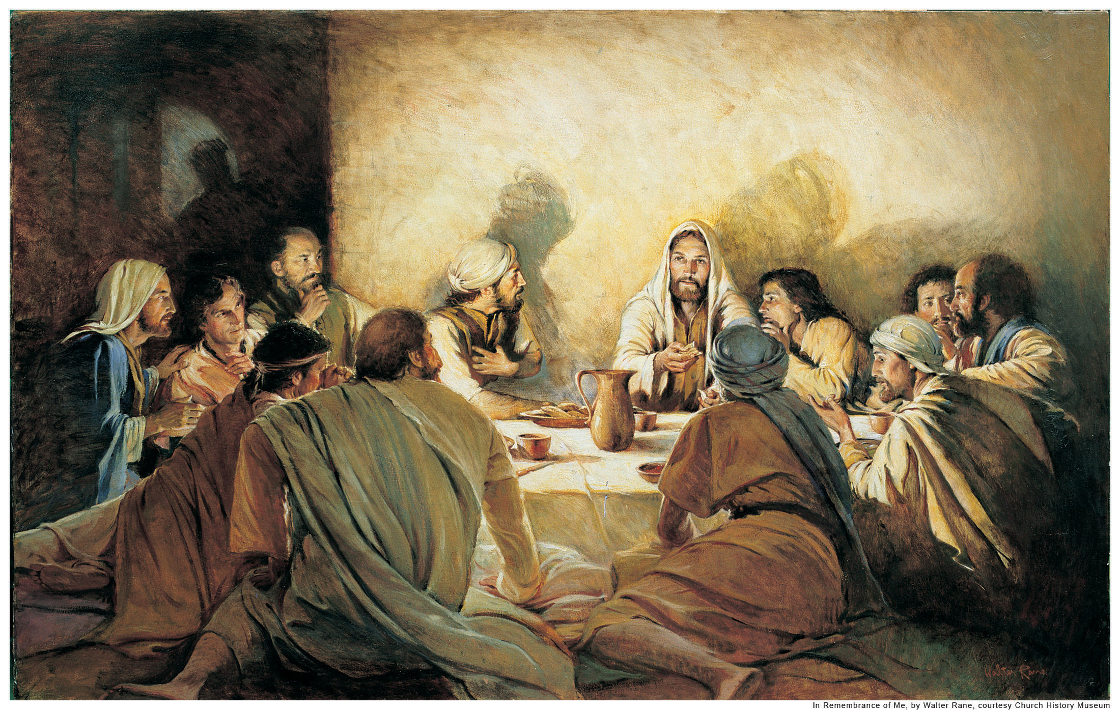

Slide 3
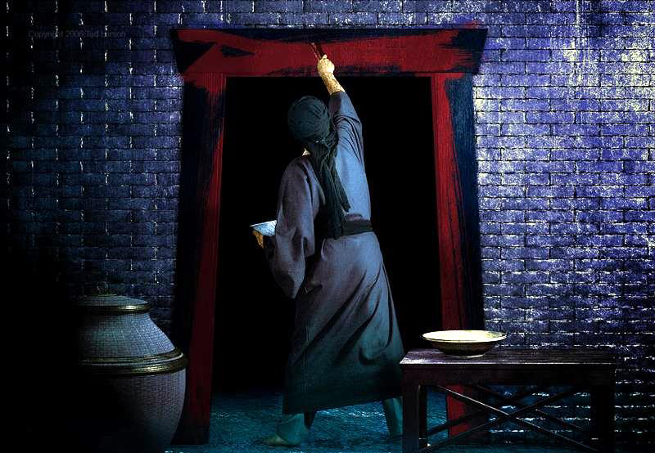

Slide 5
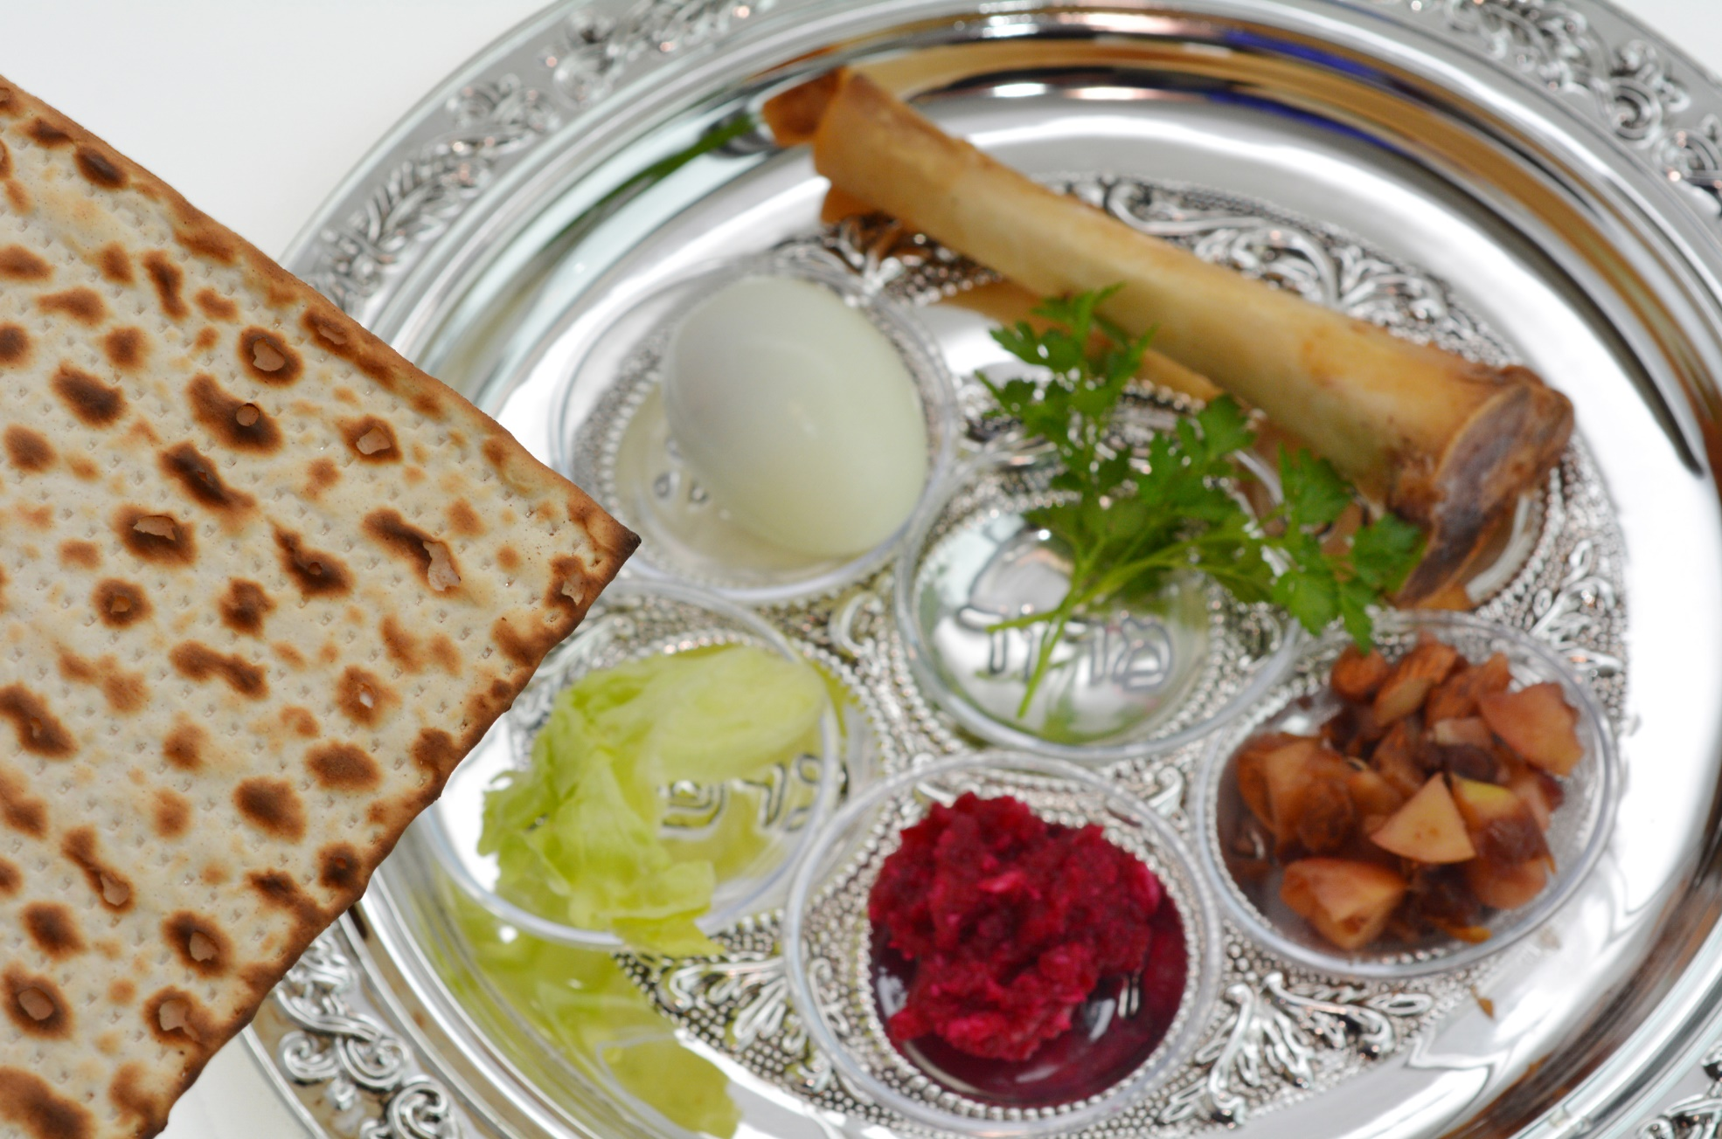
THE PASSOVER MEAL

Slide 7
THE PASSOVER MEAL

Slide 8
SANCTIFICATION – JUDGMENT – REDEMPTION - PRAISE

Slide 9
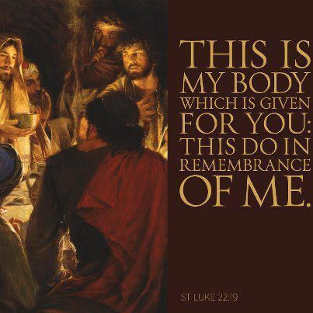
LUKE 22:9

Slide 10
Matthew 26, Mark 14, Luke 22, John 13

Slide 12
LUKE CHAPTER
TWENTY-TWO

Slide 14
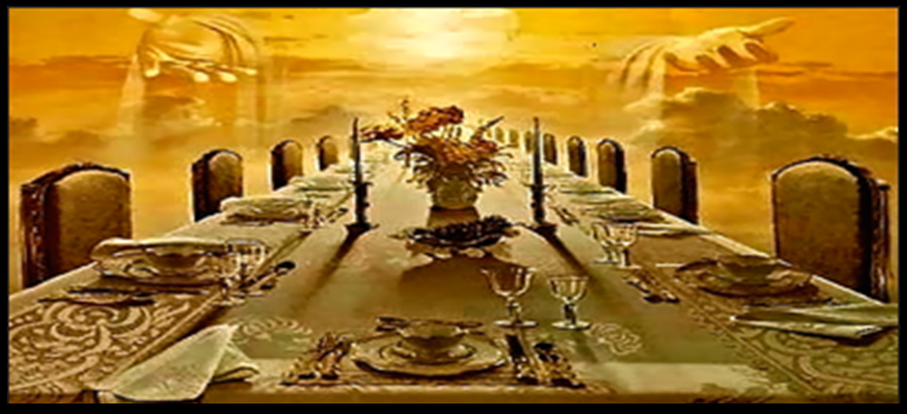
Revelation 19:9 (NKJV) ⁹ Then he said to me, "Write: 'Blessed are those who are called to the marriage supper of the Lamb!' " And he said to me, "These are the true sayings of God."

Slide 16
HEBREWS 12:2

Slide 17
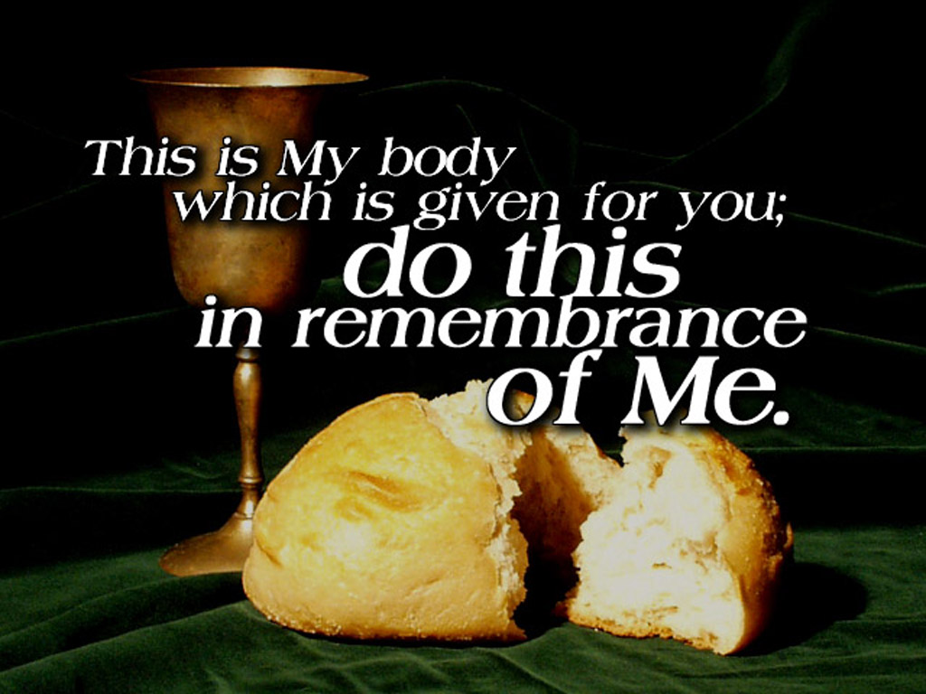

Slide 18
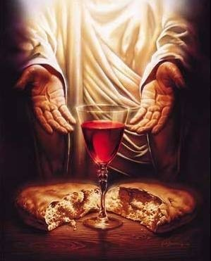
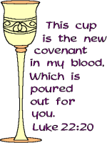

Slide 19
Eucharist
From Greek eukharistia "thanksgiving, gratitude," later "the Lord's Supper," from eukharistos "grateful."

Slide 20
1
11

Slide 22
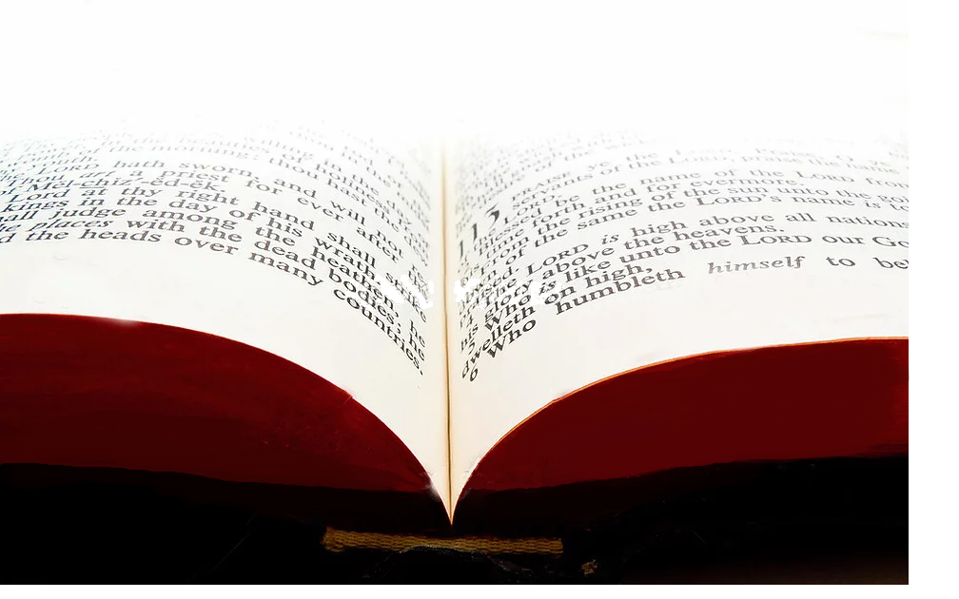
¹⁷ Now in giving these instructions I do not praise you, since you come together not for the better but for the worse. ¹⁸ For first of all, when you come together as a church, I hear that there are divisions among you, and in part I believe it. ¹⁹ For there must also be factions among you, that those who are approved may be recognized among you.
1 Corinthians 11:17-19 (NKJV)

Slide 23
“You call me Teacher and Lord, and you say well, for so I am. If I then, your Lord and Teacher, have washed your feet, you also ought to wash one another’s feet. For I have given you an example, that you should do as I have done to you. Most assuredly, I say to you, a servant is not greater than his master; nor is he who is sent greater than he who sent him. If you know these things, blessed are you if you do them.”
John 13:13-17

Slide 24
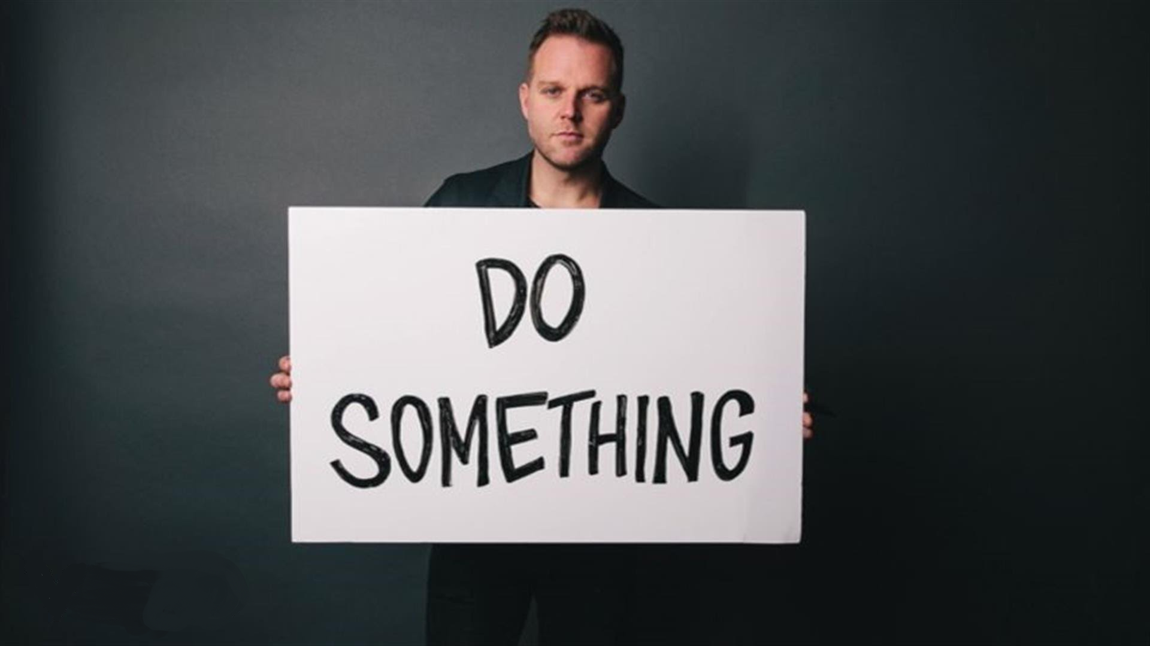

Slide 25
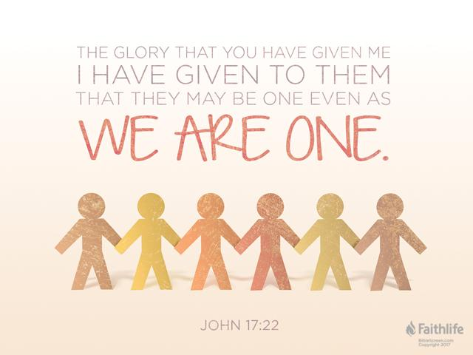
JOHN 17:22

Slide 26
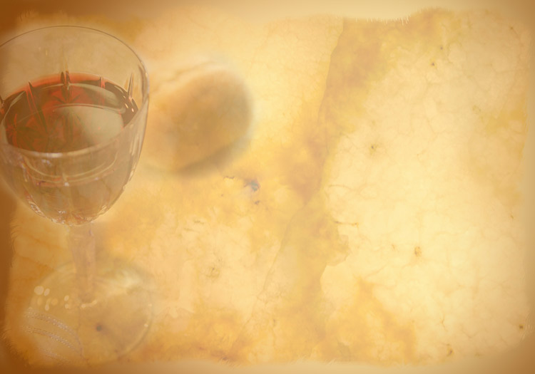
What are we to remember?

Slide 27
“I consider my life of no value to myself; my purpose is to finish my course and the ministry I received form the Lord Jesus, to testify to the gospel of God’s grace.”
Acts 20:24

Slide 28
We are re-telling the truth of the Gospel through the use of the elements in the supper.

Slide 29
What you must solemnly realize is that every time you eat this bread and every time you drink this cup, you reenact in your words and actions the death of the Master. You will be drawn back to this meal again and again until the Master returns. You must never let familiarity breed contempt.
1 Corinthians 11:26-28 MSG

Slide 30
Anyone who eats the bread or drinks the cup of the Master irreverently is like part of the crowd that jeered and spit on him at his death. Is that the kind of “remembrance” you want to be part of? Examine your motives, test your heart, come to this meal in holy awe.
1 Corinthians 11:26-28 MSG

Slide 31
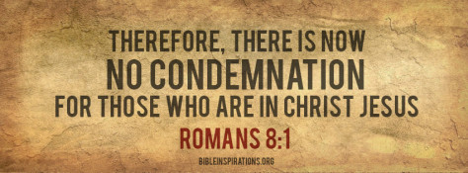

Slide 34
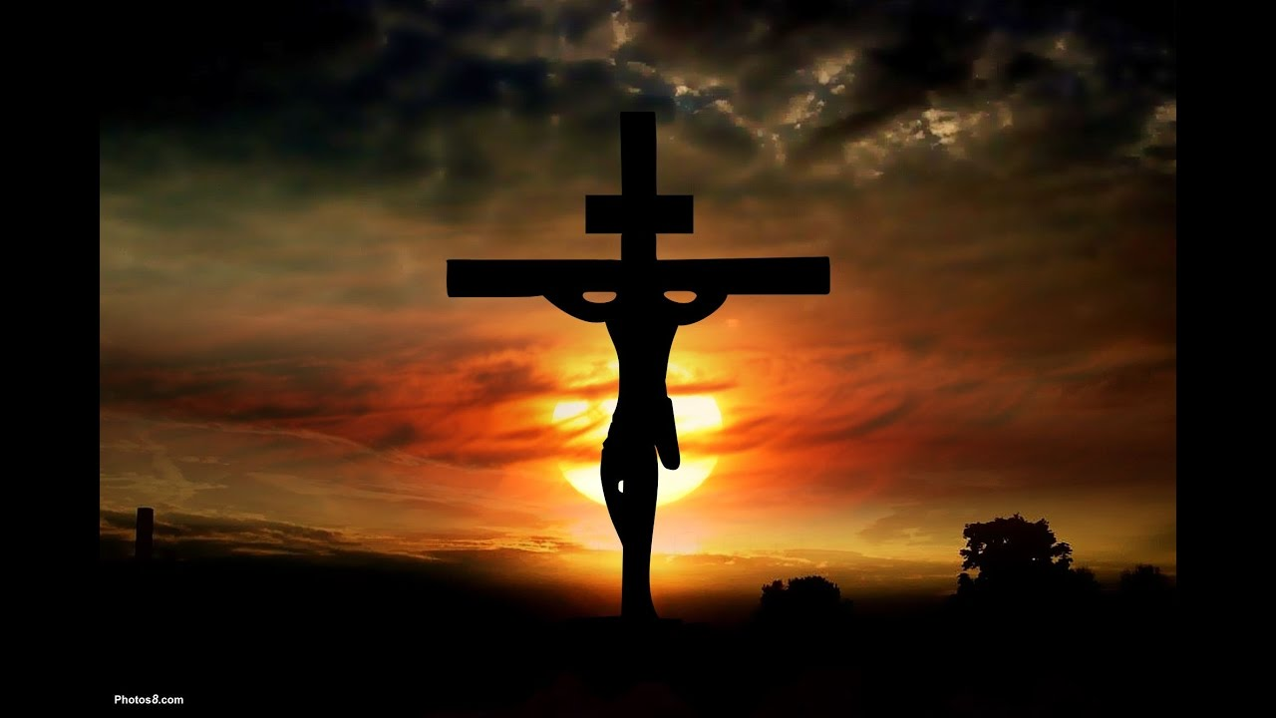
Ask not, what has Jesus done for me,
ask what can I do for JESUS?

