Slide 1
HOW MUCH DID JESUS VALUE
Acts 16

Slide 3
LOST REVENUE
MARK 5

Slide 4
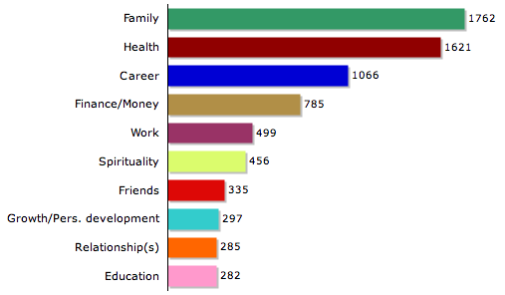
What people value most
hat it is that people value. Here are the Top Ten:

Slide 8
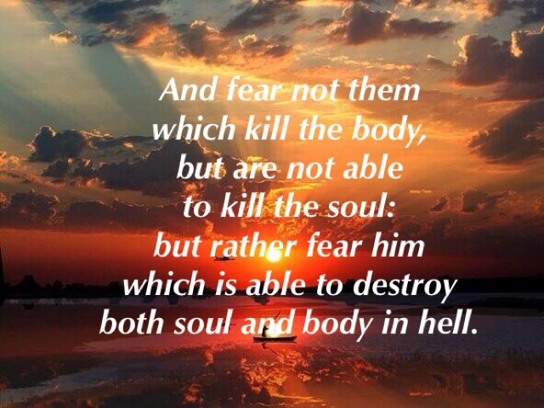
Matthew 10:28

Slide 9
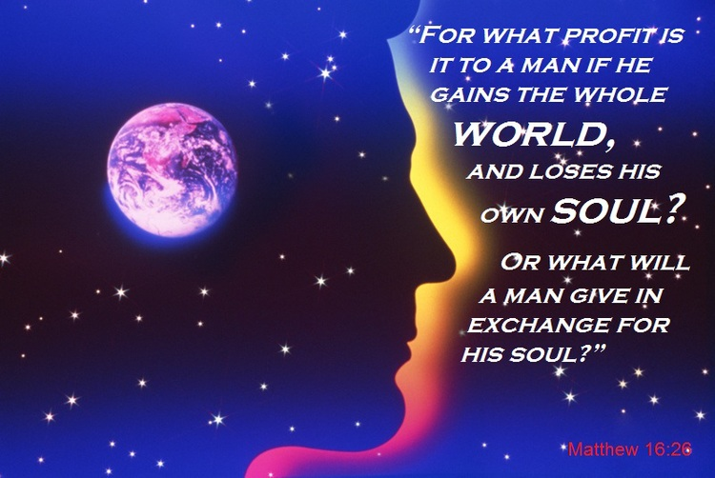
Matthew 16:26

Slide 13
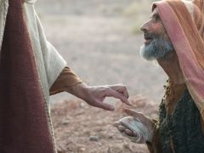
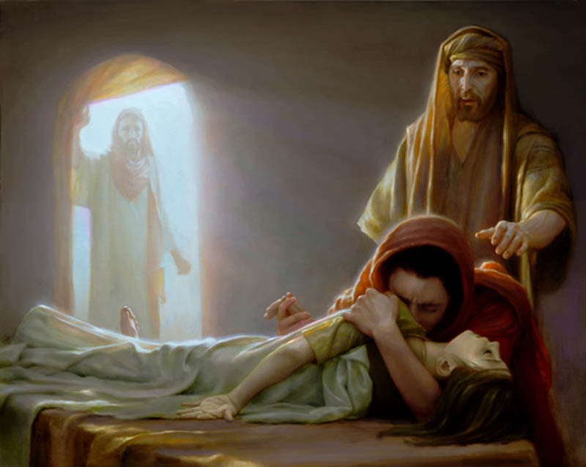
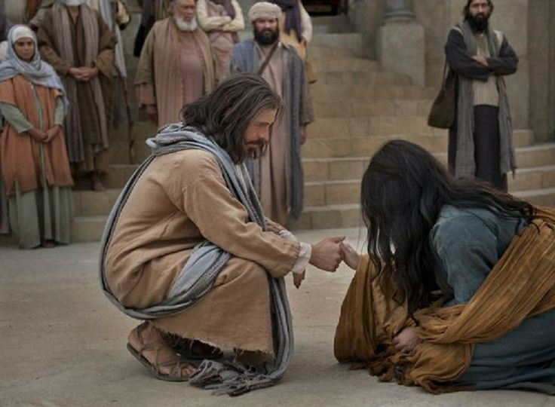
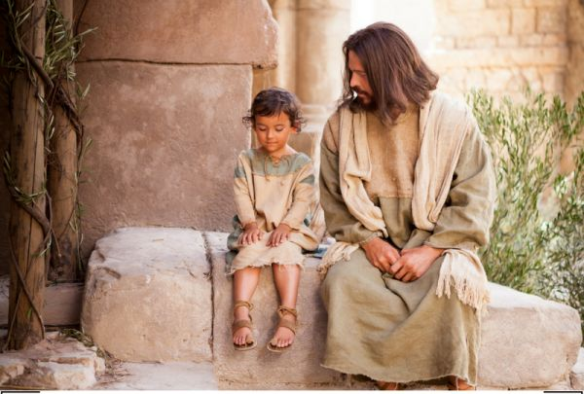

Slide 15
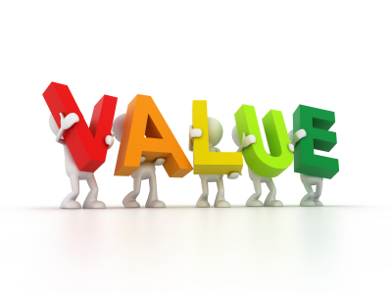
ways we can demonstrate
that we do indeed
4
EVERY LIFE
Acts 16:16-19
Psalm 139:13-16

Slide 16
NEVER USE OTHER PEOPLE
FOR SELFISH GAIN

Slide 17
NEVER USE OTHER PEOPLE
FOR SELFISH GAIN
START BY HELPING THOSE WHO
ARE TRAPPED BY SIN AND THE
CIRCUMSTANCES OF LIFE

Slide 18
NEVER USE OTHER PEOPLE
FOR SELFISH GAIN
START BY HELPING THOSE WHO
ARE TRAPPED BY SIN AND THE
CIRCUMSTANCES OF LIFE
DETERMINE TO SEE EVERY PERSON AS
A PRECIOUS CREATION MADE IN THE
IMAGE OF GOD

Slide 20
NEVER USE OTHER PEOPLE
FOR SELFISH GAIN
START BY HELPING THOSE WHO
ARE TRAPPED BY SIN AND THE
CIRCUMSTANCES OF LIFE
DETERMINE TO SEE EVERY PERSON AS
A PRECIOUS CREATION MADE IN THE
IMAGE OF GOD
MAKE IT OUR MISSION TO HELP
PEOPLE FIND THEIR GOD-GIVEN
PURPOSE

Slide 22
I have give you an example to follow.
Do as I have done to you!
John 13:15

