Slide 2
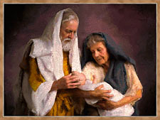
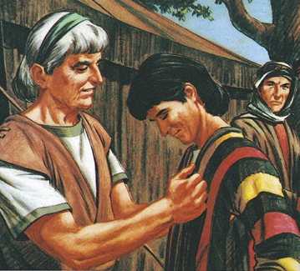
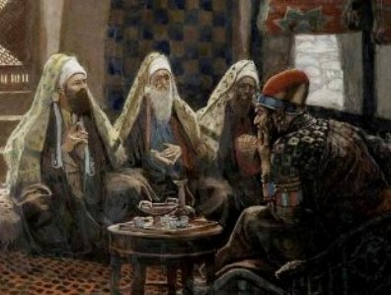
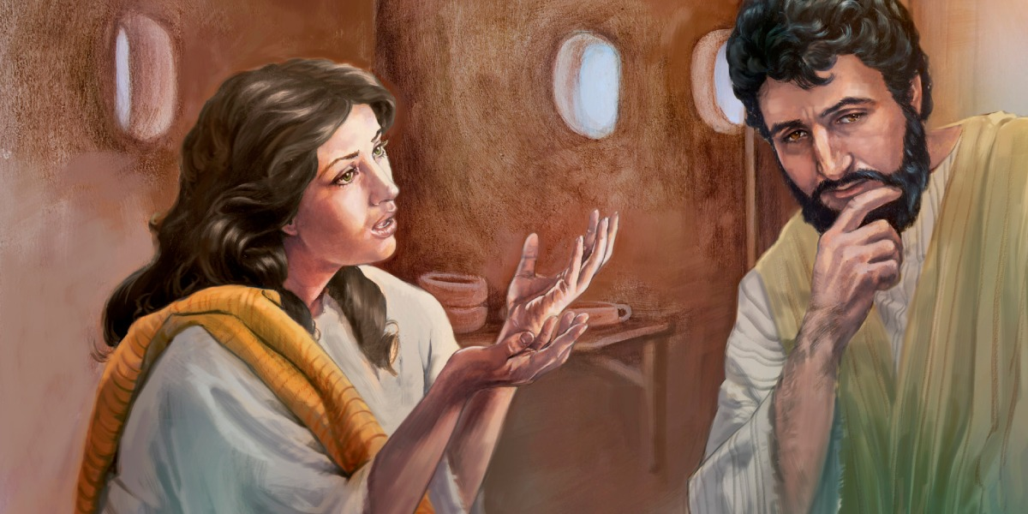

Slide 3
I want us to focus on three things.
We are messengers on a mission to share the good news.
2. What is “The Good News?”
3. How do we package it or deliver it?

Slide 4
1. John the Baptist was a messenger
² As it is written in the Prophets: "Behold, I send My messenger before Your face, Who will prepare Your way before You."
Mark 1:2

Slide 5
Luke 4:43 (NKJV) ⁴³ but He said to them, "I must preach the kingdom of God to the other cities also, because for this purpose I have been sent."

Slide 6
Luke 4:43 (NKJV) ⁴³ but He said to them, "I must preach the kingdom of God to the other cities also, because for this purpose I have been sent."

Slide 7
And Jesus went about all Galilee, teaching in their synagogues, preaching the gospel of the kingdom, and healing all kinds of sickness and all kinds of disease among the people.
Matthew 4:23 (NKJV)

Slide 8
Then Jesus went about all the cities and villages, teaching in their synagogues, preaching the gospel of the kingdom, and healing every sickness and every disease among the people.
Matthew 9:35 (NKJV)

Slide 9
Luke 4:43 (NKJV) ⁴³ but He said to them, "I must preach the kingdom of God to the other cities also, because for this purpose I have been sent."

Slide 10
John 20:21 KJV
“as my Father hath sent Me,
even so send I you.”

Slide 13
2. Secondly, Jesus says, I must share the good news about “the kingdom of God”.

Slide 15
The Spiritual Rule of God
John 14:17-18; 16:32-33.

Slide 19
But you are not willing to come to Me that you may have life. But now I come to You, and these things I speak in the world, that they may have My joy fulfilled in themselves. I have come that they may have life, and that they may have it more abundantly.
John 5:40, 17:13, 10:10

Slide 20
John 12:46 (NKJV) ⁴⁶ I have come as a light into the world, that whoever believes in Me should not abide in darkness.

Slide 21
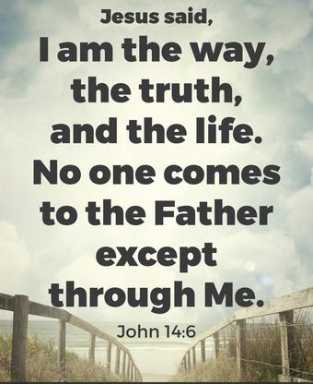

Slide 23
3. I want us to see from the writers of the four gospels, who gave witness, to the life and ministry of Jesus how the “good news” was delivered, how it was packaged.

Slide 25
“Go into all the world and preach the gospel to every creature. He that believeth and is baptized shall be saved; but he that believeth not shall be condemed.”
Mark 16:15

Slide 26
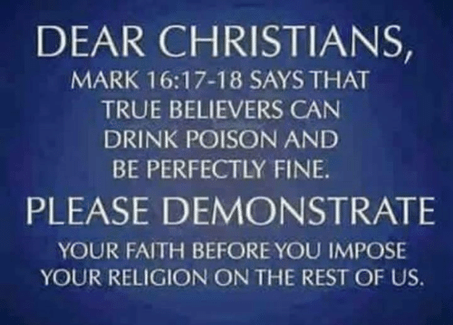

Slide 27
John D. Grassmick
former professor of the
New Testament at Dallas Theological Seminary
The first two clauses in Mark 16:18 may be understood as conditional clauses with the third clause as the conclusion. “And if they be compelled to pick up snakes with their hands and if they should be compelled to drink deadly poison, it shall by no means (emphatic negative), harm them.”

Slide 28
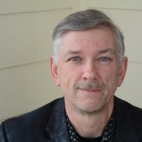
A message without a ministry
is meaningless to most people.

Slide 29
A message without a ministry
is meaningless to most people.
The good news that Jesus proclaimed, and the good news that the early church preached, was not only balanced with good works it was authenticated by good works!

Slide 30
“Let you light shine before men, that they may see your good works, and glorify your Father which is in Heaven.” Mathew 5:16
“Many good works have I shewed you from my Father; for which of those works do you stone Me?” John 10:32

Slide 31
“If I do not do the works of My Father, do not believe Me.” “But if I do, though you do not believe Me (the words that I say), believe the works, that you may know and believe that the Father is in Me, and I in Him.” Jn 10:37-38
“In Joppa there was a disciple named Tabitha, which is translated Dorcas. She was always doing good works and acts of charity.” Acts 9:36 HCSB

Slide 33
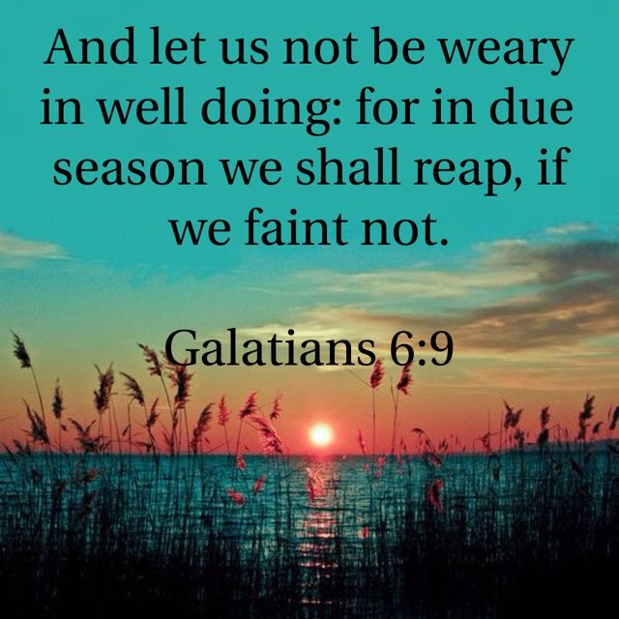

Slide 34
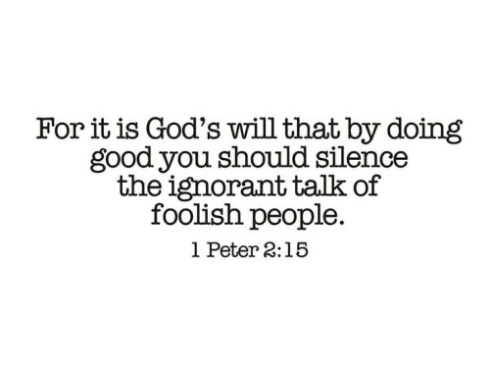

Slide 35
SHARE THE GOSPEL IN
to the glory of God!
Luke 24:19a

