Slide 1
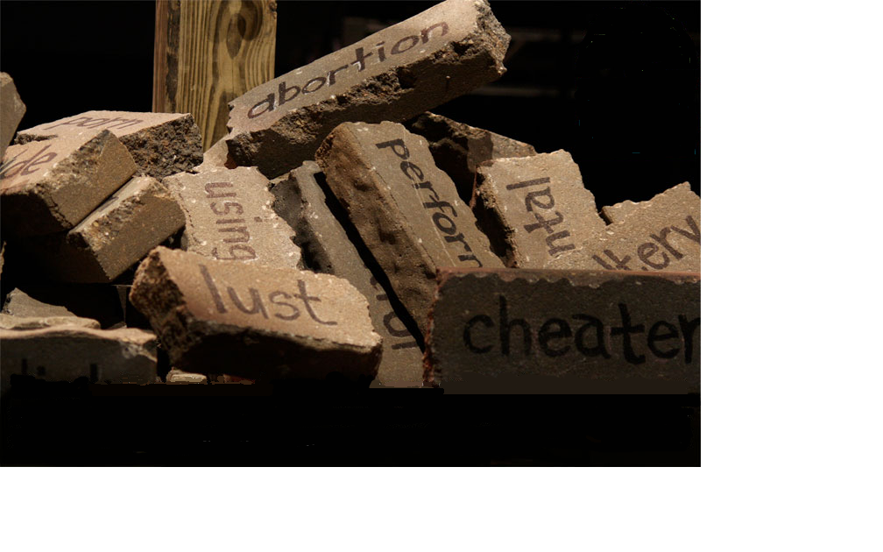
Seeing Sin For What It Is

Slide 2
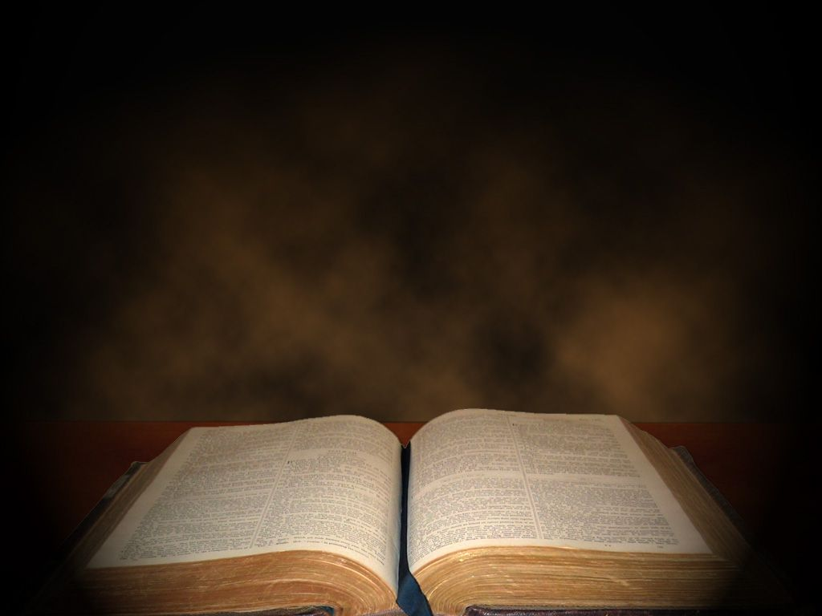
² Hear, O heavens, and give ear, O earth! For the LORD has spoken: “I have nourished and brought up children, And they have rebelled against Me; ³ The ox knows its owner And the donkey its master’s crib; But Israel does not know, My people do not consider.”
Isaiah 1:2-6

Slide 3
⁴ Alas, sinful nation, A people laden with iniquity, A brood of evildoers, Children who are corrupters! They have forsaken the Lord, They have provoked to anger The Holy One of Israel, They have turned away backward. ⁵ Why should you be stricken again? You will revolt more and more.
Isaiah 1:2-6

Slide 4
The whole head is sick, And the whole heart faints. ⁶ From the sole of the foot even to the head, There is no soundness in it, But wounds and bruises and putrefying sores; They have not been closed or bound up, Or soothed with ointment.
Isaiah 1:2-6

Slide 5
Seeing sin for what it is…
A flesh eating
virus
An
anchor holding
us down
Contagious
A deadly cancer
A wall
between us
and God
Something
that enslaves
What rust is
to metal
Harmful
Sin blinds us
Detrimental to
our health
A robber
of peace
A birther
of fear
An affront to God
An offense

Slide 7
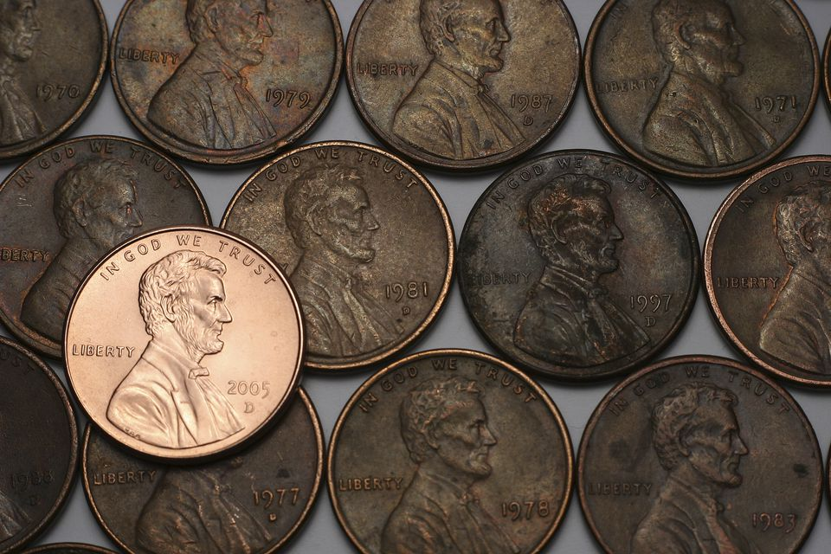
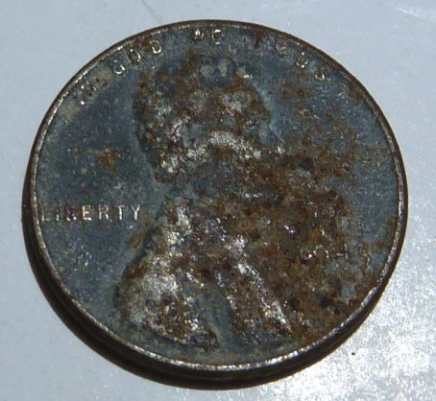

Slide 8
“I press toward the mark,
for the prize of the High calling
of God in Christ Jesus”
Philippians 3:17

Slide 9
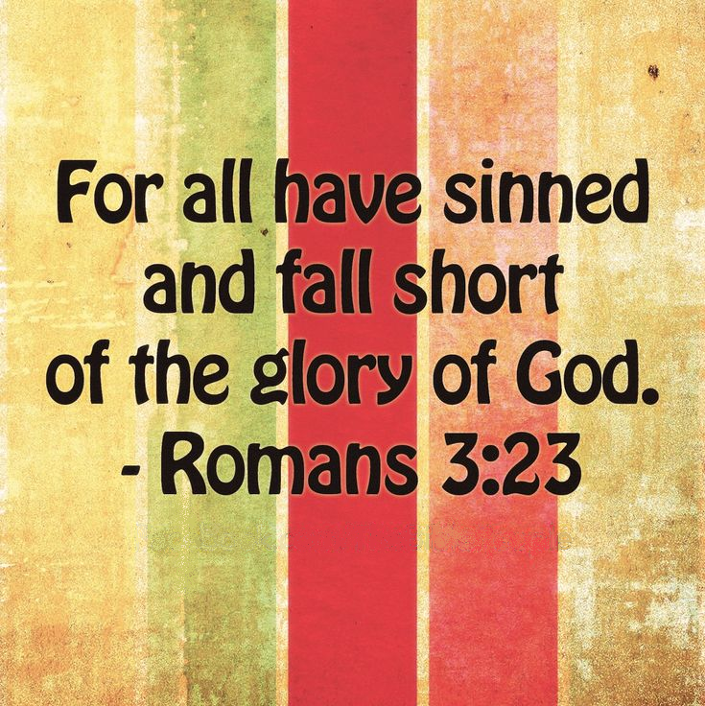

Slide 10
“Let this mind be in you
which was also in Christ
Jesus who, being in the form of God, Did not consider it robbery to be equal with God, but made Himself of no reputation, taking the form of a bondservant, and coming in the likeness of men”
Philippians 2:5-7
IMMANUEL

Slide 11
¹³ For he has rescued us from the kingdom of darkness and transferred us into the Kingdom of his dear Son, ¹⁴ who purchased our freedom and forgave our sins. ¹⁵ Christ is the visible image of the invisible God. He existed before anything was created and is supreme over all creation,
Colossians 1:13-17 NLT

Slide 12
¹⁶ for through him God created everything in the heavenly realms and on earth. He made the things we can see and the things we can’t see— such as thrones, kingdoms, rulers, and authorities in the unseen world. Everything was created through him and for him. ¹⁷ He existed before anything else, and he holds all creation together.
Colossians 1:13-17 NLT

Slide 13
¹Long ago God spoke many times and in many ways to our ancestors through the prophets. ²And now in these final days, he has spoken to us through his Son. God promised everything to the Son as an inheritance, and through the Son he created the universe.
Hebrews 1:1-3 NLT

Slide 14
³The Son radiates God’s own glory and expresses the very character of God, and he sustains everything by the mighty power of his command. When he had cleansed us from our sins, he sat down in the place of honor at the right hand of the majestic God in heaven.
Hebrews 1:1-3 NLT

Slide 16
“There will always be temptations to sin, but what sorrow awaits the person who does the tempting! ² It would be better to be thrown into the sea with a millstone hung around your neck than to cause one of these little ones to fall into sin.
Luke 17:1-2NLT

Slide 17
¹⁴ He found the Temple teeming with people selling cattle and sheep and doves. The loan sharks were also there in full strength. ¹⁵ Jesus put together a whip out of strips of leather and chased them out of the Temple,
John 2:13-17NLT

Slide 18
stampeding the sheep and cattle, upending the tables of the loan sharks, spilling coins left and right. ¹⁶ He told the dove merchants, "Get your things out of here! Stop turning my Father's house into a shopping mall!" ¹⁷ That's when his disciples remembered the Scripture, "Zeal for your house consumes me."
John 2:13-17NLT

Slide 19
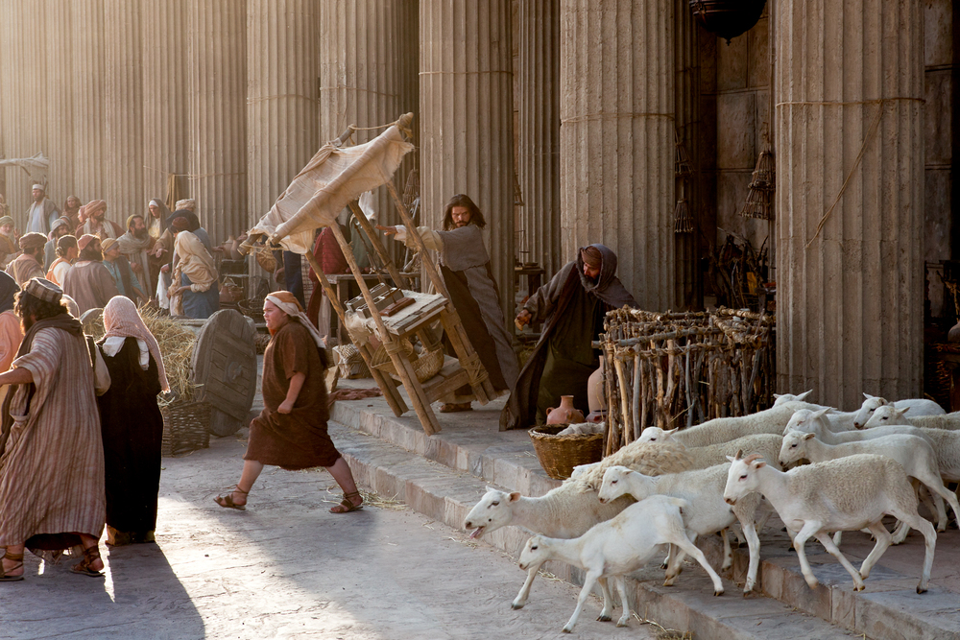

Slide 20
“the Pharisees went out and plotted against Him, how they might destroy Him.”

Slide 21
Matthew 17:15, 18
¹⁵ “Lord, have mercy on my son. He has seizures and suffers terribly. He often falls into the fire or into the water. ¹⁸ Then Jesus rebuked the demon in the boy, and it left him. From that moment the boy was well.

Slide 22
Only when we see sin for what it is, will we begin to see God’s amazing grace for what IT IS!

Slide 24
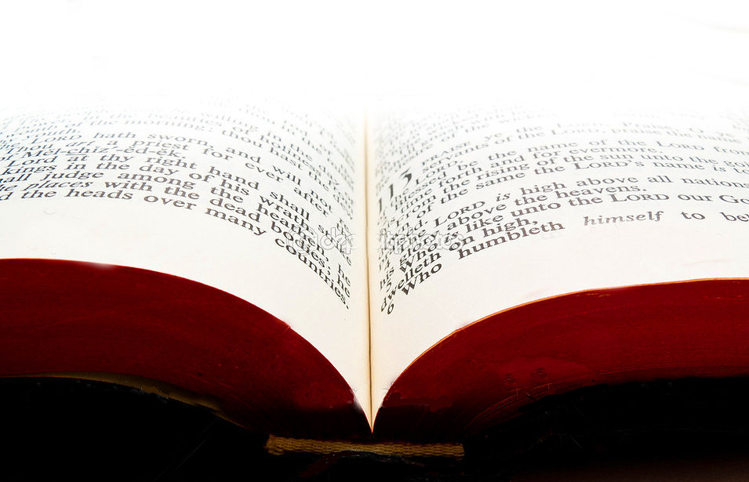
¹¹ “You were the model of perfection, full of wisdom and exquisite in beauty. ¹³ You were in Eden, the garden of God. ¹⁴ I ordained and anointed you as the mighty angelic guardian. You had access to the holy mountain of God and walked among the stones of fire. ¹⁵ “You were blameless in all you did from the day you were created until the day evil was found in you. ¹⁷ Your heart was filled with pride because of all your beauty. Your wisdom was corrupted by your love of splendor.
Ezekiel 28:11-17 NLT

Slide 25
“the woman whom you gave me, she brought the fruit from the tree to me and I ate it.”
Genesis 3:12

Slide 26
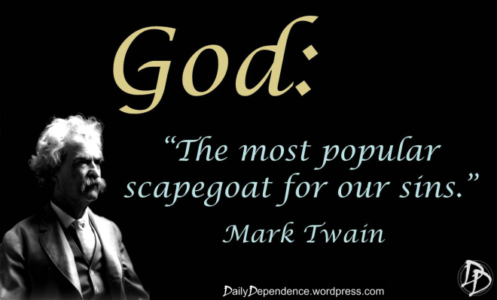

Slide 27
