Slide 1
to Serve
1 Timothy 3:1-13

Slide 2
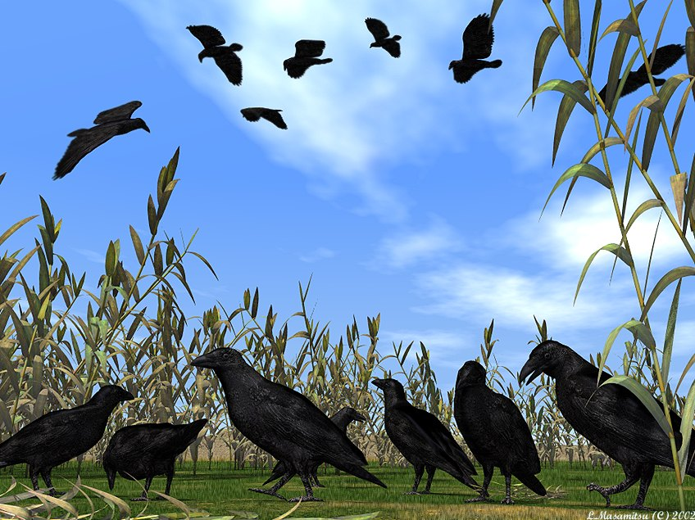

Slide 3
If you are not loving your
neighbors
you’re breaking
the Law
JAMES 2:8

Slide 4
¹⁷“Son of man, I have made you a watchman over the house of Israel. When you hear a word from My mouth, give them a warning from Me. ¹⁸If I say to the wicked person, ‘You will surely die,’ but you do not warn him—you don’t speak out to warn him about his wicked way in order to save his life—
Ezekiel 3:18-19 (HCSB)

Slide 5
—that wicked person will die for his iniquity. Yet I will hold you responsible for his blood. ¹⁹But if you warn a wicked person and he does not turn from his wickedness or his wicked way, he will die for his iniquity, but you will have saved your life.
Ezekiel 3:18-19 (HCSB)

Slide 6
⁹ …chosen for the high calling of priestly work, chosen to be a holy people, God's instruments to do his work and speak out for him, to tell others of the night-and-day difference he made for you
1 Peter 2:9 (MSG)

Slide 8
¹ The old system under the law of Moses was only a shadow, a dim preview of the good things to come, not the good things themselves. The sacrifices under that system were repeated again and again, year after year, but they were never able to provide perfect cleansing for those who came to worship.
Hebrews 10:1 NLT

Slide 9
9:23-10:10

Slide 10
CHAPTER 10 & 21

Slide 11
Leviticus 10:8-9 (NKJV) ⁸ Then the LORD spoke to Aaron, saying: ⁹ "Do not drink wine or intoxicating drink, you, nor your sons with you, when you go into the tabernacle of meeting, lest you die. It shall be a statute forever throughout your generations,

Slide 12
Leviticus 21:7 (NKJV) ⁷ They shall not take a wife who is a harlot or a defiled woman, nor shall they take a woman divorced from her husband; for the priest is holy to his God.

Slide 13
Priests
Priests

Slide 15
Romans 12:1 (MSG) ¹ So here's what I want you to do, God helping you: Take your everyday, ordinary life—your sleeping, eating, going-to-work, and walking-around life—and place it before God as an offering. Embracing what God does for you is the best thing you can do for him.

Slide 20
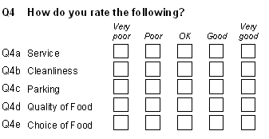
BLAMELESS
ONE WIFE
SELF CONTROLLED
SOBER-MINDED
GOOD BEHAVIOR
HOSPITABLE,
ABLE TO TEACH
NOT GIVEN TO WINE
NOT VIOLENT,
NOT GREEDY
GENTLE
NOT COVETOUS
MANAGES FAMILY WELL
NOT A NEW CONVERT
THOUGHT WELL OF BY OUTSIDERS

Slide 21
DEACONS

Slide 22
REVERENT
NOT DOUBLE-TONGUED
NOT HEAVY DRINKERS
NOT GREEDY FOR MONEY
DEVOTED TO CHRIST
TESTED - PROVEN
GOOD REPUTATION
MANAGE HOUSEHOLD WELL
WIFE OF GOOD CHARACTER
NOT GOSSIPS
FAITHFUL

Slide 23
Priests
Priests
No intoxicating drinks
One wife
Well behaved children
Not hot headed
Faithful to God
Not to divorce
Good reputation
Good character
Able to teach
No intoxicating drinks
No worldly women
Teach the children
Well behaved children
Not worldly
Faithful to God
Not to divorce

Slide 26
"For what we preach is not ourselves, but Jesus Christ as Lord, with ourselves as your servants for Jesus' sake."
2 Corinthians 4:5

Slide 27
"For though I am free from all men, I have made myself a servant to all, that I
might win the more,"
1 Corinthians 9:19

Slide 28
Acts 21:8 (NKJV) ⁸ On the next day we who were Paul's companions departed and came to Caesarea, and entered the house of Philip the evangelist, who was one of the seven, and stayed with him.

Slide 29
Acts 28:1-3
¹ Now when they had escaped, they then found out that the island was called Malta. ² And the natives showed us unusual kindness; for they kindled a fire and made us all welcome, because of the rain that was falling and because of the cold. ³ But when Paul had gathered a bundle of sticks and laid them on the fire, a viper came out because of the heat, and fastened on his hand.

Slide 30
Philippians 2:6-7
⁶ who, being in the form of God, did not consider it robbery to be equal with God, ⁷ but made Himself of no reputation, taking the form of a bondservant, and coming in the likeness of men.

Slide 31
Luke 22:24-30
24 Within minutes they were bickering over who of them would end up the greatest. 25 But Jesus intervened: "Kings like to throw their weight around and people in authority like to give themselves fancy titles. 26 It's not going to be that way with you. Let the senior among you become like the junior; let the leader act the part of the servant.

Slide 32
Luke 22:24-30
27 "Who would you rather be: the one who eats the dinner or the one who serves the dinner? You'd rather eat and be served, right? But I've taken my place among you as the one who serves. 28 And you've stuck with me through thick and thin.

Slide 33
Luke 22:24-30
29 Now I confer on you the royal authority my Father conferred on me 30 so you can eat and drink at my table in my kingdom and be strengthened as you take up responsibilities among the congregations of God's people.

