Slide 1
When the Song in our
Heart Begins to Fade
Exodus 15:1-10
Psalm 28:1-9, 118:1-29

Slide 2
The Song of Moses
The Song of the Sea
Exodus 15:1-21

Slide 3
ROMANS 8:31-39

Slide 6
Do we KNOW these TRUTHS

Slide 10
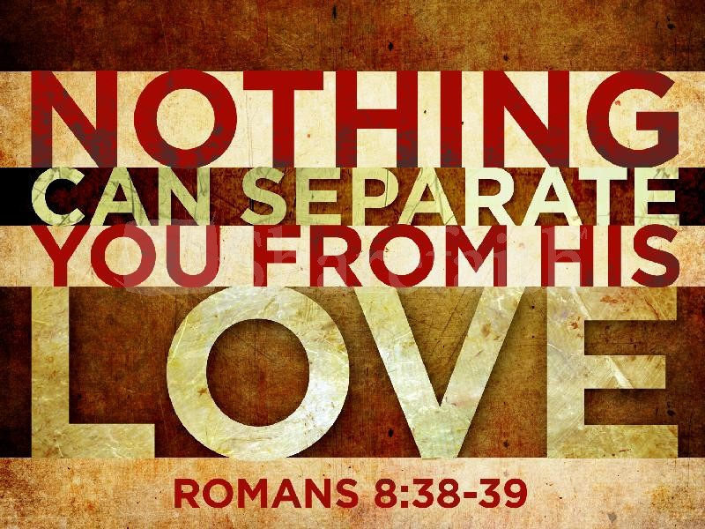

Slide 12
Romans 8:28-30
²⁸ And we know that in all things God works for the good of those who love him, who have been called according to his purpose. ²⁹ For those God foreknew he also predestined to be conformed to the likeness of his Son, that he might be the firstborn among many brothers. ³⁰ And those he predestined, he also called; those he called, he also justified; those he justified, he also glorified.

Slide 13
Exodus

Slide 14
THANKFULNESS
DELIVERANCE
TRIUMPH
VICTORY

Slide 15
THANKFULNESS
DELIVERANCE
TRIUMPH
VICTORY

Slide 16
Exodus 15:26 (MSG)
²⁶ That's the place where GOD set up rules and procedures; that's where he started testing them. GOD said, "If you listen, listen obediently to how GOD tells you to live in his presence, obeying his commandments and keeping all his laws, then I won't strike you with all the diseases that I inflicted on the
Egyptians; I am GOD your healer."

Slide 17
God was pleased to demonstrate His power in and through them if they would simply trust and obey Him.
I wonder, do we realize this?

Slide 18
September 23, 1930 – June 10, 2004

Slide 19
Sometimes it seems that God is silent or even absent when we cry out to him from our pain.
But let’s not mistake God’s silence for his absence.

Slide 20
God wants us to grow through the undesirable experiences of life.

Slide 21
Songs have a way of helping us remember God’s presence, His concern, and His promises to help.

Slide 22
What a privilege to carry everything to God in prayer! Oh what peace we often forfeit, Oh, what needless pain we bear, All because we do not carry everything to God in prayer!

Slide 23
Jesus is Mine, O what a foretaste of glory divine Heir of salvation, purchase of God, Born of His Spirit, washed in His blood!

Slide 24
How sweet the sound that saved a wretch like me.
I once was lost but now am found,
was blind but now I see.

Slide 25
all the children of the world, Red, and Yellow, black and white, they are precious in His sight.
Jesus loves the little children of the world.

Slide 26
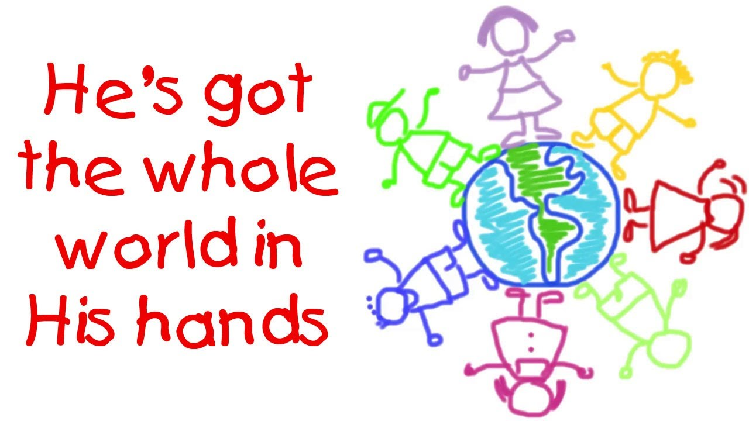
He’s got the whole world in His hands.
He’s got the whole wide world in His hands,
He got the whole world in His hands.

Slide 27
Songs are…
tools to help us

Slide 29
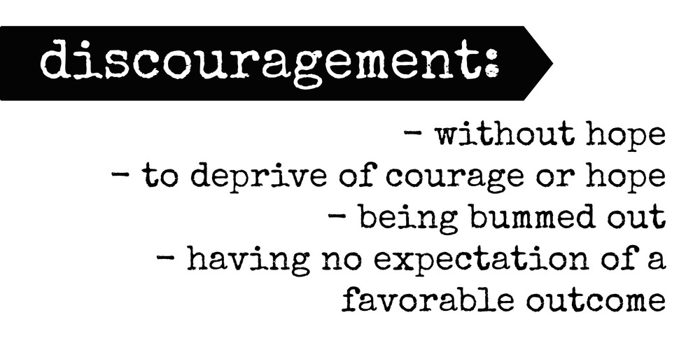

Slide 30
THANKFULNESS
DELIVERANCE
PRAise
VICTORY

Slide 31
What can one do when the song begins to fade?

Slide 32
Set you mind on things above, not on the things that are on earth…
Colossians 3:2

Slide 33
Fix your thoughts on what is true, and honorable, and right, and pure, and lovely, and admirable. Think about things that are excellent and worthy of praise.
Philippians 4:8

Slide 34
God has showed us what is good. And what the LORD requires of us… To act justly and to love mercy and to walk humbly with our God.
Micah 6:8

Slide 35
ENCOURAGE YOURSELF
David encouraged himself
in the LORD his God.
1 Samuel 30:6

