Slide 1
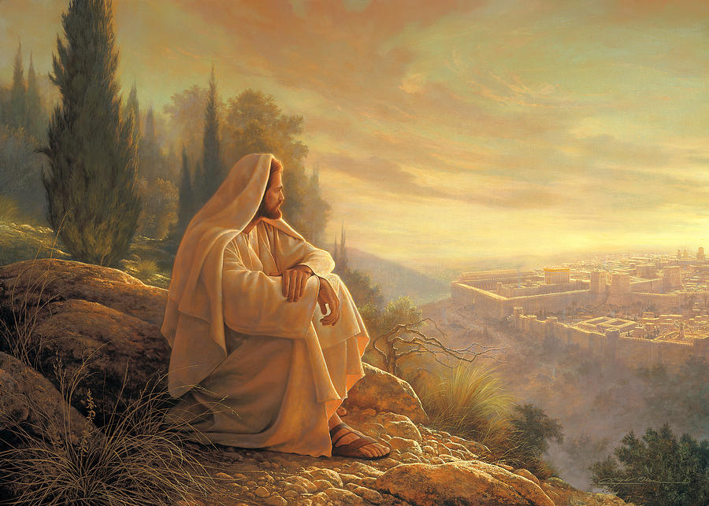

Slide 2
The Invitation of Jesus

Slide 3
Who Is Jesus Christ?
The Miracles of Jesus
The Teachings of Jesus
The Prophecies About Jesus
Jesus and His Kingdom
THE INVITATION OF JESUS

Slide 7
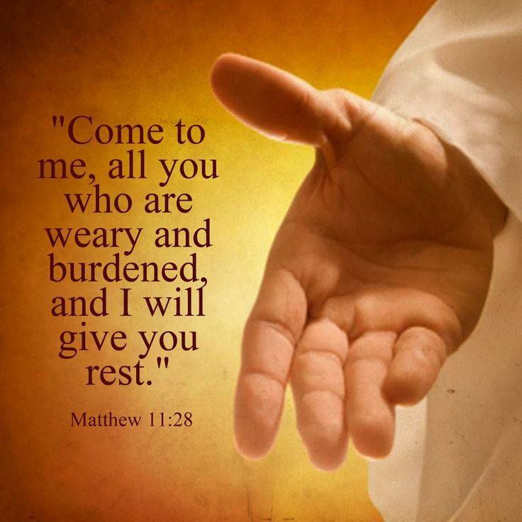

Slide 8
“Take my yoke upon you. Let me teach you, because I am humble and gentle at heart, and you will find rest for your souls. For my yoke is easy to bear, and the burden I give you is light.”
Matthew 11:29-30

Slide 12
Genesis 7:1
"Come, come into the ark“
Exodus 32:26
"Let him who is on the Lord’s side, let him come unto me"

Slide 13
Isaiah 1:18
"Come now, saith the Lord. Come
now, saith the Lord, let us reason together: Though your sins be as scarlet, they shall be white as snow; though they be red like crimson, they shall be as wool."

Slide 14
Isaiah 55:1 (ESV) ¹ “Come, everyone who thirsts, come to the waters; and he who has no money, come, buy and eat! Come, buy --- without money and without price.

Slide 16
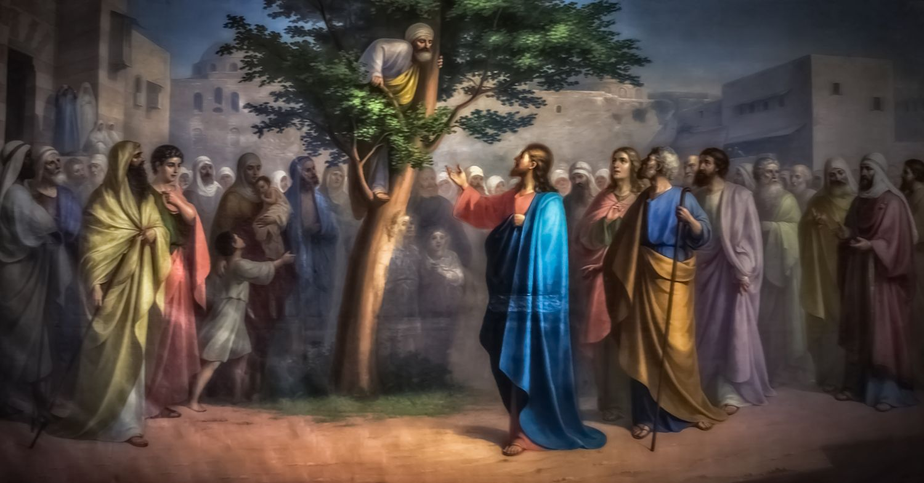
Luke 19:5
"Zaccheus, today, salvation is come to thy house. Make haste,
and come down!

Slide 17
"Go out into the highways, and hedges, and compel them to come in"
Luke 14:23

Slide 18
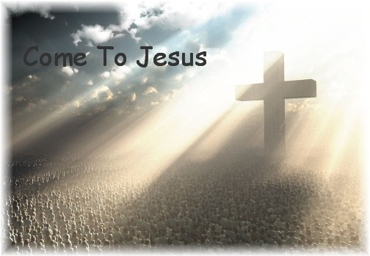

Slide 20
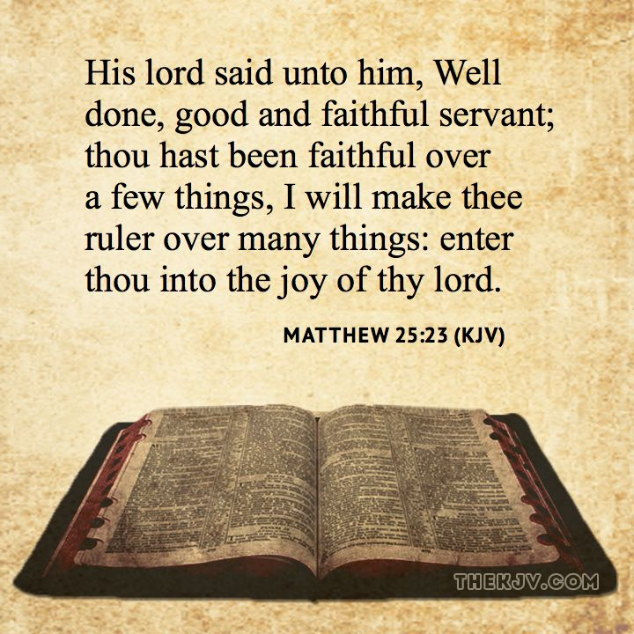

Slide 21
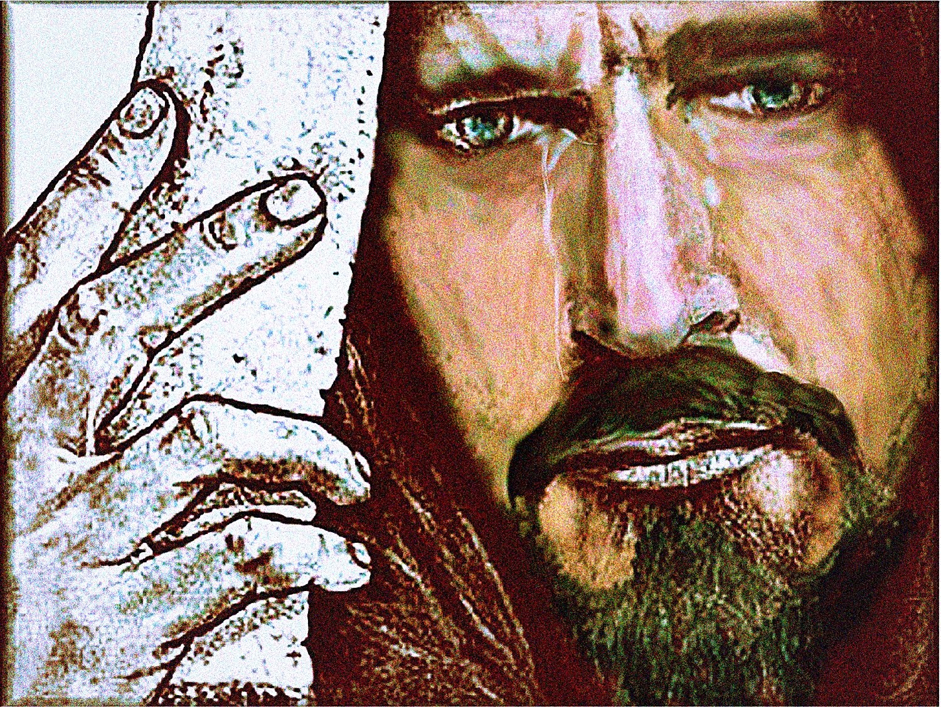
Luke 19:41 (NKJV) ⁴¹ Now as He drew near, He saw the city and wept over it,

Slide 22
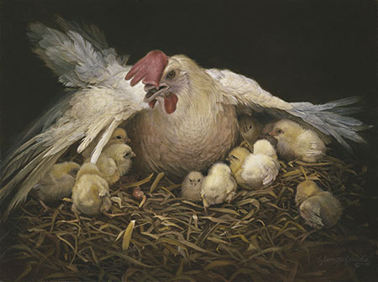

Slide 25
¹⁶ "I, Jesus, have sent My angel to testify to you these things in the churches. I am the Root and the Offspring of David, the Bright and Morning Star."
Revelation 22:16-17 (NKJV)

Slide 26
¹⁷And the Spirit and the bride say, "Come!" And let him who hears say, "Come!" And let him who thirsts come. Whoever desires, let him take the water of life freely.
Revelation 22:16-17 (NKJV)

Slide 27
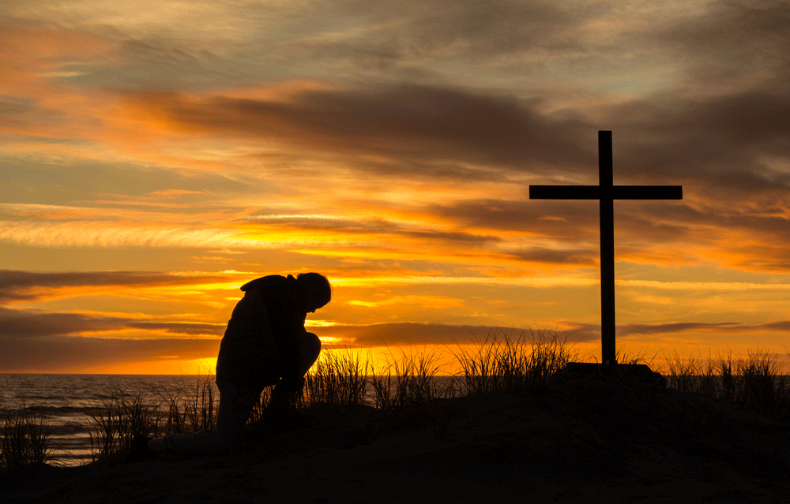
Do You Want Christ

Slide 28
“Whosoever will come after me, let him deny himself, and take up his cross, and follow me.” Mark 8:34

Slide 29
Do you want forgiveness
to be reconciled to God?

Slide 30
Do You Want Heaven?

Slide 31
Enter into the JOY of your Lord

Slide 32
“God delegates the rule of
His creation to us, and
we’ll reign with him over
his new creation. We’ll
have things to do, places
to go, people to see. Heaven is guaranteed to be a thrilling adventure because Jesus is a thrilling person—the source of all great adventures, including those awaiting us in the new universe.”

Slide 33
Ezekiel 37:27 (NKJV) ²⁷ My tabernacle also shall be with them; indeed I will be their God, and they shall be My people. Revelation 21:3 (NKJV) ³ And I heard a loud voice from heaven saying, "Behold, the tabernacle of God is with men, and He will dwell with them, and they shall be His people. God Himself will be with them and be their God.

