Slide 1
A GOOD FOUNDATION
Luke 6:46-49 / Matthew 7:24-27 & 1 Timothy 6:17-19

Slide 2
²⁴ "Therefore whoever hears these sayings of Mine, and does them, I will liken him to a wise man who built his house on the rock: ²⁵ and the rain descended, the floods came, and the winds blew and beat on that house; and it did not fall, for it was founded on the rock. ²⁶ But everyone who hears these sayings of Mine, and does not do them, will be like a foolish man who built his house on the sand: ²⁷ and the rain descended, the floods came, and the winds blew and beat on that house; and it fell. And great was its fall."
⁴⁶ "But why do you call Me 'Lord, Lord,' and do not do the things which I say? ⁴⁷ Whoever comes to Me, and hears My sayings and does them, I will show you whom he is like: ⁴⁸ He is like a man building a house, who dug deep and laid the foundation on the rock. And when the flood arose, the stream beat vehemently against that house, and could not shake it, for it was founded on the rock. ⁴⁹ But he who heard and did nothing is like a man who built a house on the earth without a foundation, against which the stream beat vehemently; and immediately it fell.
And the ruin of that house was great."
Matthew 7:24-27 NKJV Luke 6:46-49 NKJV

Slide 3
“Whoever COMES to Me, and HEARS my sayings and DOES them,
I will show you whom he is like.”

Slide 4
1. A FOUNDATION THAT LASTS

Slide 5
²⁴ "Therefore whoever hears these sayings of Mine, and does them, I will liken him to a wise man who built his house on the rock: ²⁵ and the rain descended, the floods came, and the winds blew and beat on that house; and it did not fall, for it was founded on the rock. ²⁶ But everyone who hears these sayings of Mine, and does not do them, will be like a foolish man who built his house on the sand: ²⁷ and the rain descended, the floods came, and the winds blew and beat on that house; and it fell. And great was its fall."
⁴⁶ "But why do you call Me 'Lord, Lord,' and do not do the things which I say? ⁴⁷ Whoever comes to Me, and hears My sayings and does them, I will show you whom he is like: ⁴⁸ He is like a man building a house, who dug deep and laid the foundation on the rock. And when the flood arose, the stream beat vehemently against that house, and could not shake it, for it was founded on the rock. ⁴⁹ But he who heard and did nothing is like a man who built a house on the earth without a foundation, against which the stream beat vehemently; and immediately it fell.
And the ruin of that house was great."
Matthew 7:24-27 NKJV Luke 6:46-49 NKJV

Slide 6
Thus, the “ROCK” represents the truth of God’s word, and the teachings of Jesus.

Slide 8
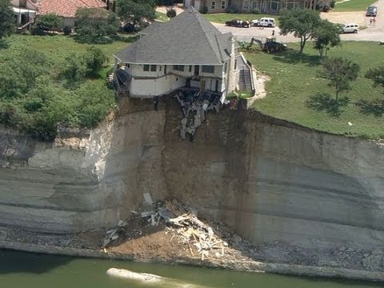

Slide 9
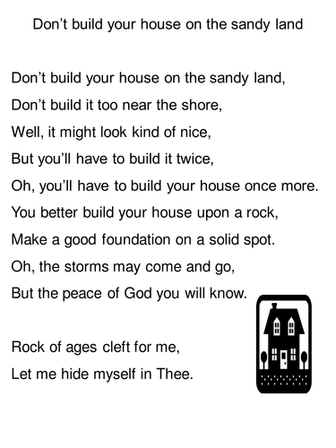
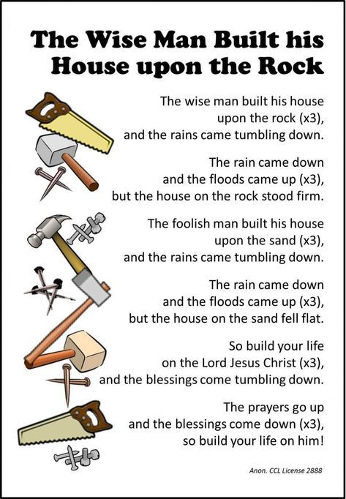

Slide 12
2. BUILDING A FOUNDATION FOR
GREAT RELATIONSHIPS

Slide 13
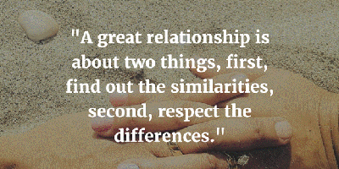
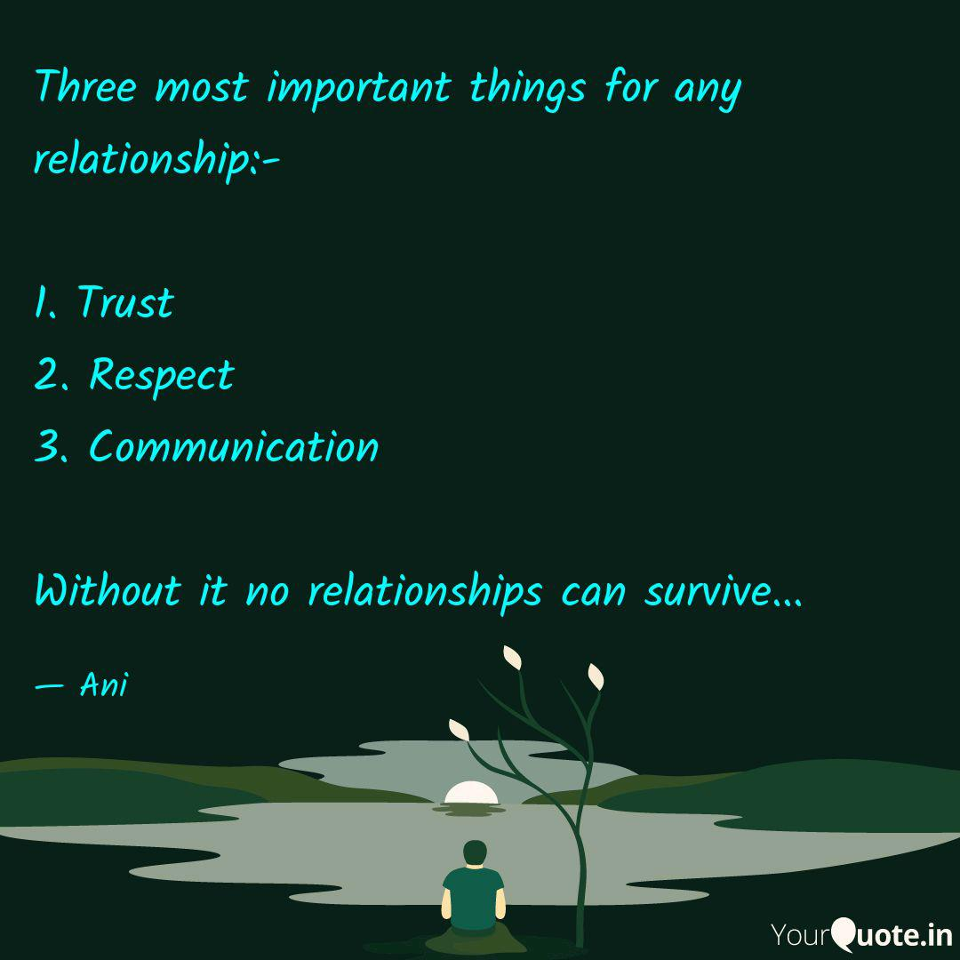
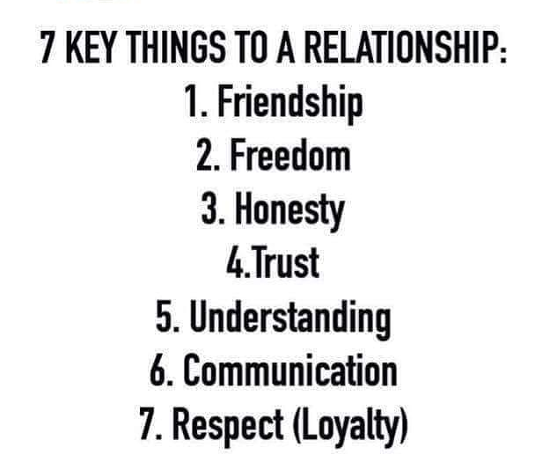

Slide 14
Great relationships both with God and with others, are built upon the bedrock of God’s Word, the teachings of Jesus and following the Holy Spirit’s leading in our lives.

Slide 15
Mark 10:9 (TLB) ⁹ And no man may separate what
God has joined together."

Slide 16
³¹"The law of Moses says, ‘If anyone wants to be rid of his wife, he can divorce her merely by giving her a letter of dismissal.’ ³²But I say that a man who divorces his wife, except for fornication, causes her to commit adultery if she marries again. And he who marries her commits adultery.
Matthew 5:31-32 TLB

Slide 19
For I know that nothing good lives in me, that is, in my flesh. For the desire to do what is good is with me, but there is no ability to do it.
Romans 7:18 CSB

Slide 20
Adhering to the principles
of Sacred Scripture
is the only enduring foundation
of all lasting relationships.

Slide 21
“If you claim to be religious but don’t control your tongue, you are fooling yourself, and your religion is worthless.” ^{James 1:26 (NLT2)}
“If anyone does not provide for his own family, especially for his own household, he has denied the faith and is worse than an unbeliever.” ^{1 Timothy 5:8 (CSB)}
Romans 7:18 CSB

Slide 22
3. FOUNDATION INSTRUCTIONS
FOR GREAT RELATIONSHIPS

Slide 23
¹⁷ Command those who are rich in this present age not to be haughty, nor to trust in uncertain riches but in the living God, who gives us richly all things to enjoy. ¹⁸ Let them do good, that they be rich in good works, ready to give, willing to share, ¹⁹ storing up for themselves a good foundation for the time to come, that they may lay hold on eternal life.
1 Timothy 6:17-19 NKJV

Slide 24
We build enduring relationships
by being rich in helping others.

Slide 25
We build enduring relationships
by being extravagantly generous.

Slide 26
We build enduring relationships
by following the Holy Spirit’s
leading in our lives.

Slide 30
We build enduring relationships when we exhibit the
fruit of the Spirit.
a
a
a
a
a
a
a
a
aw

Slide 32
¹⁶ So I say, let the Holy Spirit guide your lives. Then you won’t be doing what your sinful nature craves. ¹⁷ The sinful nature wants to do evil, which is just the opposite of what the Spirit wants. And the Spirit gives us desires that are the opposite of what the sinful nature desires. These two forces are constantly fighting each other, so you are not free to carry out your good intentions. ¹⁸ But when you are directed by the Spirit, you are not under obligation to the law of Moses.
Galatians 5:16-25 NLT2

Slide 33
¹⁹ When you follow the desires of your sinful nature, the results are very clear: sexual immorality, impurity, lustful pleasures, ²⁰ idolatry, sorcery, hostility, quarreling, jealousy, outbursts of anger, selfish ambition, dissension, division, ²¹ envy, drunkenness, wild parties, and other sins like these. Let me tell you again, as I have before, that anyone living that sort of life will not inherit the Kingdom of God.
Galatians 5:16-25 NLT2

Slide 34
²² But the Holy Spirit produces this kind of fruit in our lives: love, joy, peace, patience, kindness, goodness, faithfulness, ²³ gentleness, and self-control. There is no law against these things! ²⁴ Those who belong to Christ Jesus have nailed the passions and desires of their sinful nature to his cross and crucified them there. ²⁵ Since we are living by the Spirit, let us follow the Spirit’s leading in every part of our lives.
Galatians 5:16-25 NLT2

Slide 35
Vow Renewal Ceremony

