Slide 1
Better Days Ahead
Isaiah 11:1-14

Slide 3
³³ Then Pilate entered the Praetorium again, called Jesus, and said to Him, "Are You the King of the Jews?" ³⁴ Jesus answered him, "Are you speaking for yourself about this, or did others tell you this concerning Me?" ³⁵ Pilate answered, "Am I a Jew? Your own nation and the chief priests have delivered You to me. What have You done?" ³⁶ Jesus answered, "My kingdom is not of this world. If My kingdom were of this world,
John 18:33-37

Slide 4
My servants would fight, so that I should not be delivered to the Jews; but now My kingdom is not from here." ³⁷ Pilate therefore said to Him, "Are You a king then?" Jesus answered, "You say rightly that I am a king. For this cause I was born, and for this cause I have come into the world, that I should bear witness to the truth. Everyone who is of the truth hears My voice."
John 18:33-37

Slide 5
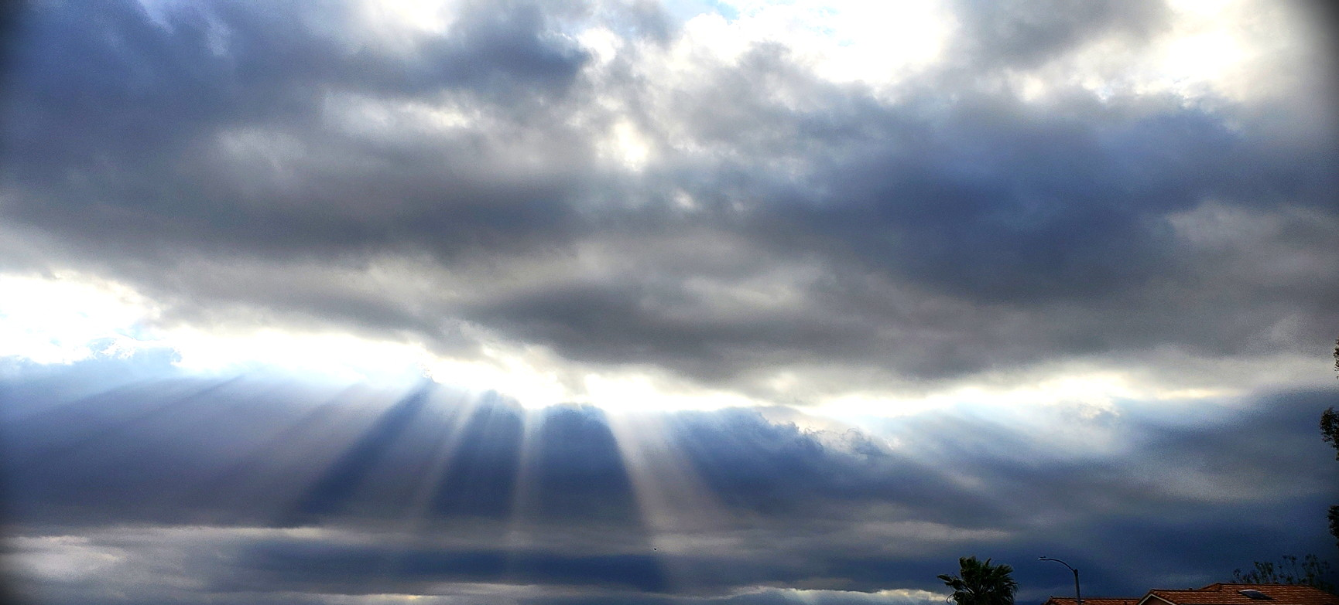
1. There’s A Kingdom to Come!

Slide 8
Jesus spoke of His kingdom as a future reality!

Slide 12
God’s kingdom is first spiritual because God is a spirit.
2. Two Aspects of the Kingdom to Come

Slide 13
God’s kingdom is first spiritual because God is a spirit.
2. Two Aspects of the Kingdom to Come

Slide 15
One day, the Kingdom of God will be a physical reality and with a physical location.

Slide 17
A time when God’s will,
will be done on Earth, as it is in Heaven.
3. Isaiah Describes the Kingdom to Come

Slide 18
²⁴ He will answer them before they even call to Him. While they are still talking to God about their needs, He will go ahead and answer their prayers! ²⁵ The wolf and lamb shall feed together, the lion shall eat straw as the ox does, and poisonous snakes shall strike no more! In those days nothing and no one shall be hurt or destroyed in all my Holy Mountain," says the Lord.”
Isaiah 65:24-25

Slide 19
Everyone who heard the words of Isaiah, understood that there were better days
ahead for God’s people.
4. Living With Anticipation of Better Days Ahead

Slide 20
¹ The Lord says, "People who never before inquired about me are now seeking me out. Nations who never before searched for me are finding me. ² "But my own people—though I have been spreading out my arms to welcome them all day long—have rebelled; they follow their own evil paths and thoughts.
Isaiah 65:1-7 TLB

Slide 21
³ All day long they insult me to my face by worshiping idols in many gardens and burning incense on the rooftops of their homes. ⁴ At night they go out among the graves and caves to worship evil spirits, and they eat pork and other forbidden foods. ⁵ Yet they say to one another, ’Don’t come too close, you’ll defile me!
Isaiah 65:1-7 TLB

Slide 22
For I am holier than you!’ They stifle me. Day in and day out they infuriate me. ⁶ "See, here is my decree all written out before me: I will not stand silent; I will repay. Yes, I will repay them—⁷ not only for their own sins but for those of their fathers too,’ says the Lord, ’for they also burned incense on the mountains and insulted me upon the hills.
I will pay them back in full.
Isaiah 65:1-7 TLB

Slide 25
Titus 2:13 (CSB) ¹³ while we wait for the blessed hope,
the appearing of the glory of our great God
and Savior, Jesus Christ.

Slide 26
We know that better days are ahead
and we live for the Kingdom to Come!

