Slide 1
Shining as Stars
for Jesus!
Philippians 2:1-15

Slide 3
If you’re going to claim to be a Christ follower, then follow Jesus’ example of making yourself of service to others.

Slide 5
Paul closes out this part of his letter by challenging them to shine like stars in this crooked and perverted world.

Slide 6
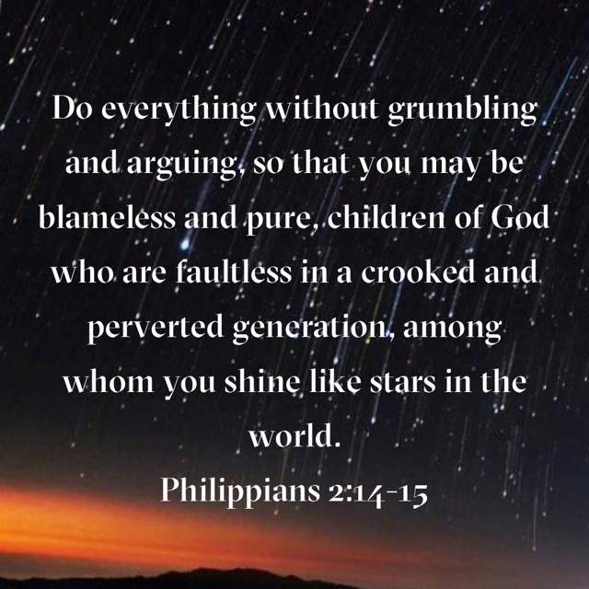

Slide 7
Humility is not thinking
too highly of yourself!

Slide 8
star

Slide 10
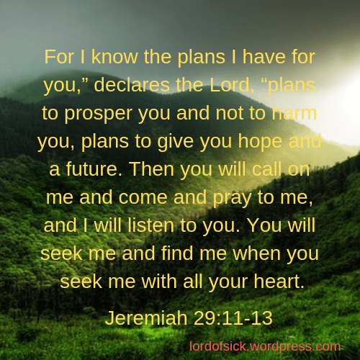

Slide 14
The path of serving self leads to a dead end, while the path of serving others leads to Heaven!

Slide 17
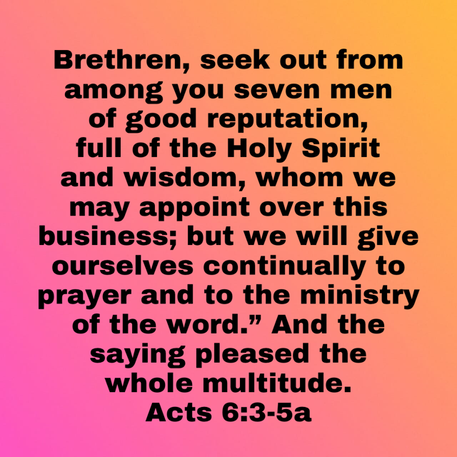

Slide 18
Believers are to be examples for lost humanity and other believers by humbly shining as stars in the darkness of a sinful world.

Slide 20
Shining as Stars
for Jesus!
Philippians 2:1-15

Slide 21
¹ O LORD, our Lord, how majestic is your name in all the earth! You have set your glory above the heavens. ² Out of the mouth of babies and infants, you have established strength because of your foes, to still the enemy and the avenger. ³ When I look at your heavens, the work of your fingers, the moon and the stars, which you have set in place, ⁴ what is man that you are mindful of him, and the son of man that you care for him?
Psalm 8:1-9

Slide 22
⁵ Yet you have made him a little lower than the heavenly beings (Elohim) and crowned him with glory and honor. ⁶ You have given him dominion over the works of your hands; you have put all things under his feet, ⁷ all sheep and oxen, and also the beasts of the field, ⁸ the birds of the heavens, and the fish of the sea, whatever passes along the paths of the seas. ⁹ O LORD, our Lord, how majestic is your name in all the earth!
Psalm 8:1-9

Slide 23
1. Christ followers are the real
Stars that shine in the darkness.

Slide 25
a. Our world is in moral darkness because it is a “crooked and
perverted” world. (Phil. 2:15)
b. Paul described his generation as “crooked”.
c. “Perverted” translates the Greek term diastrepho.
d. Darkness also suggests the brokenness of the world, the emptiness, it only make us hungry for something better.
e. In this darkness of twisted perversion, our calling is to be bright
lights, stars of uprightness, that lead people to the Father of light.
(James 1:17)

Slide 26
2. Stars bring light into a dark world.

Slide 27
a. We as Christians are God’s spiritual stars.
b. Each believer receives a spiritual gift to employ in the body of Christ (1 Cor. 12:7).
c. Our giftedness is determined by the grace and will of God.
d. The Word of God informs us that we are stars that standout in utter darkness, and our spiritual giftedness equips us to shine as God intended.
e. Joy comes when we shine for Jesus.

Slide 28
3. Stars are created to shine!

Slide 29
CREATED TO SHINE!
a. Meaning we must cooperate with the Holy Spirit within us.
b. Though the believers at Philippi had everything they needed for their salvation in the grace of God, they were called to reflect Christ’s presence in their lives.

Slide 30
THIS
US

Slide 31
1. This requires fellowship with the Spirit. (v.1)
2. That we be united in spirit, intent on one purpose,
to please the LORD! (v.2)
3. It requires, looking out for the interests of others. (v.4)
4. That we refrain from complaining and arguing (v. 14)
5. That we seek unity through love and tenderness (v. 1)

Slide 32
STARS reflect the light of Jesus so others can find their way
to the Father of light.

Slide 34
for
JESUS!

