Slide 1
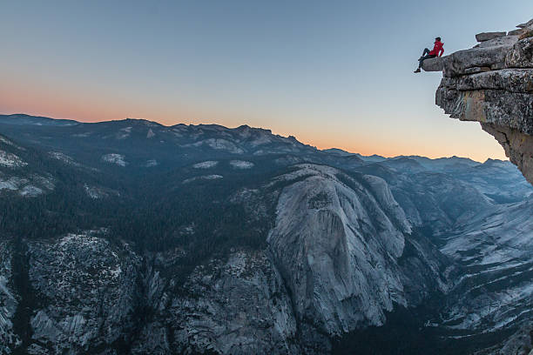
LIVING ON THE EDGE OF ETERNITY
I Peter 4:7-11

Slide 2
1 Peter 4:7-11 (NKJV) ⁷ But the end of all things is at hand; therefore be serious and watchful in your prayers. ⁸ And above all things have fervent love for one another, for "love will cover a multitude of sins." ⁹ Be hospitable to one another without grumbling. ¹⁰ As each one has received a gift, minister it to one another, as good stewards of the manifold grace of God.

Slide 3
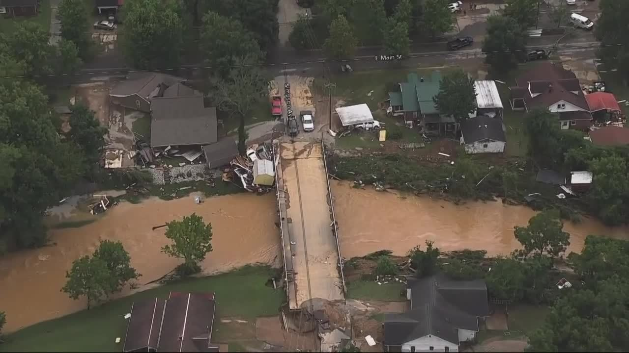
Where you live and when you live has
a great deal to do with how you live.
T
E
N
N
E
S
S
E
E

Slide 4
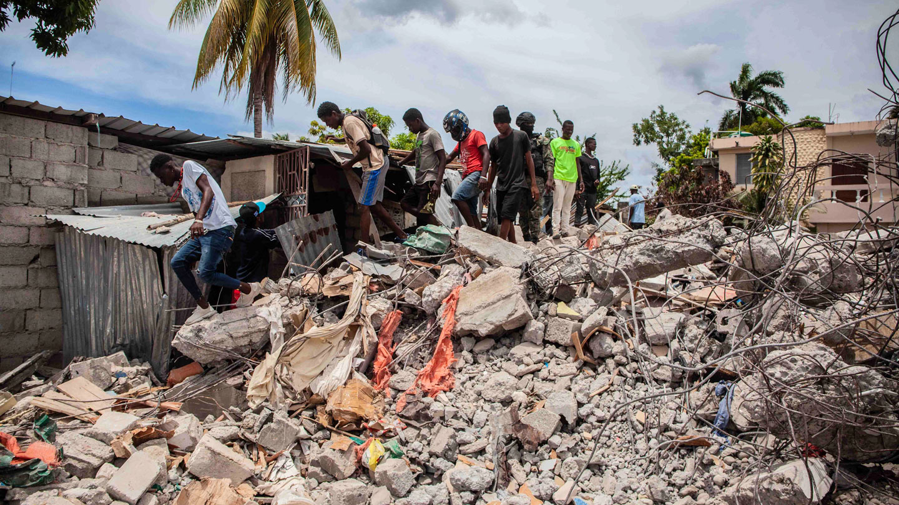
Where you live and when you live has
a great deal to do with how you live.
H
A
I
T
I

Slide 5
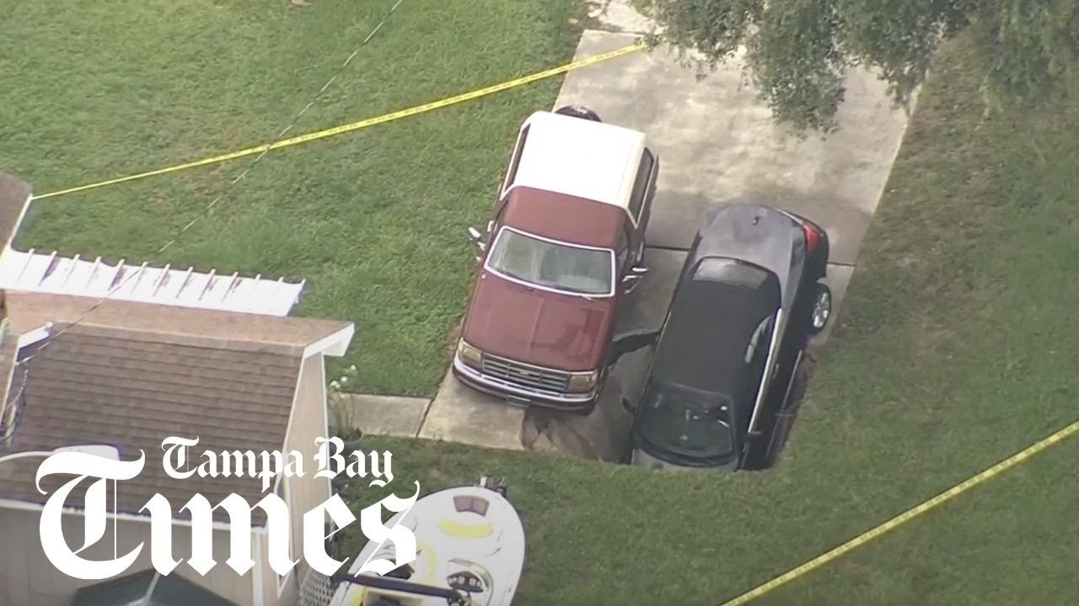
P
A
L
M
H
A
R
B
O
R

Slide 6
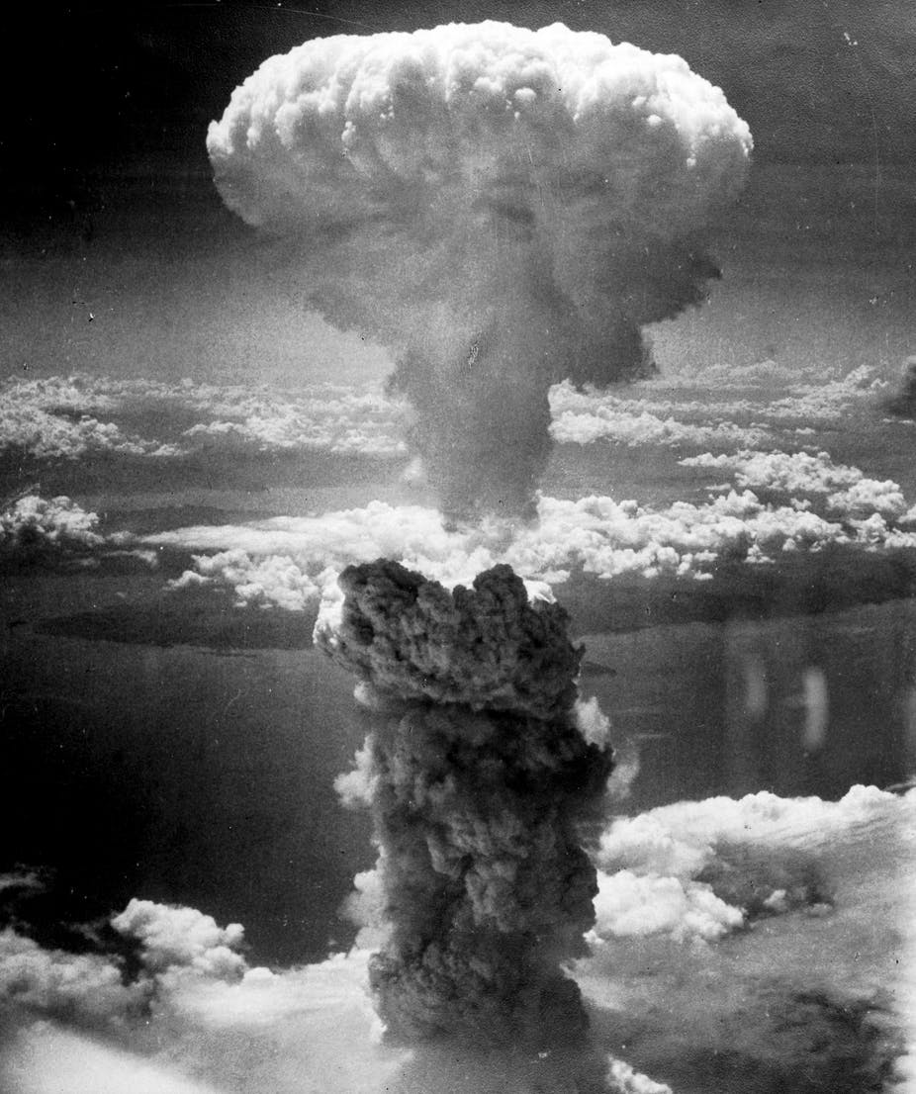
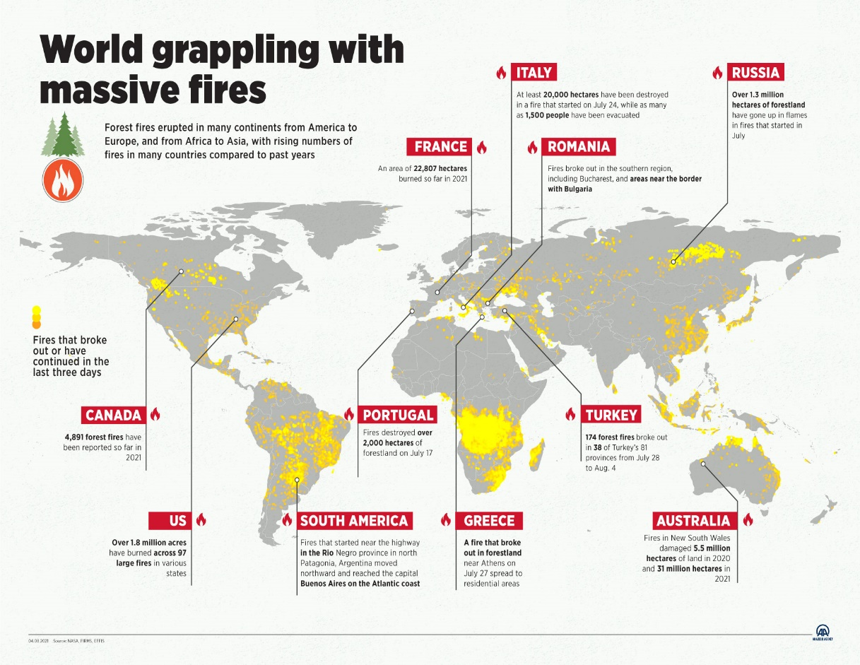
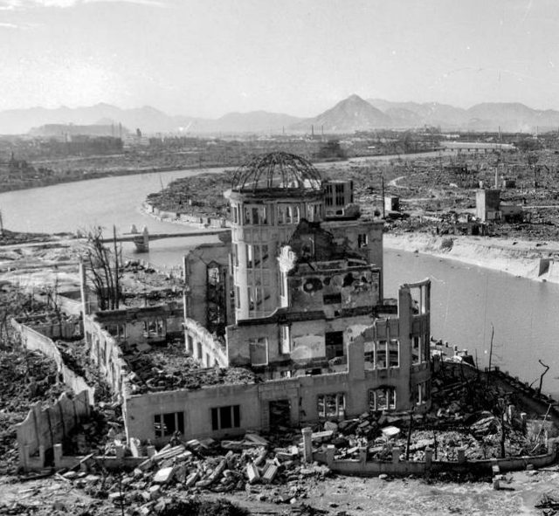
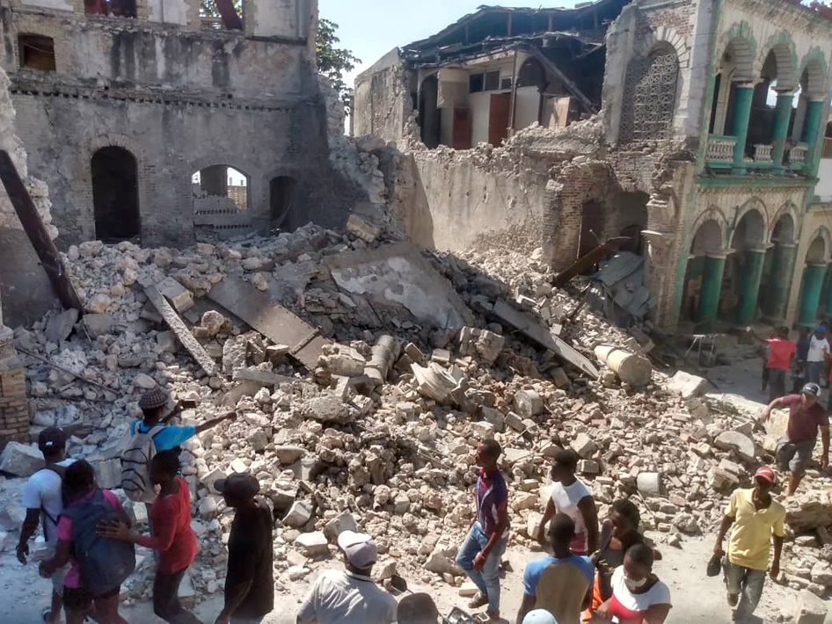
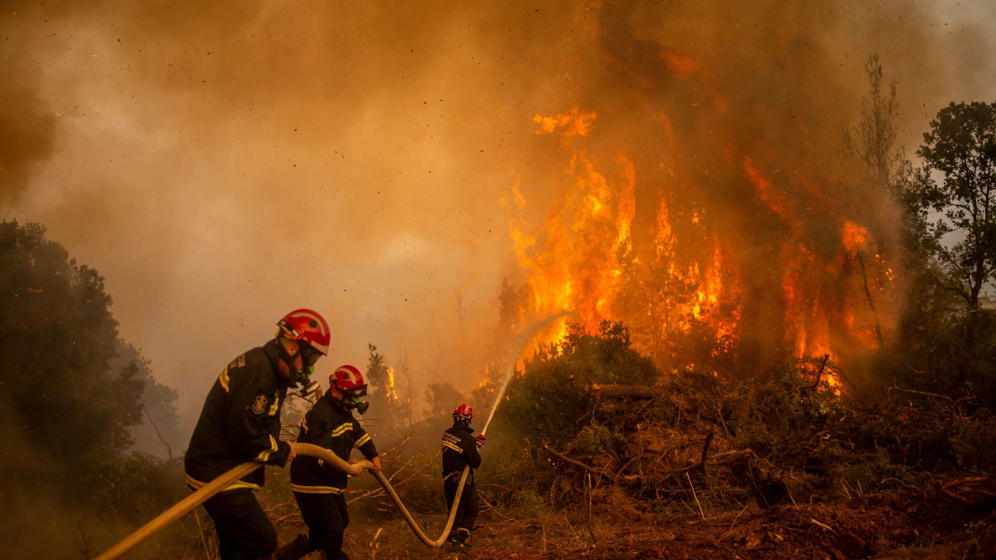

Slide 7
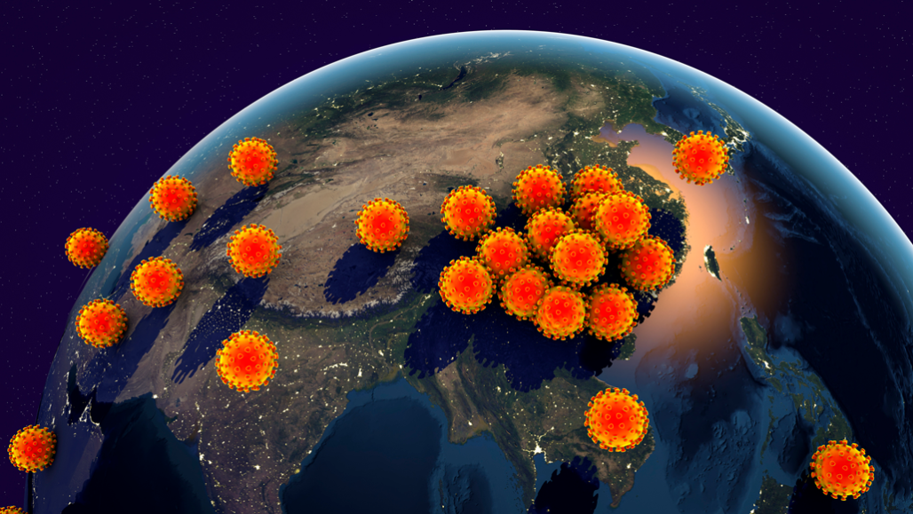
COVID-19
Matthew 24:7 (NKJV) ⁷ For nation will rise against nation, and kingdom against kingdom. And there will be famines, pestilences, and earthquakes in various places.

Slide 8
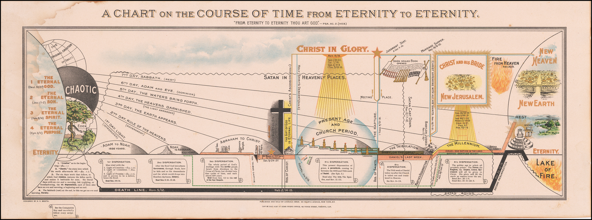
ADAM – ABRAHAM
2000 YEARS
“PATRIARCHAL AGE”
ADAM – CHRIST
2000 YEARS
“AGE OF LAW”
CHURCH AGE
2000 YEARS
“AGE OF GRACE”
ETERNITY

Slide 12
The second coming of Jesus may not be immediate, it is imminent.

Slide 15
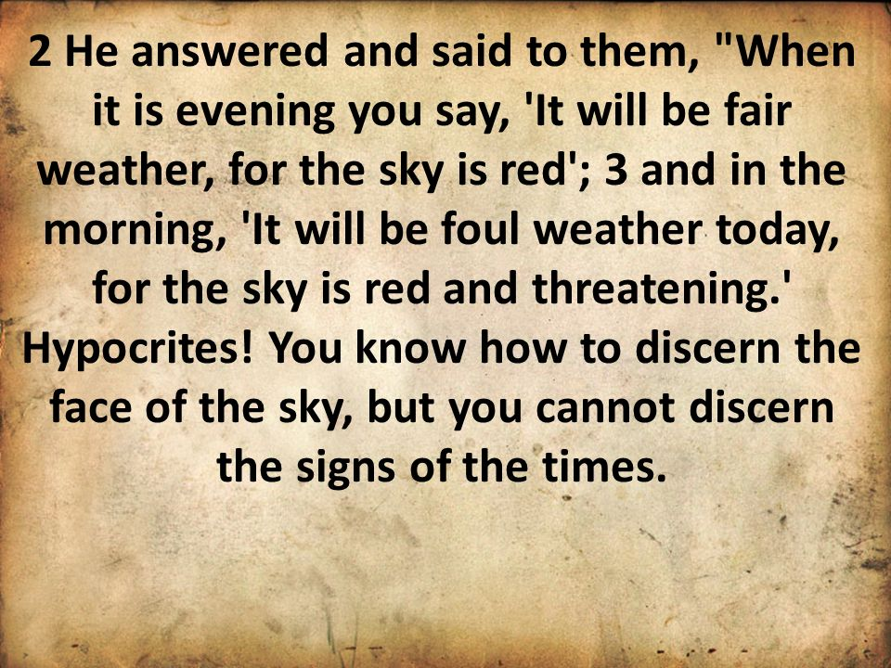
MATTHEW 16

Slide 16
There are basically two things in 1 Peter 4:7-11 which flow from this statement "But the end of all things is at hand.”
There are first of all some implications for our Daily Life. And secondly there are some motivations for our Daily Life.

Slide 17
1 Peter 4:7-9 (NKJV) ⁷ But the end of all things is at hand; therefore be serious (sober) and watchful in your prayers. ⁸ And above all things have fervent love for one another, for "love will cover a multitude of sins." ⁹ Be hospitable to one another without grumbling.
Focus on these two words “SERIOUS” and “WATCHFUL”.

Slide 19
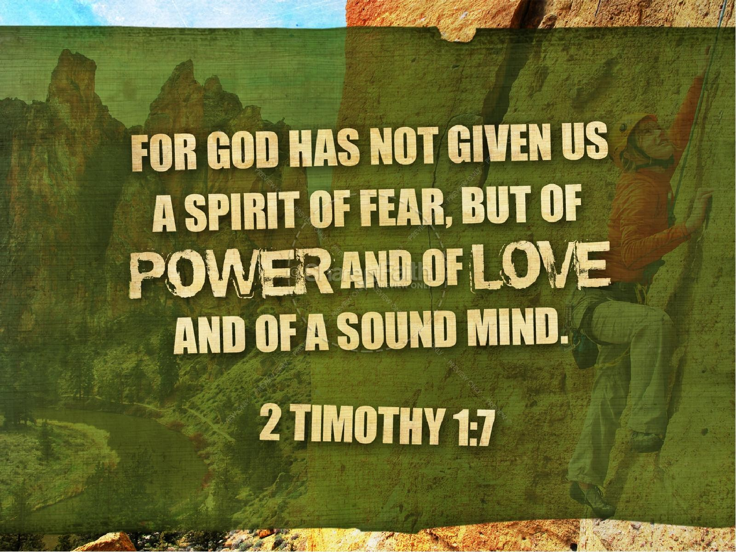

Slide 22
PETER WANTS US TO UNDERSTAND THE IMPORTNANCE OF PRAYER

Slide 23
Peter says that we ought to
be rightly concerned about, and connected to, our spiritual family.

Slide 24
Above all things

Slide 26
LOVE COSTS
#1

Slide 27
LOVE COSTS
It cost us something to love people!

Slide 30
LOVE COSTS
#1
LOVE COVERS
#2
"love will cover a multitude of sins".

Slide 32
LOVE COSTS
#1
LOVE COVERS
#2
LOVE CARES
#3
"Be hospitable to one another without grumbling"

Slide 34
“Behold how those Christians at FBCL love one another!”

Slide 36
WATCHMAN PRAYER
Sunday, August 29, 2021
Prayer Week – 35 Prayer Night – 1545
Prayer Requests as of August 25, 2021:
OTHER PRAYER REQUESTS: (italicized – new requests)
Preschool/Children’s Department Sunday School Workers
Marriages within the church family
Kathy Bennett – family situations, medical issue
Sonya Ziegenfelder – Joel, pressure building around brain tumor
Andi Hanson –surgery recovery
Moji Gaintner – healing of eye issues
Sam Woods – health (pneumonia)
Mark Lundy – son, Mike, surgery recovery
Amy Carroll – daughter, Sarah, surgery recovery
New England, Haiti, Tennessee storm recoveries
Families awaiting COVID results/those with COVID
SALVATION:
Adaira, Adam, Adam S. (RCC), Barry, Bob, Brandi, Christopher, Corey, Deb, Dianna, Fluff, Fred (RCC), Guy, Harry, Hiroyuki, Ivan, Jeff, Jerrod, John, Linda S., Lisa L., Megumi M., Michelle, Noriko, Paul, Philip, Randa, Rory, Sera, Sivara, Staycia, Tina, Whitney, Yukiko, co-workers, family members
Afghanastan, Haiti, etc.
Anderson, Jack & Becky
Beats, Ed
Berge, Patty
Bostwick, Lloyd
Brown, Irma
Bumgarner, Grant
Burbank, Jim & Sarah
Claypoole, Wendy
Elliott, Charles & Elaine
Farrell, Greg
Felgar, Stan
French, Ken & Terry
Gandee, Ina
Gaviglio, Don
Greer, George & Arlene
Halsted, Shirley
Hanson, Bill
Howard, Richard
Jones, Tim & Brynne
Lane, Young
Latshaw, C.C. & Kaz
Lougheed, Jim
McKinney, Allen
Morrow, Dene
Morse, Georgia
Perez, Clara
Potter, D. Lee
Rarden, Al
Richardson, Marian
Robbins, Alvie
Shaw, Lonnie & Liz
Simmons, Matt
Walker, Ernie
Wutz, Bruce & Cheryl
Ziegenfelder, Rush

