Slide 1
Finding Our Significance
IN GOD
Ecclesiastes 1:12-15; 2:18-26

Slide 2
"For eye-trouble spittle was commonly used, but we are told there is a tradition that the spittle of the first-born son of a father has healing powers..." (A. Cohen, Everyman’s Talmud, p. 253).

Slide 3
Jesus used spit
to help a blind
man see, so
I know Jesus
can use me.

Slide 4
John 3:16-17
“For God so loved the world, that He gave His only Son, that whoever believes in him should not perish but have eternal life. For God did not send his Son into the world to condemn the world, but in order that the world might be saved through Him.”

Slide 5
Worth and significance is found in understanding God’s purpose for our life; and then acting upon it.

Slide 6
DAVID PACKARD (1912-1996)

Slide 7
¹ Behold what manner of love the Father has bestowed on us, that we should be called children of God! Therefore, the world does not know us, because it did not know Him. ² Beloved, now we are children of God; and it has not yet been revealed what we shall be, but we know that when He is revealed, we shall be like Him, for we shall see Him as He is. ³ And everyone who has this hope in Him purifies himself, just as He is pure.
^{1 JOHN 3:1-3 (NKJV)}

Slide 11
FOUR SPIRITUAL DISCIPLINES
W_________, S___________, D_________
and F______________

Slide 12
Worship, Stewardship, Discipleship and Fellowship

Slide 14
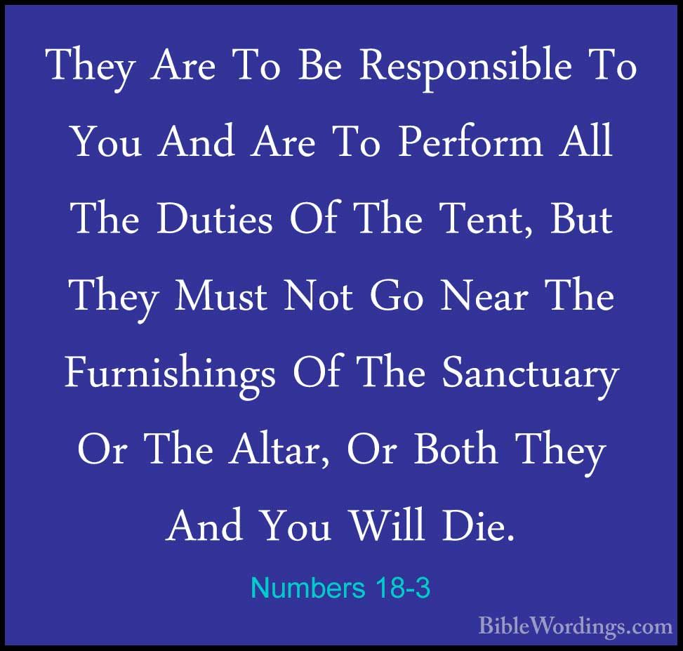

Slide 15
We see both the acts of worship and stewardship as Adam and Eve co-labored with God.

Slide 16
With stewardship, comes responsibility, and with responsibility come significance!

Slide 17
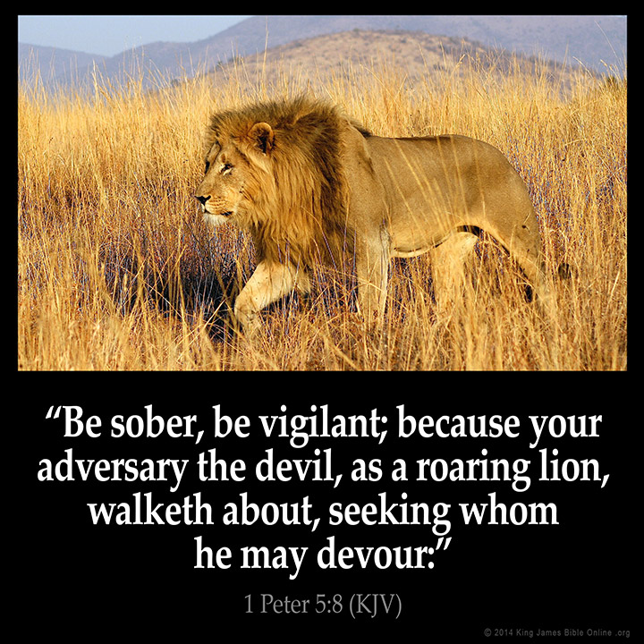

Slide 19
The aim of the Christian’s life is to be
transformed into the likeness of God’s Son.

Slide 20
By seeking God, and doing what
the LORD has told us to do, we find worth and significance.

Slide 21
Worship, Stewardship, Discipleship and Fellowship

Slide 24
We were not created to live independent of others, we were created to be interdependent.

Slide 25
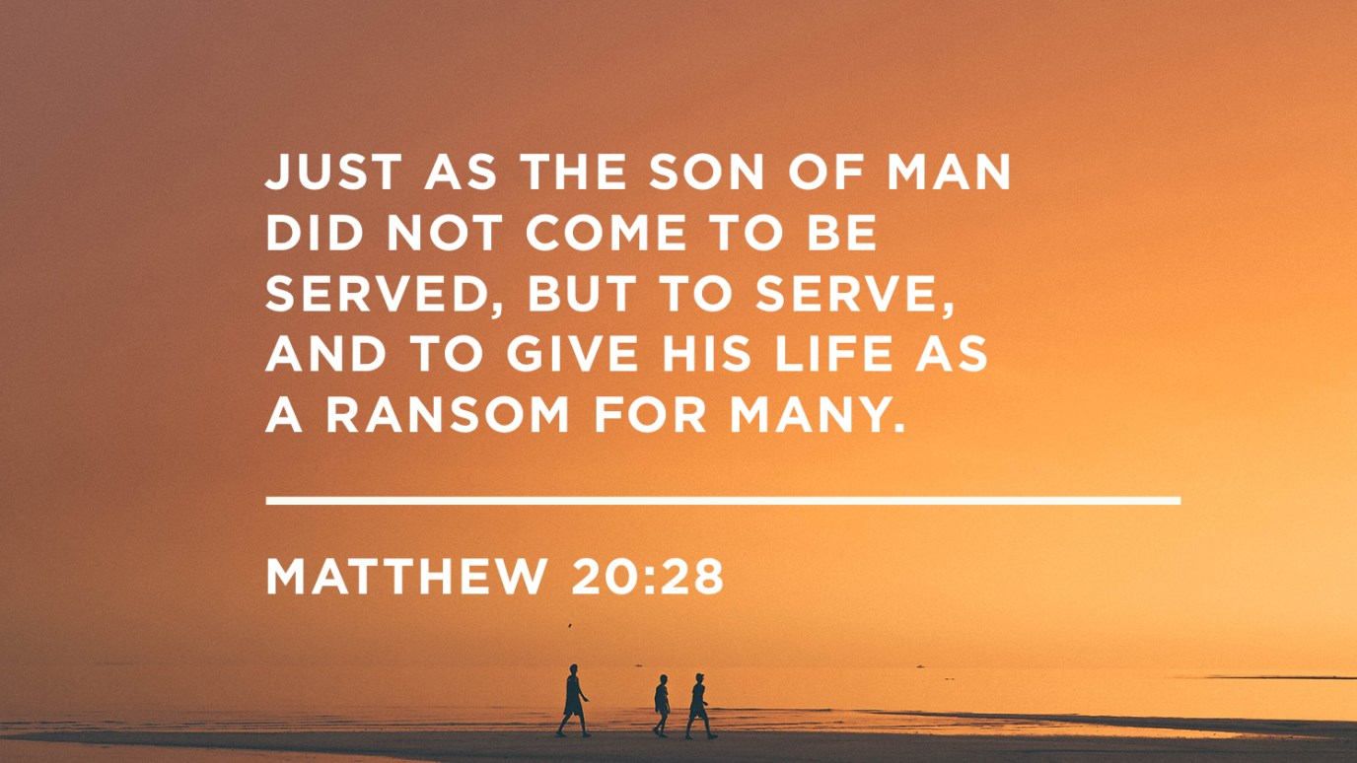

Slide 26
“Get Out of Your Head”
“The fact is, our brains are hardwired to thrive when we are serving others. Though subconsciously we seek to be served and have our needs met, research has proved that our brains actually do much better when we’re on the giving end rather than the receiving end. Serving others reduces activity in the stress-and threat-related parts of our brains.⁸ People who live with purpose sleep better and live longer.⁹ Serving others lights up a region that is part of the brain’s reward system,¹⁰ which helps us recognize and pursue things that bring us pleasure like a good meal, and encouraging interaction with a friend, or a hug from a trusted family member.”

Slide 27
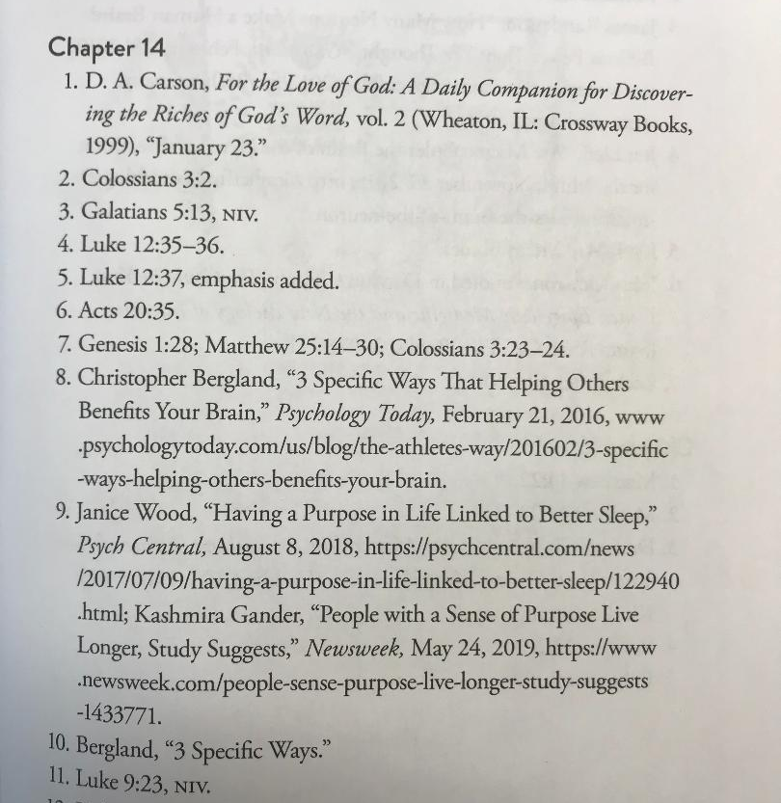
CITATIONS

Slide 28
Worship, Stewardship, Discipleship and Fellowship

