Slide 2
A Good, Good Father
Mark 10:17-22

Slide 3
The best father of all is our Heavenly Father above!

Slide 4
The New Testament refers to God
as a Father over 25 times!

Slide 5
Four essential characteristics of God,
our Heavenly Father, that every Christian should strive to emulate.

Slide 6
FBC LAKEWOOD, WA
The first characteristic is FAITHFULNESS,

Slide 7
How about you? Will people say, especially your children, at the end of your life, that you were faithful?

Slide 8
“Every good and perfect gift is from the Father above, who does not change like shifting shadows.” James 1:17
“Even if we are faithless, He remains faithful.”
2 Timothy 2:13

Slide 9
May it be said of us after we are gone “Great was our faithfulness.”

Slide 11
FBC LAKEWOOD, WA
The second characteristic of our Heavenly Father is to be FORGIVING.

Slide 12
Our Heavenly Father is not only Faithful,
but Forgiving!

Slide 13
FBC LAKEWOOD, WA
The third characteristic of our Heavenly Father, FAVOR.

Slide 14
FBC LAKEWOOD, WA
The fourth characteristic of God is the ability
to focus on the FUTURE.

Slide 19
A FUTURE! A hope filled future!
A perfect future in Heaven.

Slide 20
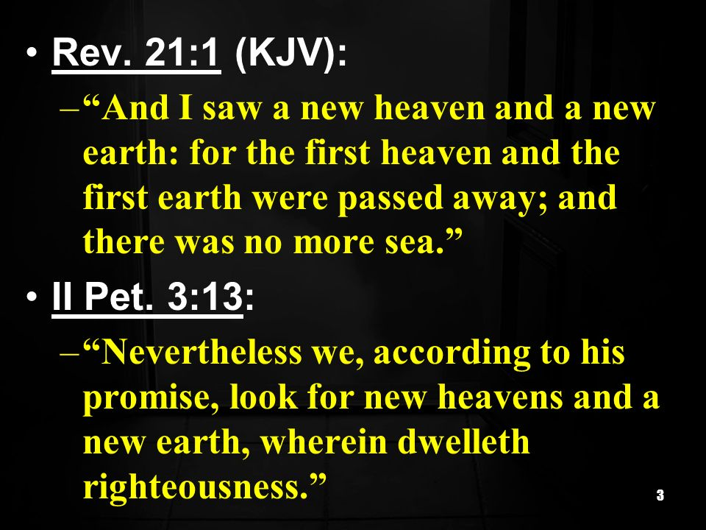

Slide 21
Because He’s a
That’s who He is

