Slide 1
What Does Jesus Ask Us to Remember?
1 Corinthians 11:23-26

Slide 3
In our study today of Luke 19, Jesus is on His way to Jerusalem with His disciples, to fulfill His God-given mission; our redemption!

Slide 4
For He shall grow up before Him as a tender plant,
And as a root out of dry ground.

Slide 5
Jesus wanted them to remember this, when the things He had just told them came to pass!

Slide 6
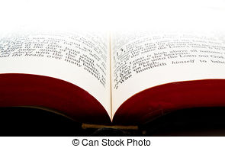
¹¹ I am the good shepherd. The good shepherd gives His life for the sheep. I lay down My life for the sheep. ¹⁶ And other sheep I have which are not of this fold; them also I must bring, and they will hear My voice; and there will be one flock and one shepherd.
John 10:11, 16--18 (NKJV)

Slide 7
¹⁷ Therefore My Father loves Me, because I lay down My life that I may take it again. ¹⁸ No one takes it from Me, but I lay it down of Myself. I have power to lay it down, and I have power to take it again. This command I have received from My Father."
John 10:11, 16-18 (NKJV)

Slide 8
Jesus wanted His disciples to know that the very thing that would keep them from falling away, from forsaking their faith, was the simple matter of remembering! Remembering what Jesus did, and what Jesus said!

Slide 9
1. Remember what Jesus did…

Slide 10
JESUS’
His power to turn ordinary water into wine.
His authority over the wind and the sea.
His power to walk on water,
His power to fill their fishing nets with fish.
His authority over disease and the demons,
His power to multiply the fish and loaves of bread and feed the multitudes and have food left over.

Slide 13
Jesus testified that it was His mission to do the works of Him who sent Me. ^{John 9:4}

Slide 14
Jesus proclaimed, “My food is to do the will of Him who sent me and to finish His work.” ^{John 4:34} ^{CSB}
John the Baptist testified to the mission of Jesus, “Behold the Lamb of God who takes away
he sins of the world^{.” John 1:29 NKJV}

Slide 18
As the apostle Paul put it: “Here is a trustworthy saying that deserves full acceptance: Christ Jesus came into the world to save sinners.”
1 Timothy 1:15

Slide 20
2. Remember what Jesus said…

Slide 21
Jesus said that those who trust in Him will receive forgiveness for their sins.
^{Matthew 9:6}

Slide 22
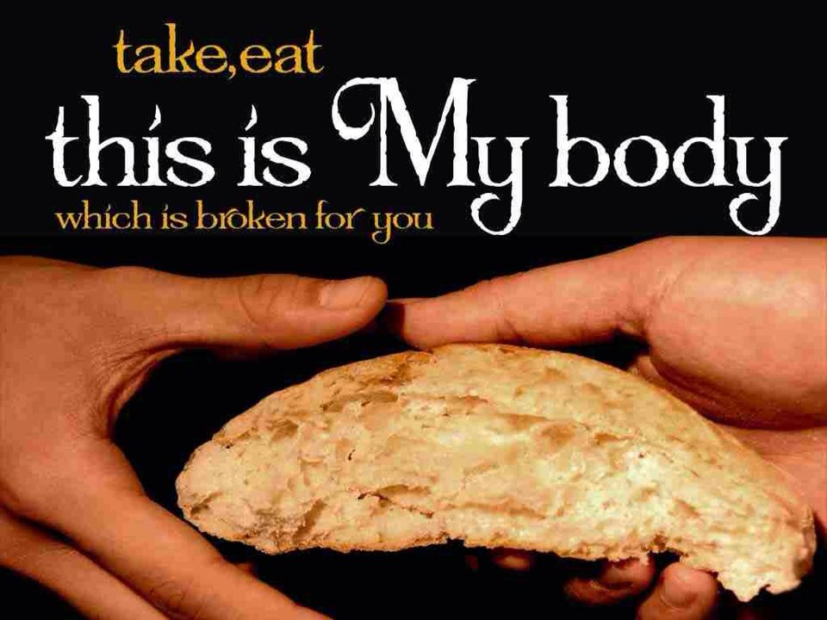

Slide 23
Jesus said,
“Do this in remembrance of me!”
^{1 Corinthians 11:24}

Slide 27
THE
LORD’S SUPPER

Slide 29
Jesus said, pray this prayer! forgive
us our sins, as we have forgiven
those who sin against us.”
^{Matthew 6:9-11 NLT}

Slide 31
Jesus said, those who have received Him, are the children of God.
^{John 1:12 NKJV}

