Slide 1
Saying Things You Should Never Say!
Matthew 5:33-37 & Luke 9:57-62

Slide 2
³³ “You have also heard that our ancestors were told, ‘You must not break your vows; you must carry out the vows you make to the LORD.’ ³⁴ But I say, do not make any vows! Do not say, ‘By heaven!’ because heaven is God’s throne. ³⁵ And do not say, ‘By the earth!’ because the earth is his footstool. And do not say, ‘By Jerusalem!’ for Jerusalem is the city of the great King. ³⁶ Do not even say, ‘By my head!’ for you can’t turn one hair white or black. ³⁷ Just say a simple, ‘Yes, I will,’ or ‘No, I won’t.’ Anything beyond this is from the evil one.
Matthew 5:33-37 (NLT2)

Slide 3
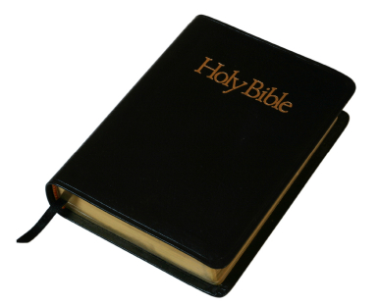
“But most of all, my brothers and sisters, never take an oath by heaven or earth or anything else. Just say a simple yes or no.” James 5:12

Slide 4
1. PROFESSING DISCIPLES

Slide 5
In our text for this morning in Luke we read of those who came to Jesus and said,

Slide 7
⁵⁷ Now it happened as they journeyed on the road, that someone said to Him, "Lord, I will follow You wherever You go." ⁵⁸ And Jesus said to him, "Foxes have holes and birds of the air have nests, but the Son of Man has nowhere to lay His head." ⁵⁹ Then He said to another, "Follow Me." But he said, "Lord, let me first go and bury my father." ⁶⁰ Jesus said to him, "Let the dead bury their own dead, but you go and preach the kingdom of God." ⁶¹ And another also said, "Lord, I will follow You, but let me first go and bid them farewell who are at my house." ⁶² But Jesus said to him, "No one, having put his hand to the plow, and looking back, is fit for the kingdom of God."
Luke 9:57-62 (NKJV)

Slide 8
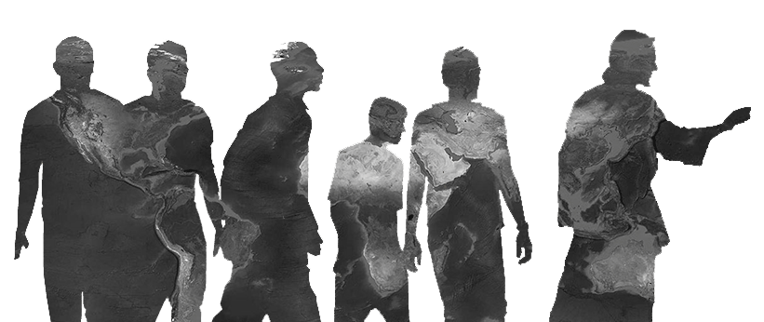
2. POTENTIAL DISCIPLES

Slide 9
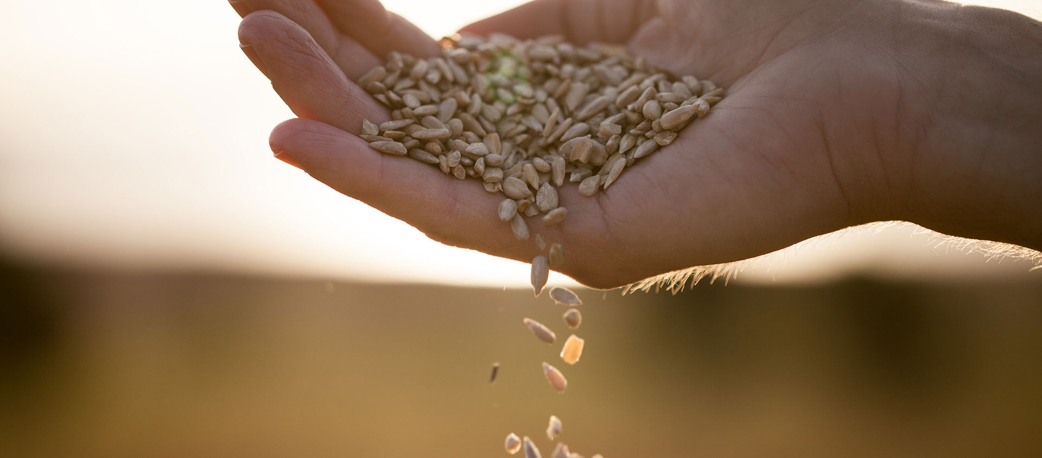
The Parable of the Sower
Luke 8

Slide 11
²³ Then He said to them all, "If anyone desires to come after Me, let him deny himself, and take up his cross daily, and follow Me. ²⁴ For whoever desires to save his life will lose it, but whoever loses his life for My sake will save it. ²⁵ For what profit is it to a man if he gains the whole world, and is himself destroyed or lost? ²⁶ For whoever is ashamed of Me and My words, of him the Son of Man will be ashamed when He comes in His own glory, and in His Father's, and of the holy angels.
Luke 9:23-26 (NKJV)

Slide 12
“You cannot serve two masters, for either you will hate the one, and love the other; or else you will hold to the one, and despise the other. You cannot serve God and mammon.” Matthew 6:24

Slide 14
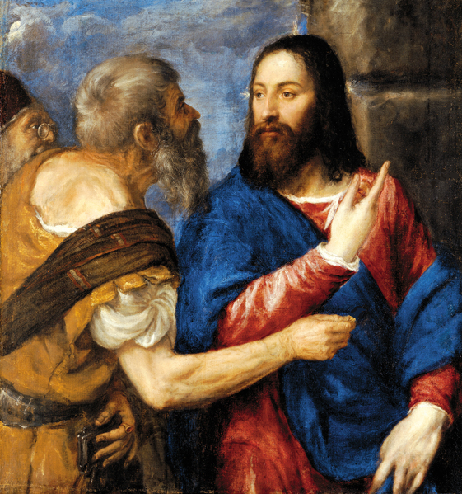
“Even if everyone else deserts you,
I will never
desert you.”
Matthew 26:33

Slide 15
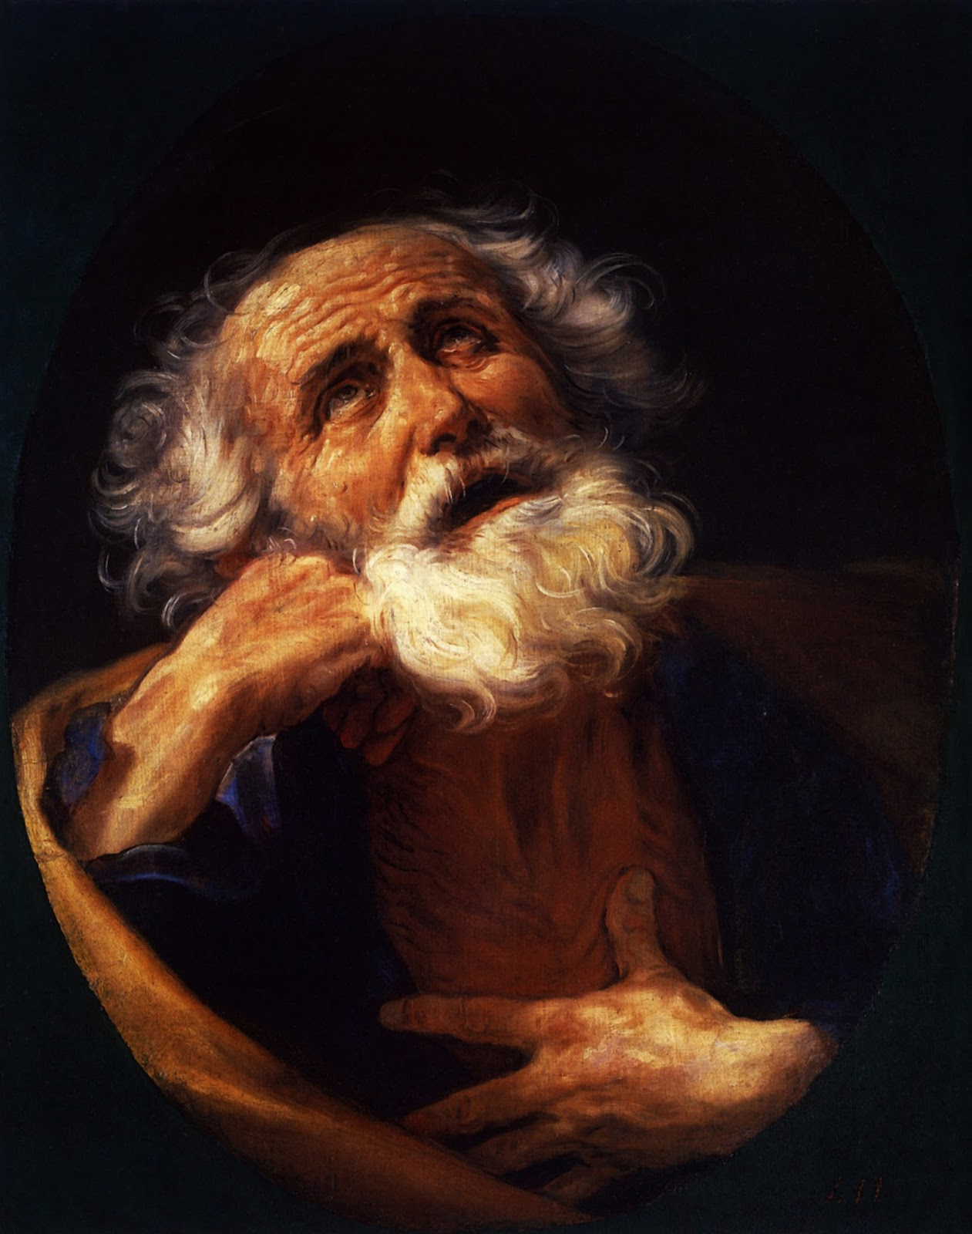
PETER

Slide 23
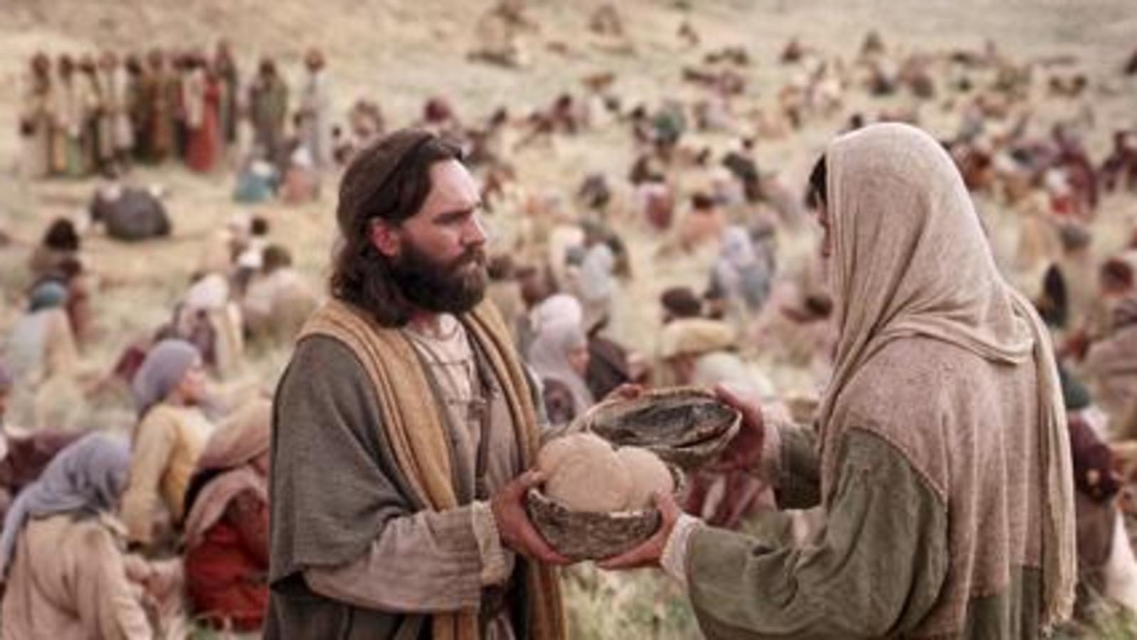
3. PRACTICING DISCIPLES

Slide 24
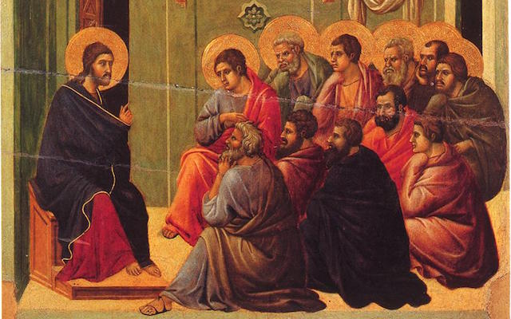
You will not be a “disciple maker” if you
are not a practicing disciple, yourself.

Slide 25
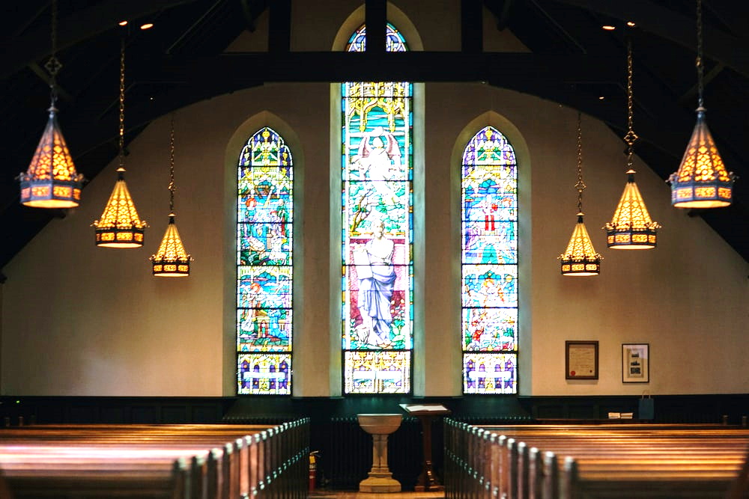

Slide 26
What does a practicing
disciple looks like?

Slide 27
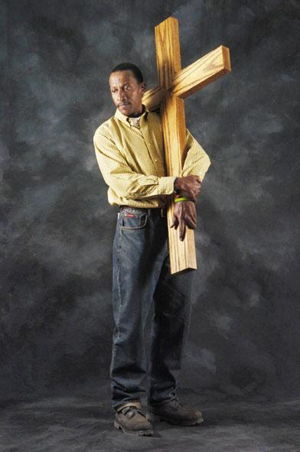
Luke 9:23 - First Descriptor…
²³ If anyone desires to come after Me, let him deny himself,

Slide 28
Second Descriptor…
²³ If anyone desires to come after Me, let him deny himself, and take up his cross daily, and follow Me.

Slide 29
²⁴ For whoever desires to save his life will lose it, but whoever loses his life for My sake will save it. ²⁵ For what profit is it to a man if he gains the whole world, and is himself destroyed or lost? ²⁶ For whoever is ashamed of Me and My words, of him the Son of Man will be ashamed when He comes in His own glory, and in His Father's, and of the holy angels.

Slide 30
Luke 14:26
²⁶ "Anyone who wants to be my follower must love me far more than he does his own father, mother, wife, children, brothers, or sisters—yes, more than his own life—otherwise he cannot be my disciple.

Slide 31
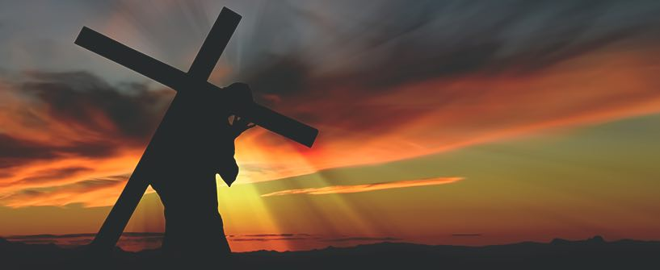
Luke 14:27
And no one can be my disciple who does
not carry his own cross and follow me.

Slide 35
JESUS:

Slide 36
I Will Follow Jesus
I
Surrender
All

