Slide 1
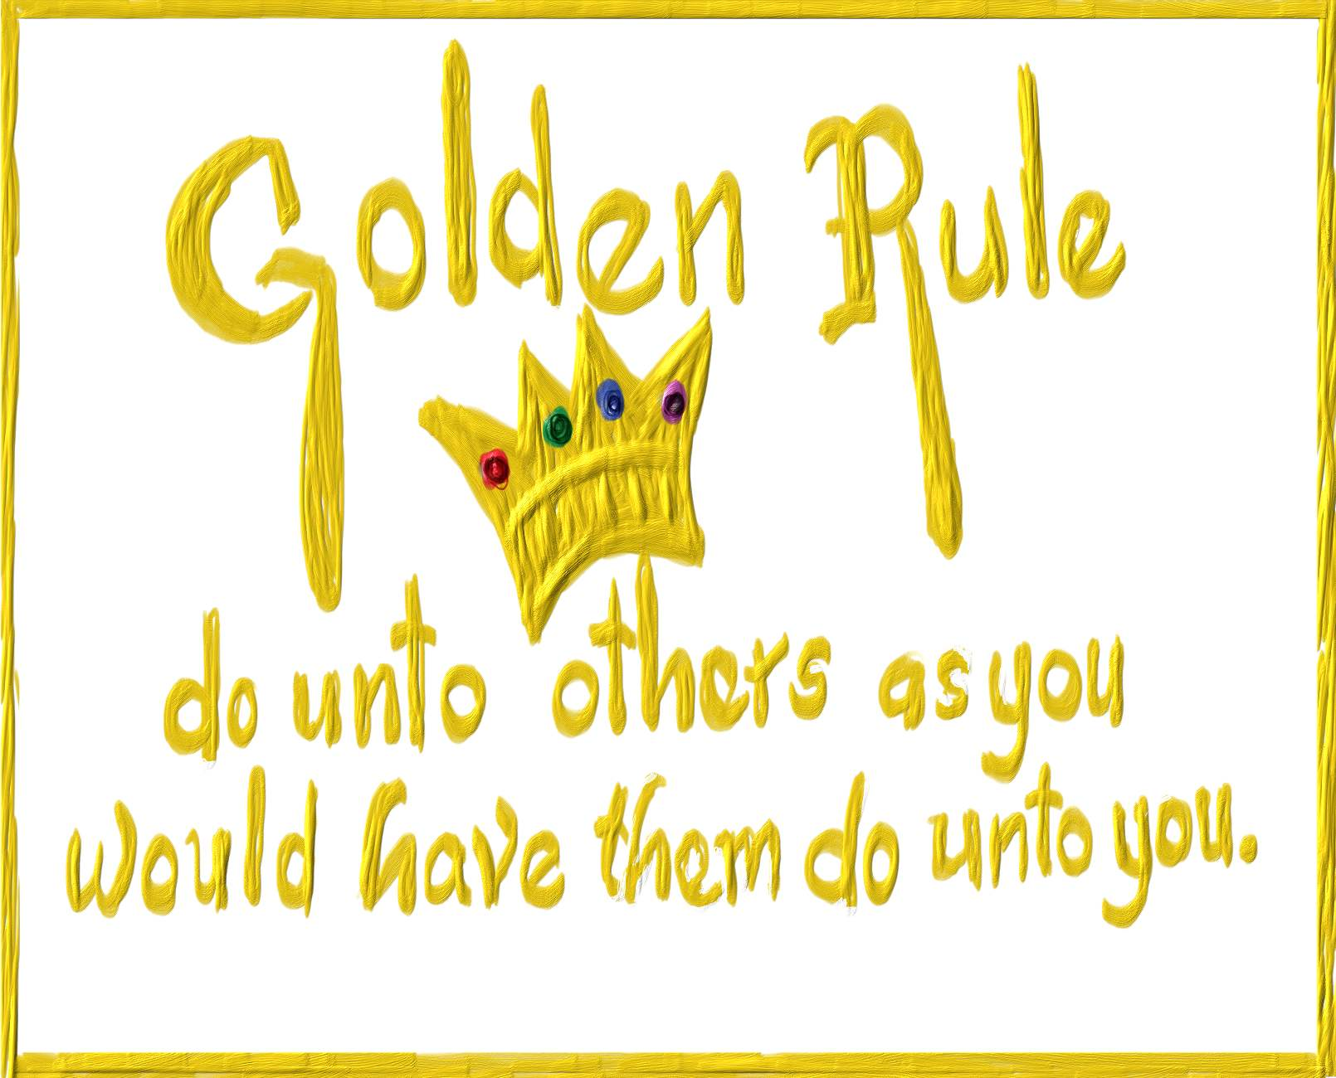
The Golden Rule
Luke 6:27-38

Slide 2
We see that Jesus entered a world already divided and He would contribute to the divide that already existed.
The
Golden
Rule

Slide 3
“Do you think I have come to bring peace to the earth? No, I have come to divide people against each other.” ^{Luke 12:51}
"Do not suppose that I have come to bring peace to the earth. I did not come to bring peace, but a sword.” ^{Mat. 10:34}

Slide 4
Luke 6:9
“Is it lawful on the Sabbath to do good or
to do evil, to save life or to destroy?”

Slide 5
Mark 3:6
“Then the Pharisees went out and immediately plotted with the Herodians against Him, how they might destroy Him.”

Slide 6
There will always be fault finders criticizing those who are doing good.
The
Golden
Rule

Slide 7
It is in this context, that Jesus presents many principles about life in the Kingdom of God and the good that we can do for others, while here on earth.
One of those principles is
the Golden Rule.
The
Golden
Rule

Slide 8
Where the Golden Rule Originate?
For the Christian ethicist it is
traced back to Leviticus 19:2
The
Golden
Rule
“Speak to the entire Israelite community
and tell them… Love your neighbor as yourself; I am the Lord.”

Slide 9
Matthew 22:36-40
“Teacher which is the most important commandment in the law of Moses?” Jesus replied, “You must love the LORD your God with all your heart, all your soul, and all your mind. This is the first and greatest commandment. A second is equally important: Love your neighbor as yourself. The entire law and all the demands of the prophets are based on these two commandments.

Slide 10
²⁷ Love your enemies, do good to those who hate you, not just to those that are likeable ²⁸ bless those who curse you, and pray for those who spitefully use you. ²⁹ To him who strikes you on the one cheek, offer the other also. (turn the other cheek) And from him who takes away your cloak, do not withhold your tunic either. ³⁰ Give to everyone who asks of you. And from him who takes away your goods (things) do not ask them back.
^{Luke 6:27-38 (NKJV)}

Slide 11
³¹ And just as you want men to do to you, you also do to them likewise. You want others to do good to you, to be kind to you, to bless you, to pray for you, (to help you) to lend to you, when you are in need, and to forgive you when you need forgiveness. ³² But if you love those who love you, what credit is that to you? For even sinners love those who love them. ³³ And if you do good to those who do good to you, what credit is that to you? For even sinners do the same.
^{Luke 6:27-38 (NKJV)}

Slide 12
Luke 6:27a and vs. 31a
²⁷ But say to you who hear...
³¹ And just as you want men to do to you, you also do to them likewise.
THIS IS CALLED THE GOLDEN RULE!
The
Golden
Rule

Slide 13
³⁴ And if you lend to those from whom you hope to receive back, what credit is that to you? For even sinners lend to sinners to receive as much back. ³⁵ But love your enemies, do good, and lend, hoping for nothing in return; and your reward will be great, and you will be children of the Most High. For He is kind to the unthankful and evil.
^{Luke 6:27-38 (NKJV)}

Slide 14
³⁶ Therefore be merciful, just as your Father also is merciful. ³⁷ "Judge not, and you shall not be judged. Condemn not, and you shall not be condemned. Forgive, and you will be forgiven. ³⁸ give, and it will be given to you: good measure, pressed down, shaken together, and running over will be put into your bosom. For with the same measure that you use, it will be measured back to you."
^{Luke 6:27-38 (NKJV)}

Slide 15
Luke 6:38 a
Give, and it will be
given to you!

Slide 16
John 15:5-14
⁵ “I am the vine; you are the branches. Those who remain in me, and I in them, will produce much fruit. For apart from me you can do nothing. ⁶ Anyone who does not remain in me is thrown away like a useless branch and withers. Such branches are gathered into a pile to be burned. ⁷ But if you remain in me and my words remain in you, you may ask for anything you want, and it will be granted!

Slide 17
John 15:5-14
⁸ When you produce much fruit, you are my true disciples. This brings great glory to my Father. ⁹ “I have loved you even as the Father has loved me. Remain in my love. ¹⁰ When you obey my commandments, you remain in my love, just as I obey my Father’s commandments and remain in his love.

Slide 18
John 15:5-14
¹¹ I have told you these things so that you will be filled with my joy. Yes, your joy will overflow! ¹² This is my commandment: Love each other in the same way I have loved you. ¹³ There is no greater love than to lay down one’s life for one’s friends. ¹⁴ You are my friends if you do what I command.

Slide 19
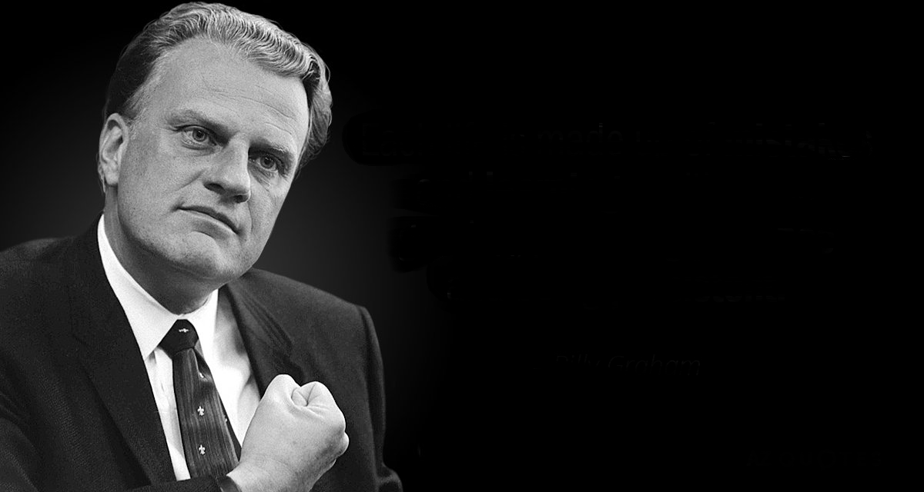
“Don’t try to live the way you should in your own strength. Instead, ask Christ to come into your life to
cleanse you and save you. Then ask Him to give you a new love for
others, and to help you treat them
the way you would want to be treated. How different our world would be if everyone did!”

Slide 20
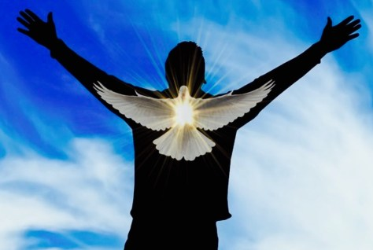

Slide 21
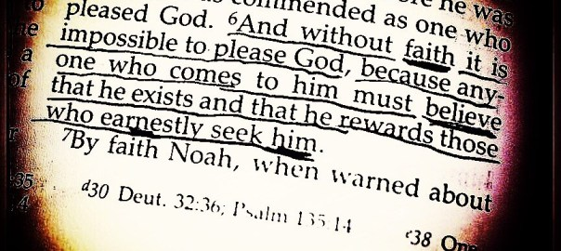

Slide 22
The compassionate know that every heartbeat matters to God.
The question is, does ever heartbeat
matter to us?
IT DOES TO GOD!
The
Golden
Rule

Slide 23
Get your copy TODAY!
Yours FREE if you stop
by the table in the foyer
as you leave,
on your RIGHT!

