Slide 1
Proverbs 15:13-24

Slide 3
“O come, let us sing unto the Lord: let us make a joyful noise to the rock of our salvation. Let us come into His presence with thanksgiving, let us make a joyful noise unto Him with songs of praise! For the Lord is a great God, and a great King above all gods.”
Psalm 95:1-3

Slide 5
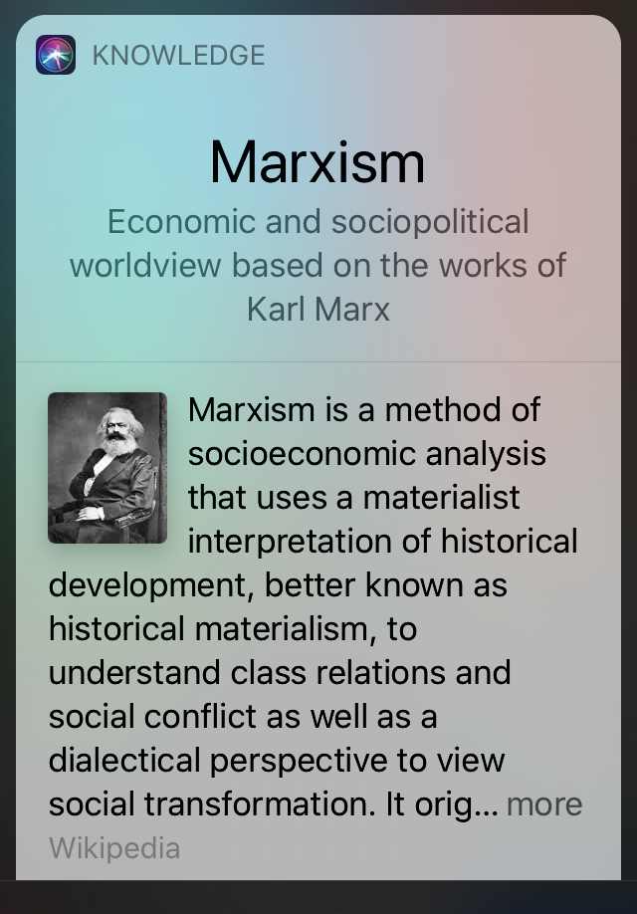
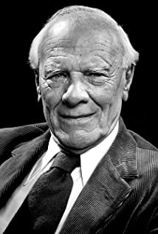
I read this week about Malcolm Muggeridge who himself was a Marxist* before he found Christ. His journalistic talent eventually led him to write some masterpieces for Christ, but he first wrote for Stalin.
*Not Compatible with Christianity
Malcolm Muggeridge

Slide 6
They would have us understand is that Joy is infectious. Joy is transformational. That’s the power of joy!

Slide 7
Biblical Joy is a foundational aspect of being a child of God,
it is the joy that comes from knowing Him and pleasing Him.

Slide 9
The best way to experience this joy is to be
in constant communion with God.

Slide 10
1. READING the Word of God and DOING what the Word says.

Slide 11
“Thy Word have I hid in my heart, that I might not sin against Thee.” ^{Ps. 119:11}
“May the words of my mouth and the meditation of my heart be pleasing to you, O LORD, my rock and my redeemer.” ^{Psalm 19:14 (NLT2)}

Slide 14
2. PRAYER, this is primarily a relational connection.

Slide 15
JOY

Slide 17
3. WORSHIP, is inspirational & transformational.

Slide 22
Let us therefore make every effort to do what
leads to peace and to mutual edification. - Romans 14:19 -

Slide 24
Psalm 43:4 (NKJV) ⁴ …I will go to the altar of God, To God my exceeding joy;
Psalm 16:11 (NKJV) ¹¹ You will show me the path of life; In Your presence is fullness of joy; At Your right hand are pleasures forevermore.

