Slide 1
DRESS FOR SUCCESS
ROMANS 13:12-14

Slide 4
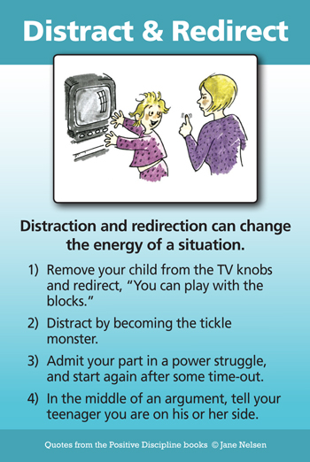

Slide 7
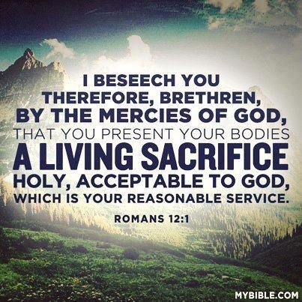

Slide 10
It is to live a life that has “no spot or wrinkle or any such thing” Eph. 5:27,
“to be found by Him in peace, spotless
and blameless” 2 Pet. 3:14.

Slide 12
Deportment:
The manner of conducting oneself,
Behavior, speech, manners.
Dress: To put clothes on.
To adorn a certain way.

Slide 13
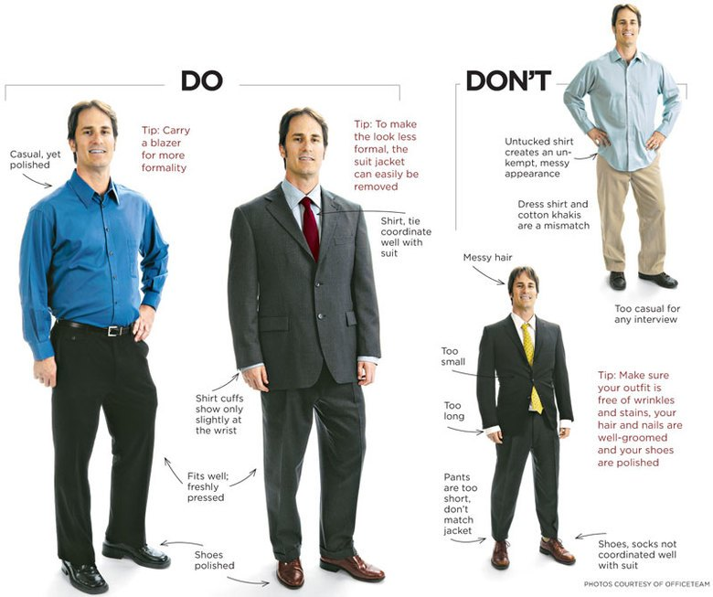

Slide 14
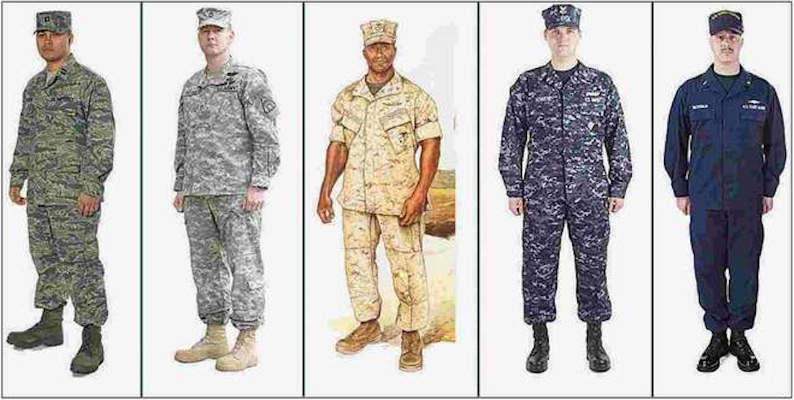

Slide 17
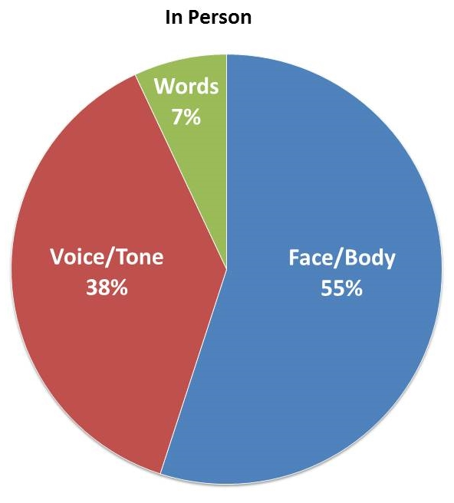

Slide 22
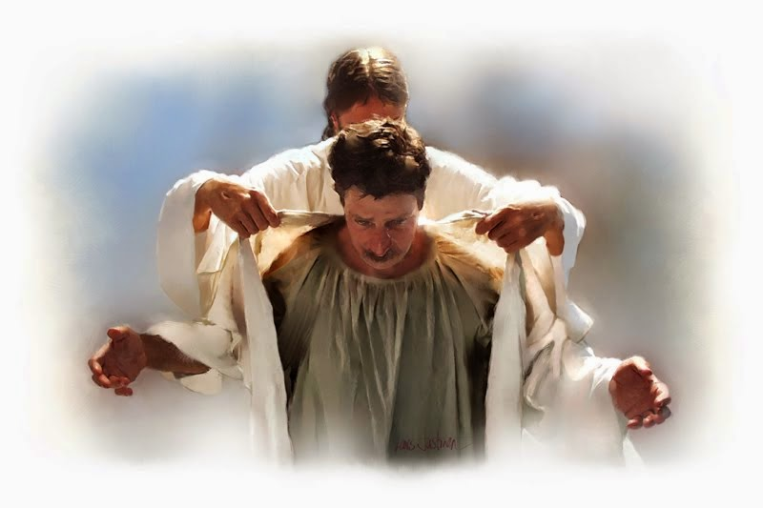
Romans 13:12 Therefore let us cast off the works of darkness,
and let us put on the armor of light.
The robe of righteousness

