Slide 1
ROMANS 5:1-5

Slide 4
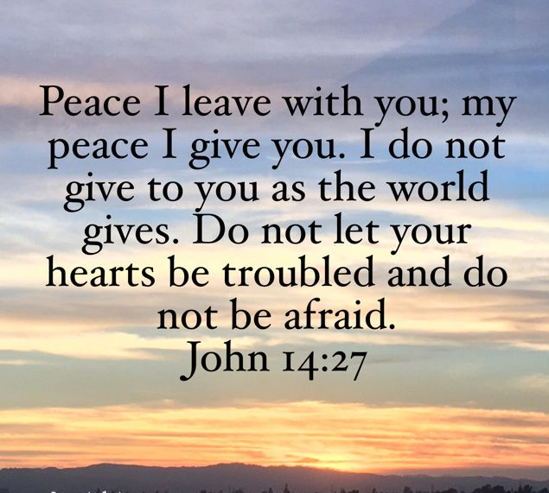

Slide 6
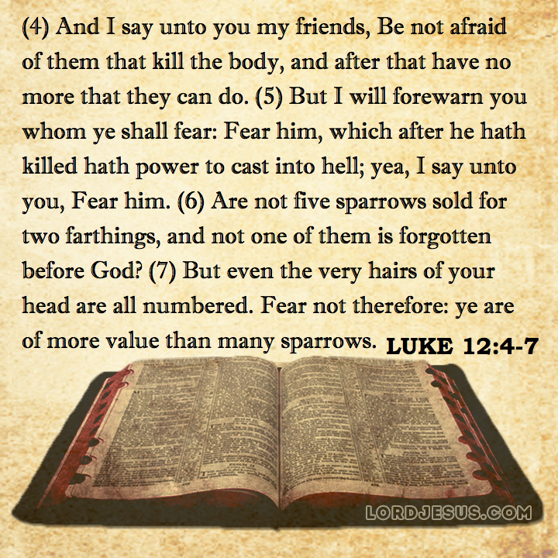

Slide 9
Then, the same day at evening, being the first day of the week, when the doors were shut where the disciples were assembled, for fear of the Jews, Jesus came and stood in the midst, and said to them,
"Peace be with you."
John 20:19

Slide 11
And after eight days His disciples were again inside, and Thomas with them. Jesus came, the doors being shut, and stood in the midst, and said, "Peace to you!"
John 20:26

Slide 12
HOW TO DEVELOP
PEACE

Slide 15
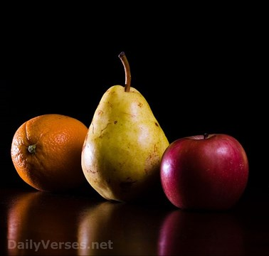
The fruit of the Spirit
Is love, joy and peace…
GALATIANS 5:22

Slide 16
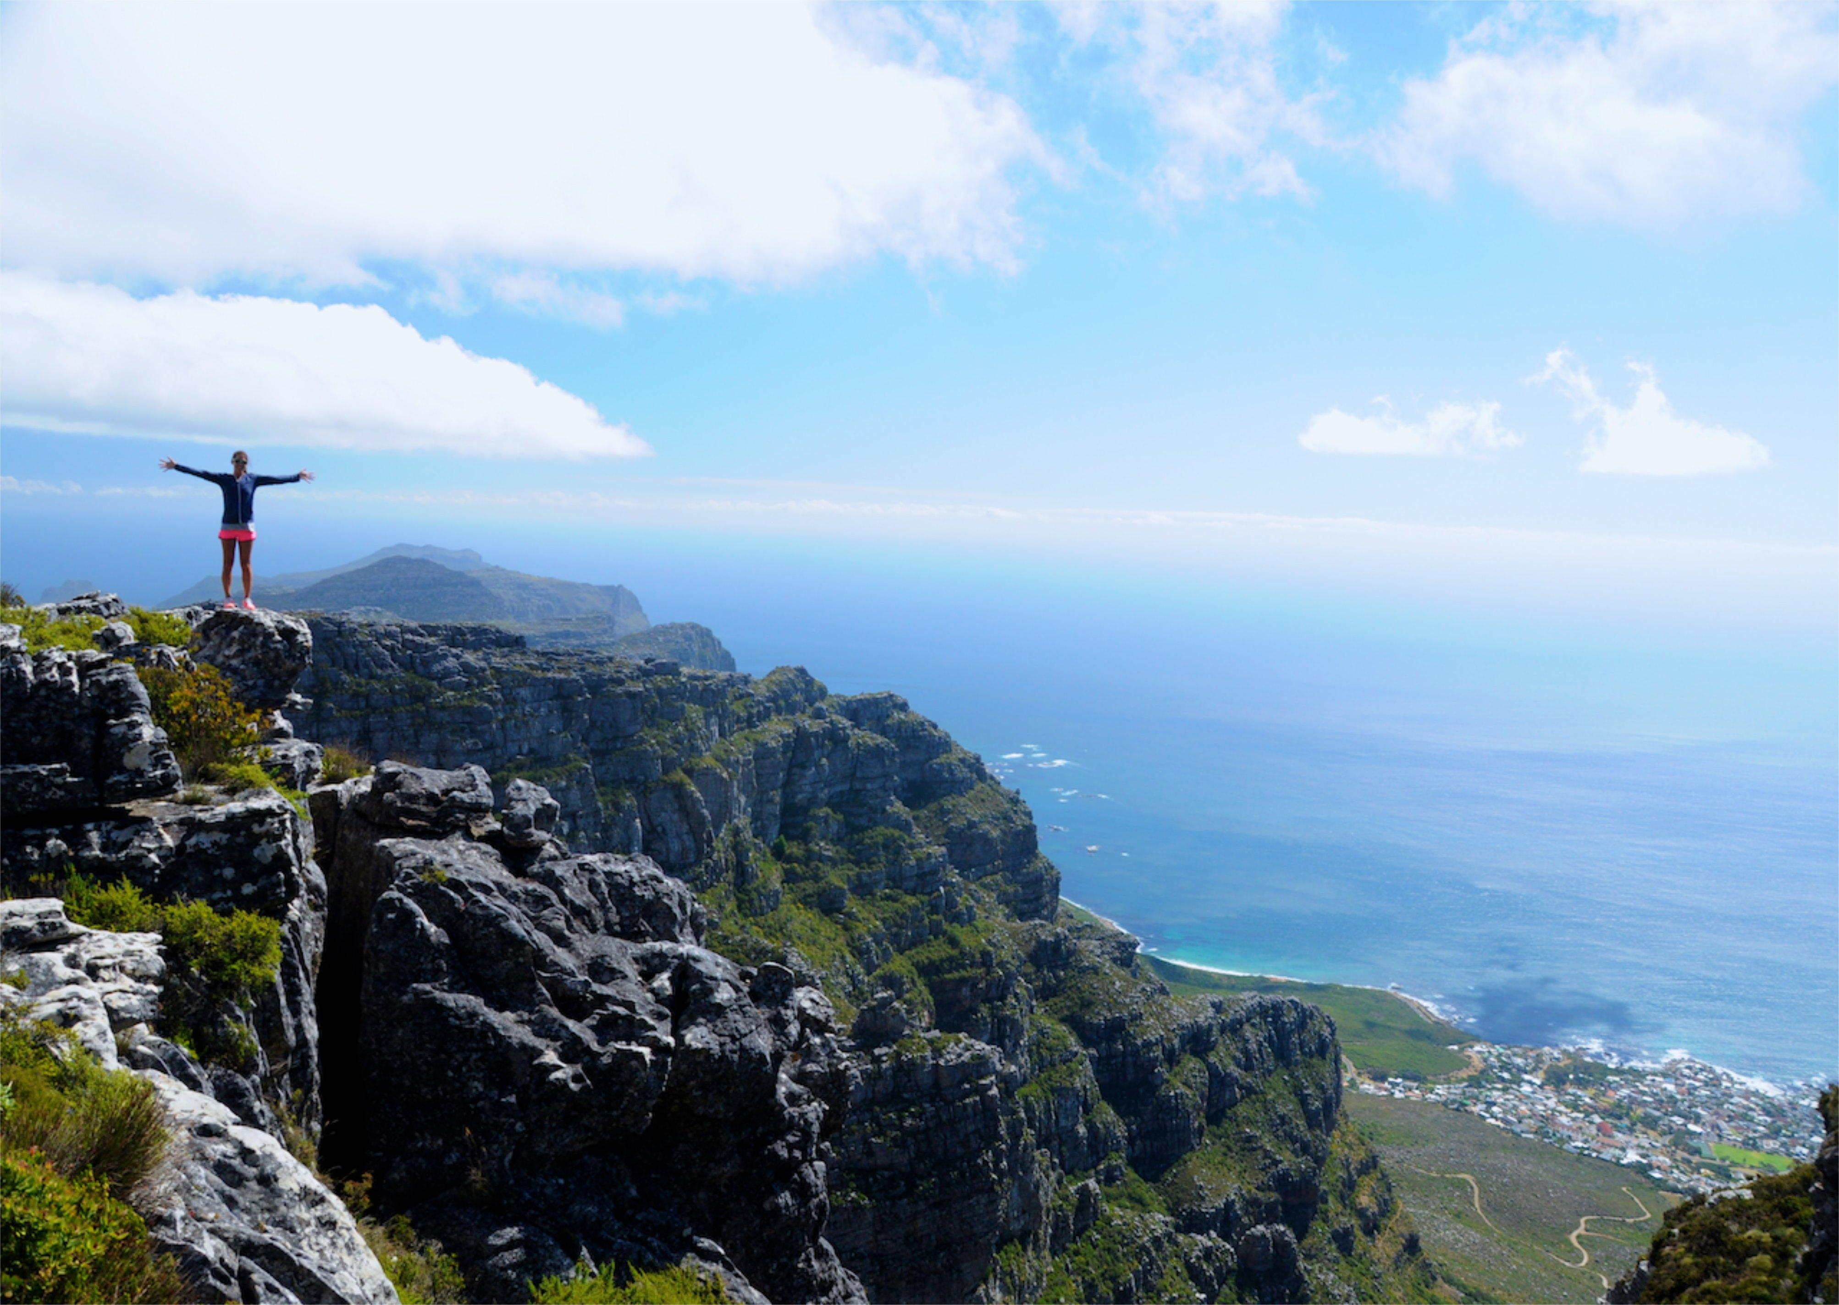
Peace comes from exercising faith in the character of God and in hiding His Word in our hearts.

Slide 17
“All things work together for the good to those who love God and are called according to His purpose.”
Romans 8:28

Slide 18
LIVE LIFE IN
PEACE!
NOT IN PIECES

Slide 20
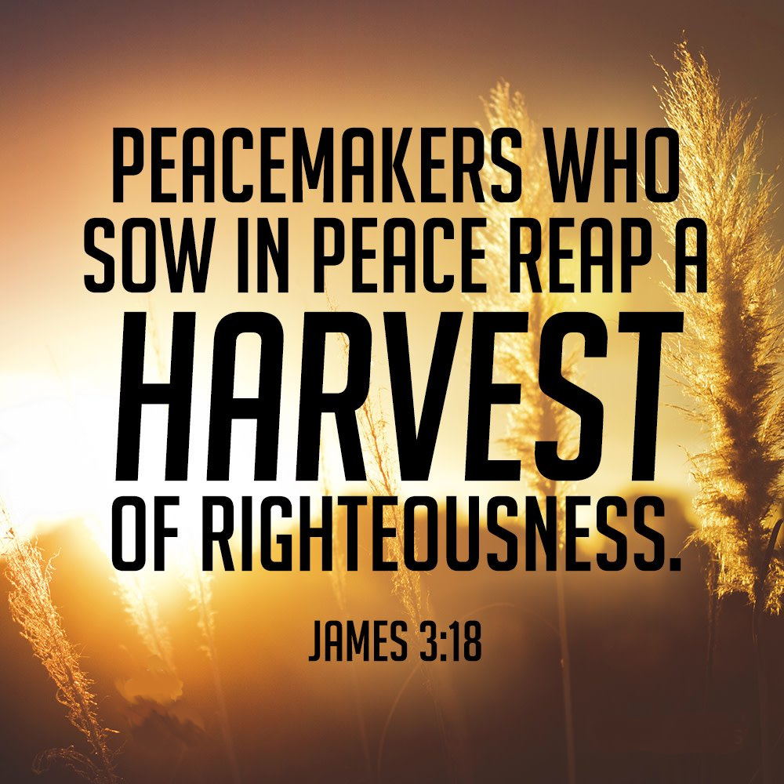

Slide 24
ACKNOWLEDGE THAT THE HOLY SPIRIT IS INSIDE YOU. ASK HIM TO HELP YOU GROW IN PEACE!
EXERCISE FAITH IN THE CHARACTER OF GOD, BY HIDING THE WORD OF GOD IN YOUR HEART.
PRACTICE THE PRESENCE OF PEACE AND SEEK TO LIVE A PEACEFUL LIFE. BE A PEACEMAKER!
KEEP YOUR MIND HEAVENLY THINGS AND NOT EARTHLY CIRCUMSTANCES.

