Slide 1
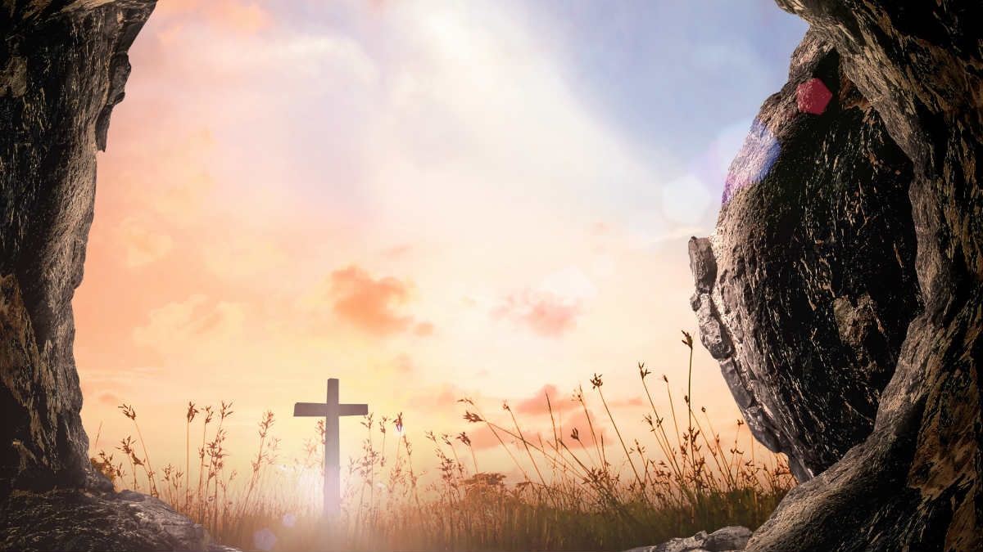
What Matters Most
About the Resurrection
Matthew 28:1-8

Slide 2
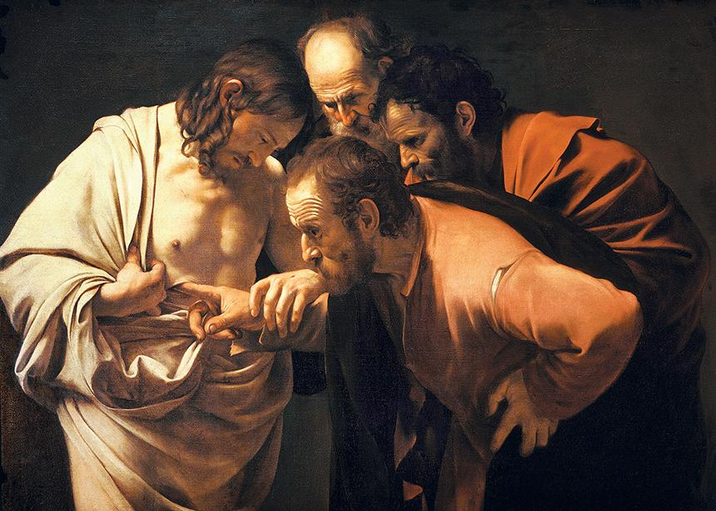
Do you really believe it happened?

Slide 3
What Matters Most
About the Resurrection
Is that it has the power to
transform your heart and life!

Slide 4
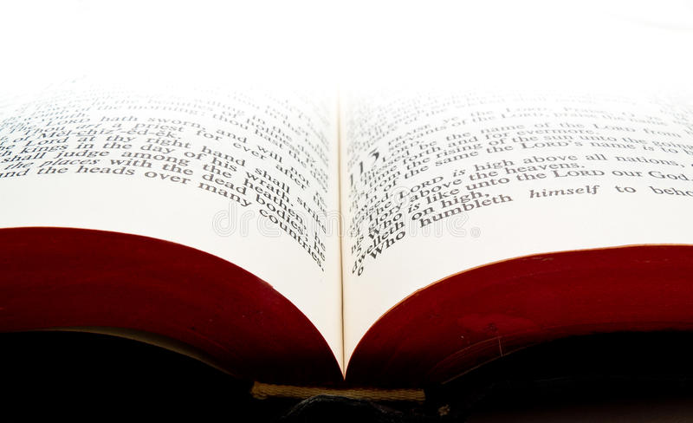
“And if Christ has not been raised, then your faith is useless, and if you are still guilty of your sins… and if our hope in Christ is only of this life, we are more to be pitied than anyone in the world.”
^{1 Corinthians 15:17-19 NLT}

Slide 5
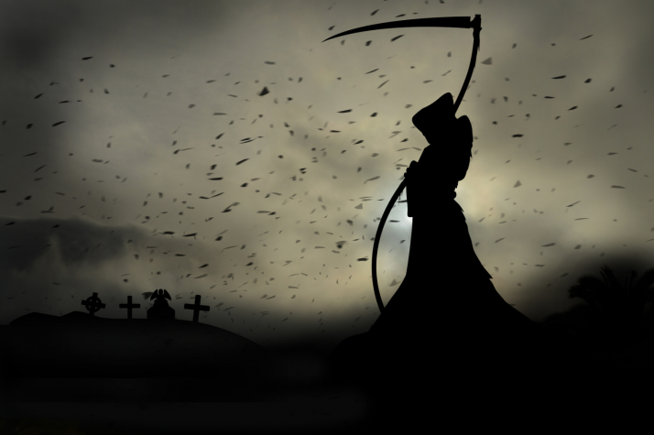
DEATH
The greatest of the stressors in life
is the fear of death!

Slide 6
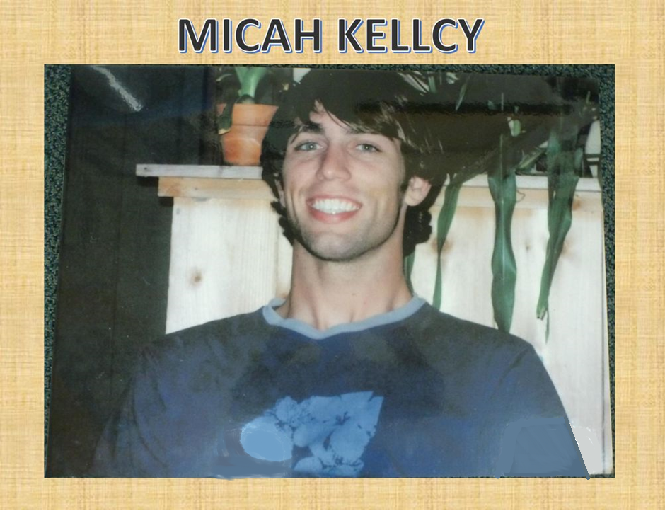

Slide 7
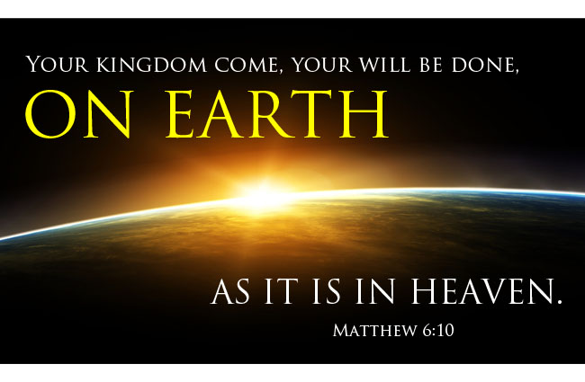

Slide 8
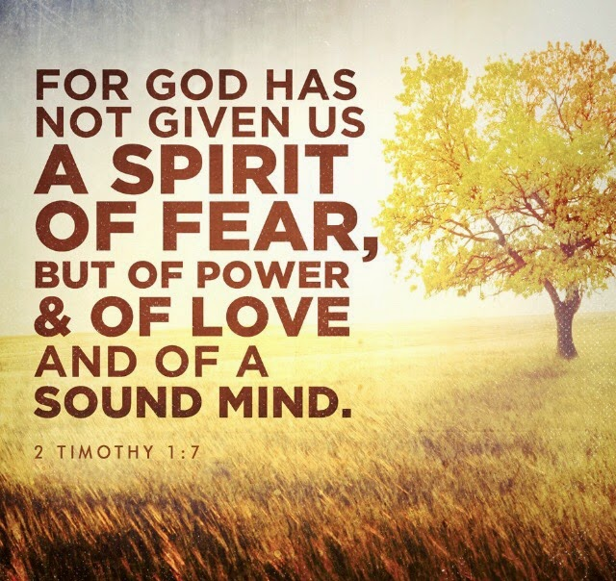

Slide 9
8:21-36
If the Son of Man hath set you free,
you are free indeed.

Slide 10
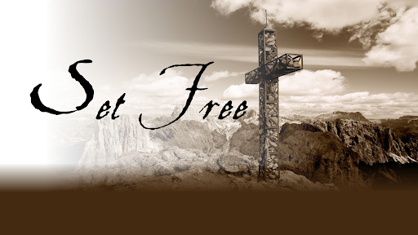
Set free from the curse of sin,
set free from the power of death,
set free from fear
Set free from the power of sin.

Slide 11
Set free from worry.
Set free from insecurity,
Set free from rejection,
Set free…

Slide 12
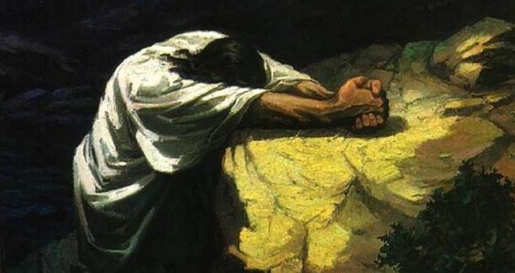
“not my will but thy will be done!”
Matthew 26:39; Mark 14:36; Luke 22:42

Slide 13
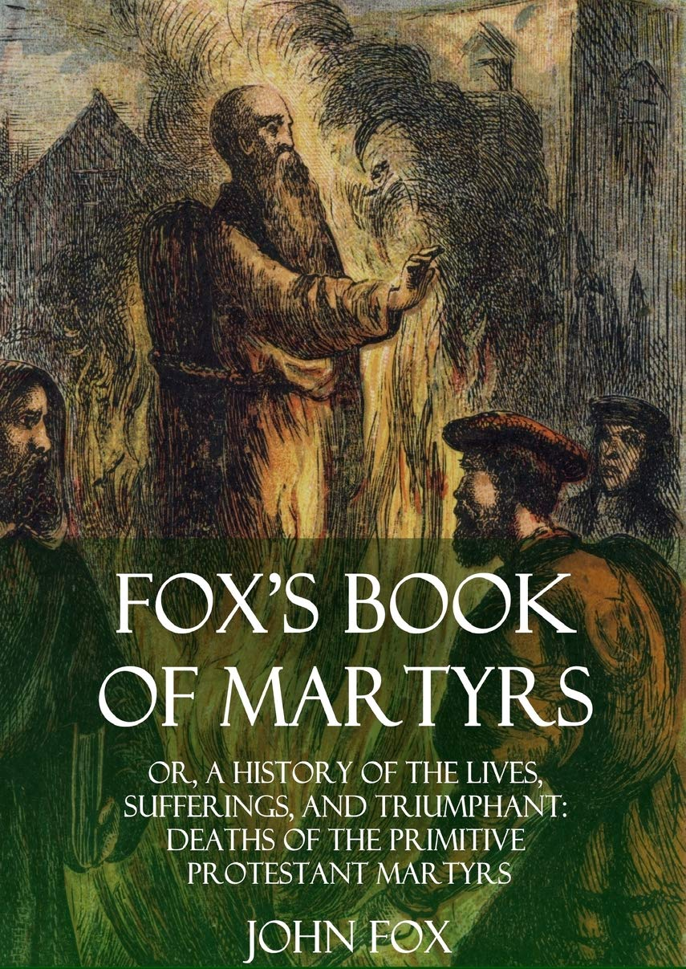
Telemachus
391 B.C.
This story of Telemachus illustrates the power that
a person can have when they truly embrace the reality and power of the resurrection.

Slide 14
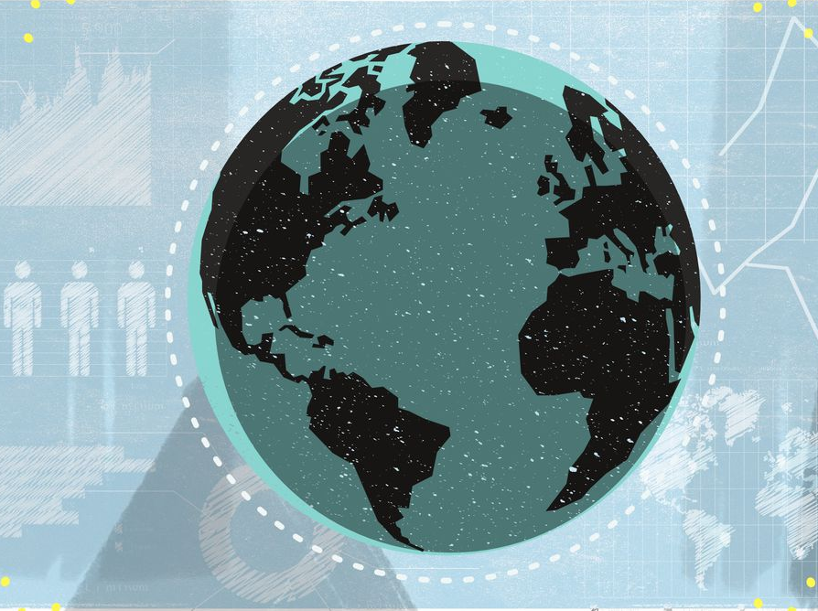
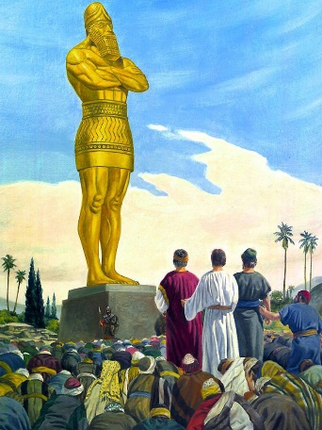
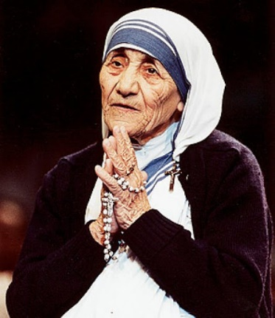
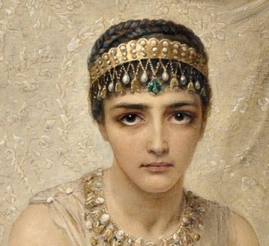
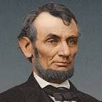
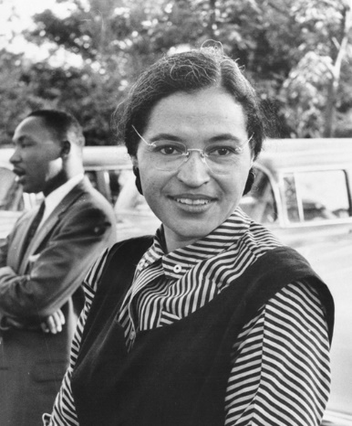
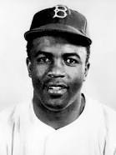
Shadrach, Meshach
Abednego
Mother Teresa
Esther
Abraham Lincoln
Jackie Robinson
Rosa Parks

Slide 16
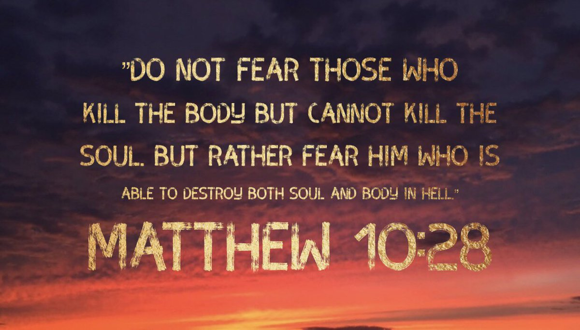

Slide 17
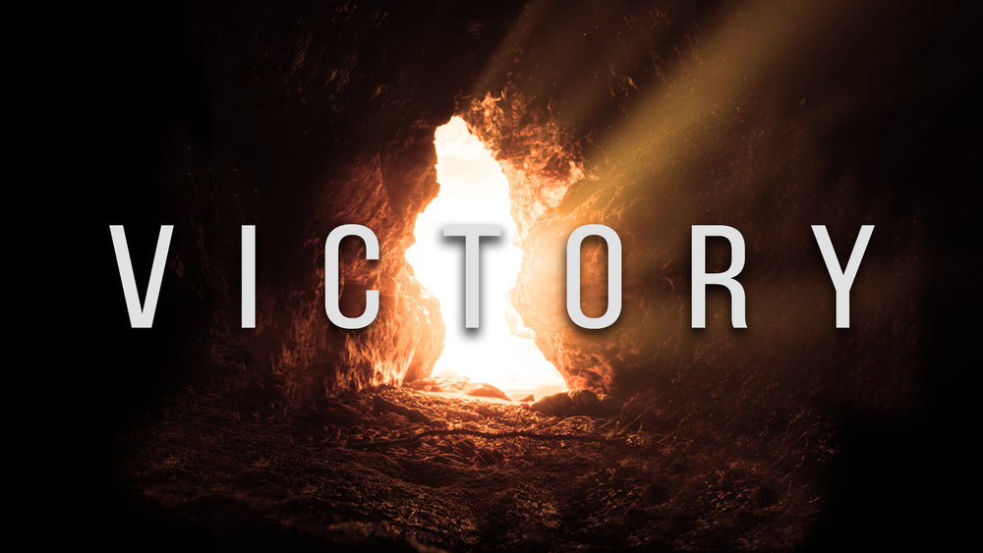
OVER WHAT?

Slide 18
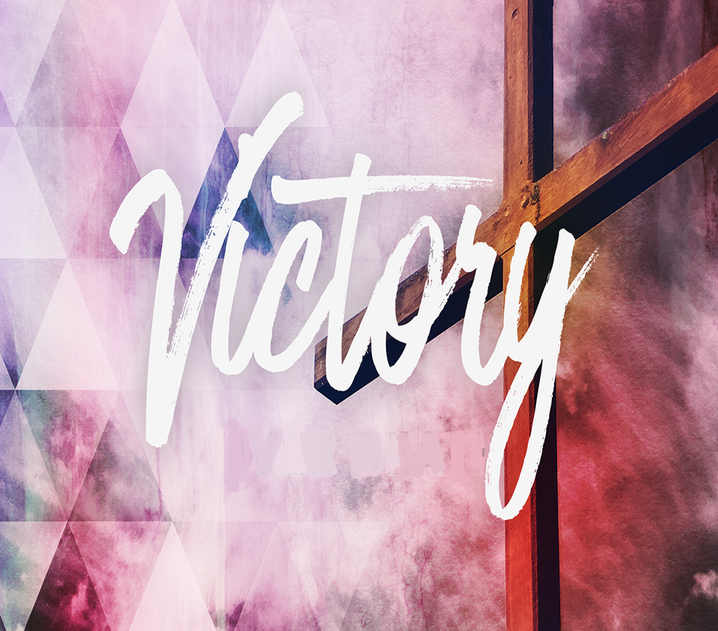
OVER FEAR

Slide 19
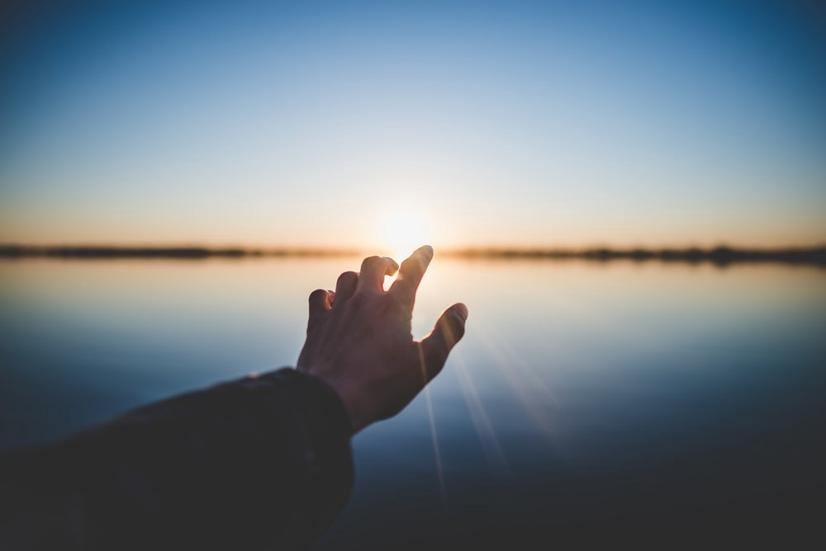
IT IS LIFE CHANGING!

